Slide 1


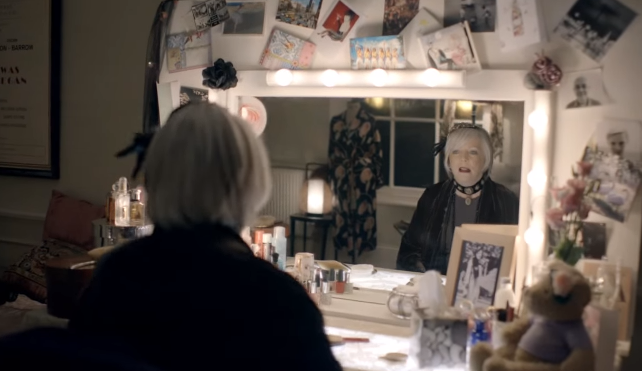
Marie Curie’s first TV ad
Challenge
Marie Curie needed to increase engagement around the charity and to reach out to the key audience of 40+ women
Solution
They used TV for the first time, to tell a compelling story and engage the audience emotionally
Advertised during event tv programmes and dramas, to reach viewers when they were already emotionally engaged
Results
Appeal raised £5,771,695 - highest amount raised to date
21,539 people gave up an hour of their time to be a collector, raising a total of £1.9 million
Notes:
Challenge
On 1st March every year, Marie Curie embarks on a month-long push to build awareness around the brilliant work of the Marie Curie nurses, and to raise money for the charity by collecting donations in exchange for yellow daffodil pins. It is called the Great Daffodil Appeal, and it is the most important fundraising event in their calendar year. Marie Curie needed to use TV to increase engagement around the charity and awareness of the Great Daffodil Appeal.
Marie Curie could see they had a very loyal support base of women aged 40+, more than willing to lend their support but they were not sure how to make themselves useful. The challenge was to find a way to re-engage this core audience and help them understand what their support meant, and educate them how to get involved. They also wanted to build awareness of Marie Curie amongst a wider audience during the Great Daffodil Appeal, so that people knew what the yellow daffodil meant. This all needed to be achieved on a small budget of £550k.
The Solution
Marie Curie Cancer Care decided to use TV for the first time as a platform to create an informed and engaged community of supporters. They decided that TV would fit at the heart of the campaign because only TV could tell Marie Curie's story in a compelling, visual way that would engage the British public around what the charity stands for, and how they can help.
The campaign was developed around the strapline ‘What does your daffodil mean to you?’ it was driven by a 30” TV advert and was built around the personal ‘stories’ behind Marie Curie. DLKW Lowe worked with one of Britain’s best-loved actresses, Alison Steadman, to share her own personal experience of the work of the Marie Curie nurses, in order to make the advert relevant to the audience and to create maximum engagement.
Spots where identified that would resonate with the core audience and create the highest levels of engagement, with a launch spot during Dancing on Ice - seen by 8million people, 3.6million of who were women aged 40+. Event TV programmes and dramas with the most compelling storylines were hand-picked, in order to catch people when they were at their most emotionally engaged - caught up in the highs and lows of their favourite characters and programmes. Through this clever phasing of TV Marie Curie were able to reach 8m people on the first day, 29m people in the first week and 40m people across the 3 weeks of the campaign. With a £550,000 budget getting the timings right was crucial to gaining this impact.
Results
Using TV resulted in the most successful Great Daffodil Appeal that Marie Curie had ever known.
21,539 people gave up an hour of their time to be a collector, raising a total of £1.9 million
The Appeal managed to raise £5,771,695. This is the highest amount raised to date, almost £800,000 up from the previous year.
Ad recall for Marie Curie increased by 293%
TV was the strongest performer
To read the full case study and access the creative visit: https://www.thinkbox.tv/Case-studies/Marie-Curie

