Slide 1
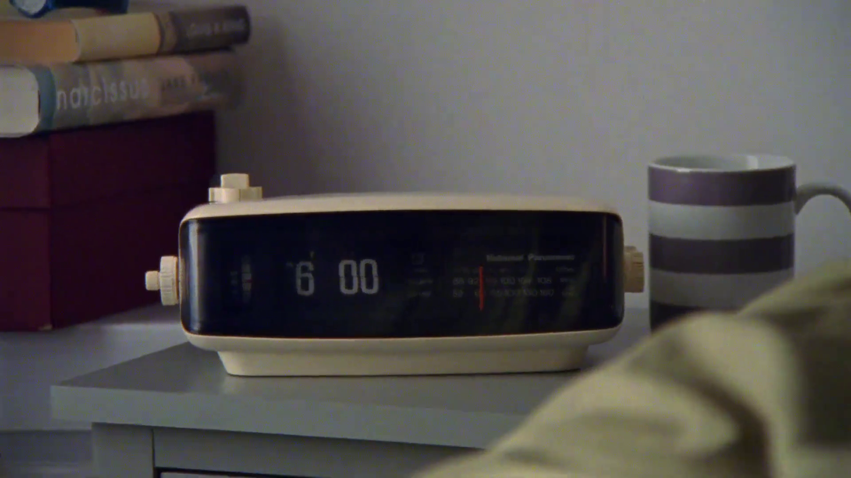

TV ad time-lengths
Dog’s Trust – Rob & Milo
Notes:
One of the most common questions we receive on our TV planning helpdesk is ‘what is the optimal spot length for my TV ad?’. The simple answer is that the length of an ad should be as long as it needs to be in order to effectively achieve its objective. However, to help flesh this statement out and offer some practical guidance on how to determine the right ad length for your marketing objective, we’ve pulled this presentation together based on the wise words of Les Binet, one of the Godfathers of effectiveness.

Slide 2
The 30” spot is the most common time-length
% TVRs
Source: Barb, 2023, Individuals, proportion of TVRs by ad duration
Notes:
30 second ads are by far the most popular and indicate that this time-length, in general, provides that right balance between cost effectiveness and providing enough time to communicate a core brand message and create a lasting emotional effect.

Slide 3
The use of time-lengths differs by category
Source: Barb, 2023, Individuals
Notes:
The most prevalent users of longer spots is the charity sector. This will consist of DR daytime and small channel spots, but shows the power of longer spots in delivering a more emotive impact. This emotive impact is dependent on good storytelling – something much easier to do successfully in longer ads.

Slide 4
30-second TV ads consistently account for half of all impacts
Source: Barb, 2013-2023, Individuals, Proportion of Impacts (R/W) by ad duration
Notes:
30-second TV ads consistently account for half of all impacts
This chart shows how the 30-second spot continues to be the most popular time length in UK ad breaks.
The main shift since 2013 has been less use of 40 to 50-second ads on TV. The prevalence of shorter time lengths (20-second, 10-second and under) and 60-second ads has remained stable. While there has been a small increase in the use 60-second+ ads.

Slide 5
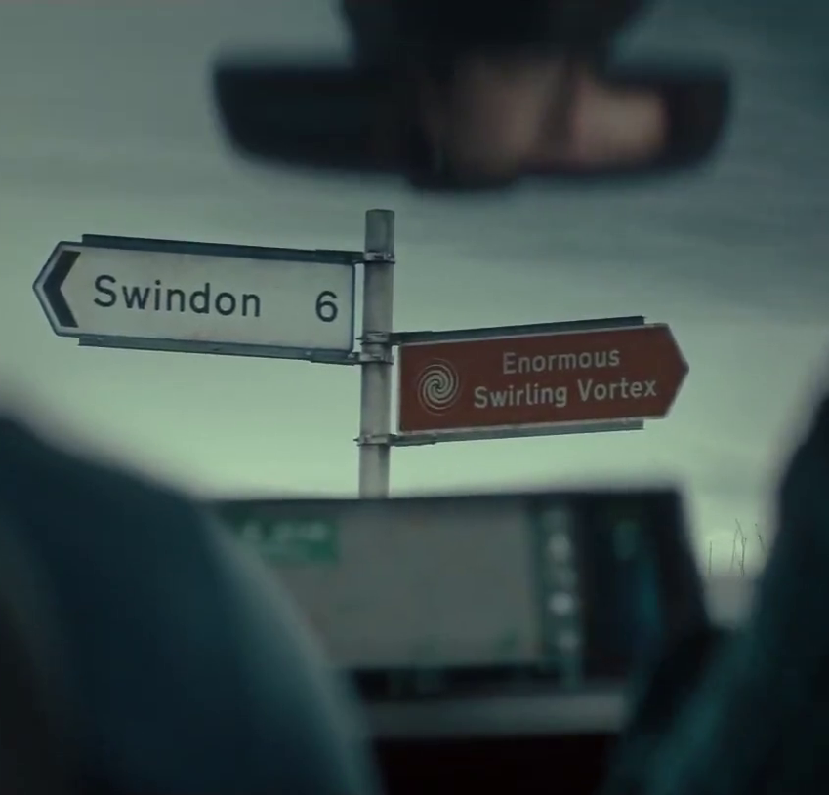
Time-lengths
These are the main variables that will influence the most suitable time-length for a TV ad:
Communication Objective
Budget
The creative execution
Creative copy rotation
Competitor activity
The following slides break down where these factors come into play.
AA – It’s Ok

Slide 6
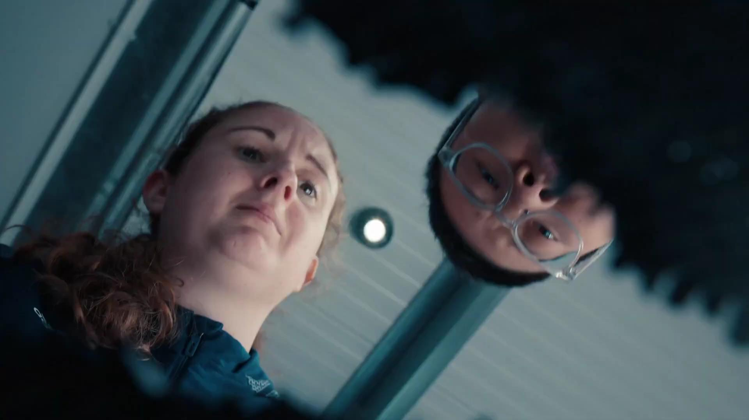
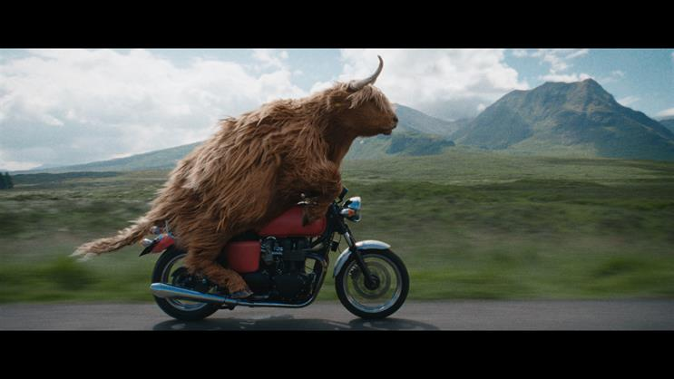
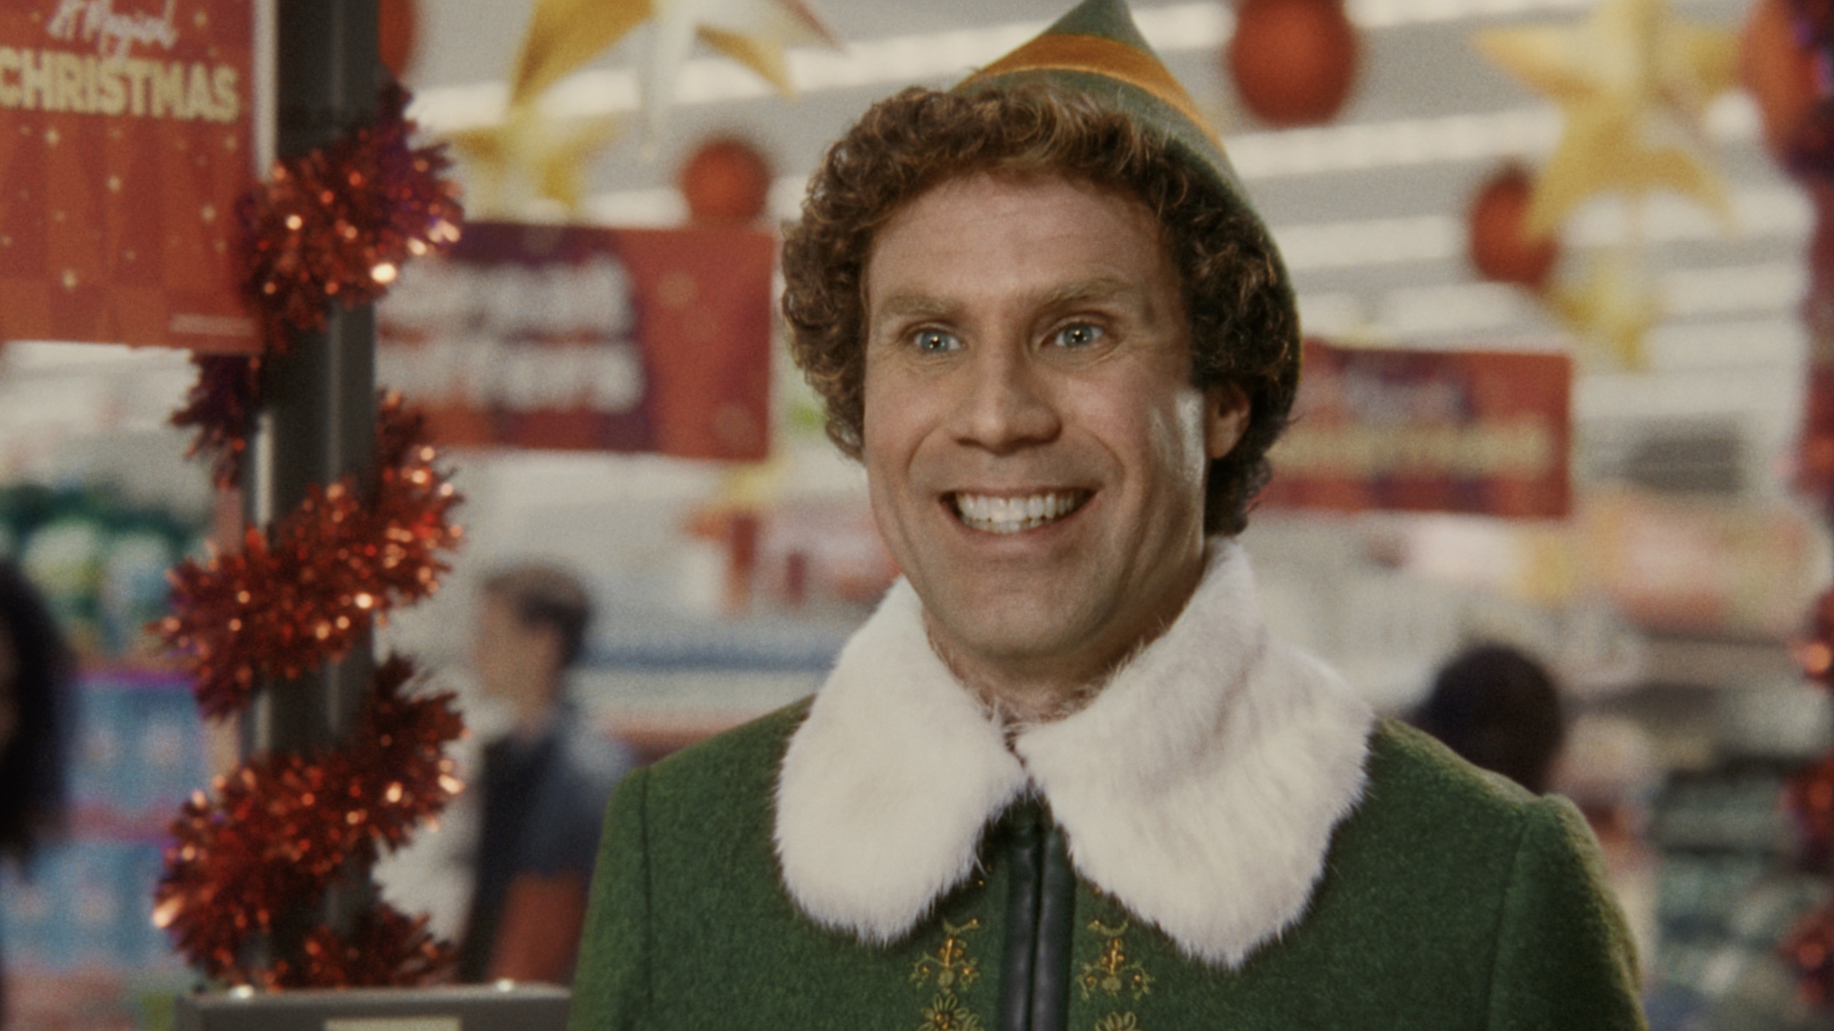
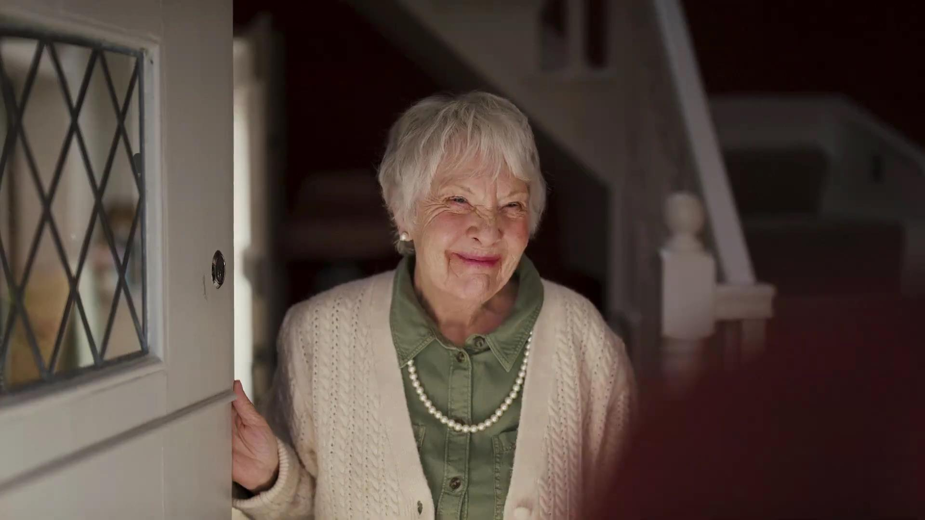
1. Longer ads are better for communicating more complex ideas and stories
Conveying multiple/complex messages is more difficult in a very short TV ad
Short ads are better for short, simple messages
Good storytelling involves taking people on an emotional journey. This is hard to do in a short ad
Millward Brown’s 2014 analysis shows that longer ads tend to score higher on a range of emotional metrics
Source: Les Binet. Millward Brown, 2014

Slide 7
Longer ads deliver more explicit brand information
Explicit agreement to brand statements
91%
64%
Source: A Matter of Time, 2019, Work/Walnut/Thinkbox. Based on 3 brands (3 x short ad; 3 x long ad)
Notes:
Longer ads delivered a 42% uplift to explicit brand statements over short ones and were therefore, unsurprisingly, better at delivering a greater volume of information.
Methodology:
Partnering with Walnut, Work Research devised the research framework. Firstly, they selected four existing creative treatments (three emotional and one rational) for brands that were unknown in the UK but sat within categories that were very familiar. These were retail, insurance, broadband and washing detergent.
Just to be certain, a team of real-life ad agency creatives tweaked the brands, giving them new identities. This way, none of the respondents had any previous brand history that could impact the results.
Next, the team of creatives formed a set of cut-downs for each using exactly the same processes they would for any of their clients. These cut-downs were then vetted by several different teams to ensure that creatively, they made sense and were fair representations of the original ads. Time-lengths were categorised as follows:
Long: 60”
Medium: 30”
Short: 10”, 6” or 5”
Finally, each of the ads were taken into an online test where each iteration was shown, in amongst a reel of other ad ‘clutter’, to 200 people each.
They were tested against two factors:
Explicit perception statements (to see what people thought and consciously remembered about the brands)
Implicit brand perceptions tests (to understand what people felt about them or thought they just knew for themselves)
The latter was tested via ‘IRT’ (Implicit Reaction Testing). If someone truly believes or disbelieves something, their initial reaction tends to be strong and automatic. The more doubt they have the slower the reaction time as the brain must consciously consider what is being processed and this slows the response down.
Around half of the respondents were tested again several days later. Some saw the ad repeated (either full length or cut-down) again whilst others didn’t which gave an indication of the decay rate for the measured effects.

Slide 8
Longer ads work even harder at an implicit level
Implicit agreement to brand statements
64%
36%
Source: A Matter of Time, 2019, Work/Walnut/Thinkbox. Based on 3 brands (3 x short ad; 3 x long ad)
Notes:
Longer ads worked much harder at an implicit level, however, where they almost doubled the implicit effects over short ads. The longer ads were evidently shifting brand feeling and sentiment more effectively, which is especially poignant when you consider that these brands were totally unknown to the respondents.
Methodology:
Partnering with Walnut, Work Research devised the research framework. Firstly, they selected four existing creative treatments (three emotional and one rational) for brands that were unknown in the UK but sat within categories that were very familiar. These were retail, insurance, broadband and washing detergent.
Just to be certain, a team of real-life ad agency creatives tweaked the brands, giving them new identities. This way, none of the respondents had any previous brand history that could impact the results.
Next, the team of creatives formed a set of cut-downs for each using exactly the same processes they would for any of their clients. These cut-downs were then vetted by several different teams to ensure that creatively, they made sense and were fair representations of the original ads. Time-lengths were categorised as follows:
Long: 60”
Medium: 30”
Short: 10”, 6” or 5”
Finally, each of the ads were taken into an online test where each iteration was shown, in amongst a reel of other ad ‘clutter’, to 200 people each.
They were tested against two factors:
Explicit perception statements (to see what people thought and consciously remembered about the brands)
Implicit brand perceptions tests (to understand what people felt about them or thought they just knew for themselves)
The latter was tested via ‘IRT’ (Implicit Reaction Testing). If someone truly believes or disbelieves something, their initial reaction tends to be strong and automatic. The more doubt they have the slower the reaction time as the brain must consciously consider what is being processed and this slows the response down.
Around half of the respondents were tested again several days later. Some saw the ad repeated (either full length or cut-down) again whilst others didn’t which gave an indication of the decay rate for the measured effects.

Slide 9
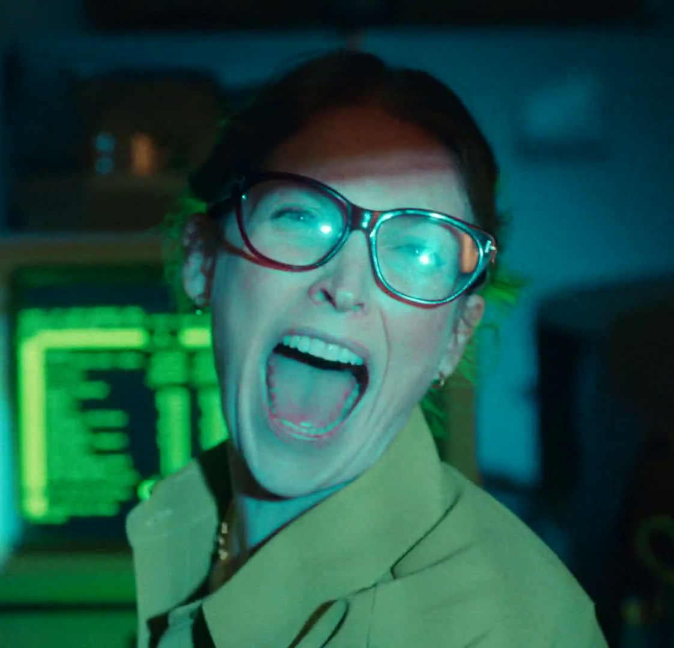
2. Longer ads may be more distinctive
Longer ads can provide stand out, particularly in categories where shorter ads are the norm
Quickbooks – Tax Deadline Delirium
Source: Les Binet

Slide 10



Longer ads enhance memory effects
=
+28%
Improvement in explicit brand perception
3-5 days
=
Improvement in explicit perception
+9%*
3-5 days
=
Improvement in explicit perception
+51%
Source: A Matter of Time, 2019, Work/Walnut/Thinkbox. Based on 3 brands (3 x short ad; 3 x long ad) * Based on one test cell for one 10 second ad
Notes:
When a short ad is seen after a long ad, there’s a 51% uplift in explicit memory effects versus just 9% for seeing a short ad in isolation. This is including a gap of several days between viewing the ads and testing.
Methodology:
Partnering with Walnut, Work Research devised the research framework. Firstly, they selected four existing creative treatments (three emotional and one rational) for brands that were unknown in the UK but sat within categories that were very familiar. These were retail, insurance, broadband and washing detergent.
Just to be certain, a team of real-life ad agency creatives tweaked the brands, giving them new identities. This way, none of the respondents had any previous brand history that could impact the results.
Next, the team of creatives formed a set of cut-downs for each using exactly the same processes they would for any of their clients. These cut-downs were then vetted by several different teams to ensure that creatively, they made sense and were fair representations of the original ads. Time-lengths were categorised as follows:
Long: 60”
Medium: 30”
Short: 10”, 6” or 5”
Finally, each of the ads were taken into an online test where each iteration was shown, in amongst a reel of other ad ‘clutter’, to 200 people each.
They were tested against two factors:
Explicit perception statements (to see what people thought and consciously remembered about the brands)
Implicit brand perceptions tests (to understand what people felt about them or thought they just knew for themselves)
The latter was tested via ‘IRT’ (Implicit Reaction Testing). If someone truly believes or disbelieves something, their initial reaction tends to be strong and automatic. The more doubt they have the slower the reaction time as the brain must consciously consider what is being processed and this slows the response down.
Around half of the respondents were tested again several days later. Some saw the ad repeated (either full length or cut-down) again whilst others didn’t which gave an indication of the decay rate for the measured effects.

Slide 11
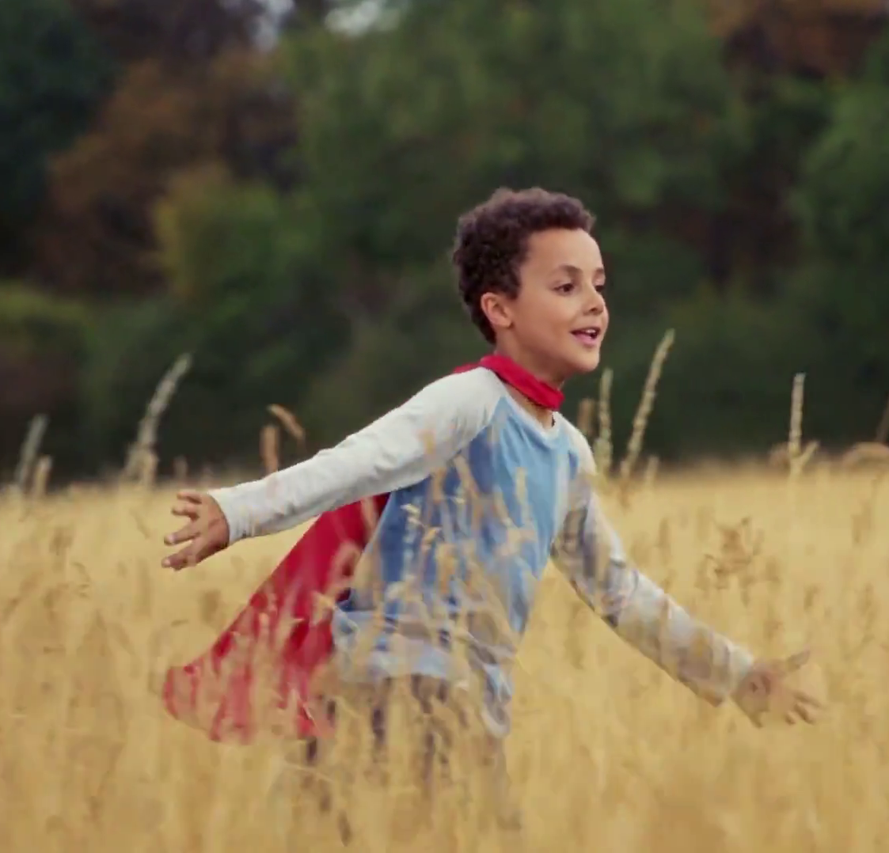
3. Longer ads are more likely to create fame
Millward Brown suggest that long ads are more likely to be seen as an "event“
As long ads are more likely to be noticed, tell interesting stories and create a bigger emotional reaction – they are more likely to be talked about
However, this is dependent on great creativity
Visit Egypt – Beyond Expectations
Source: Millward Brown, 2014. Les Binet

Slide 12
4. There are diminishing returns, but longer ads are cheaper per second
Doubling the length of the ad does not double recall (see chart)
But 30” plus ads are cheaper per second than 10” or 20” ads
Beyond a certain length, attention may drop
The optimum length will depend on context and creative
% OF VIEWERS WHO RECALLED THE AD
Indexed cost relative to a 30”
50
85
100
133
166+
Source: billetts research, 1998. Les Binet

Slide 13
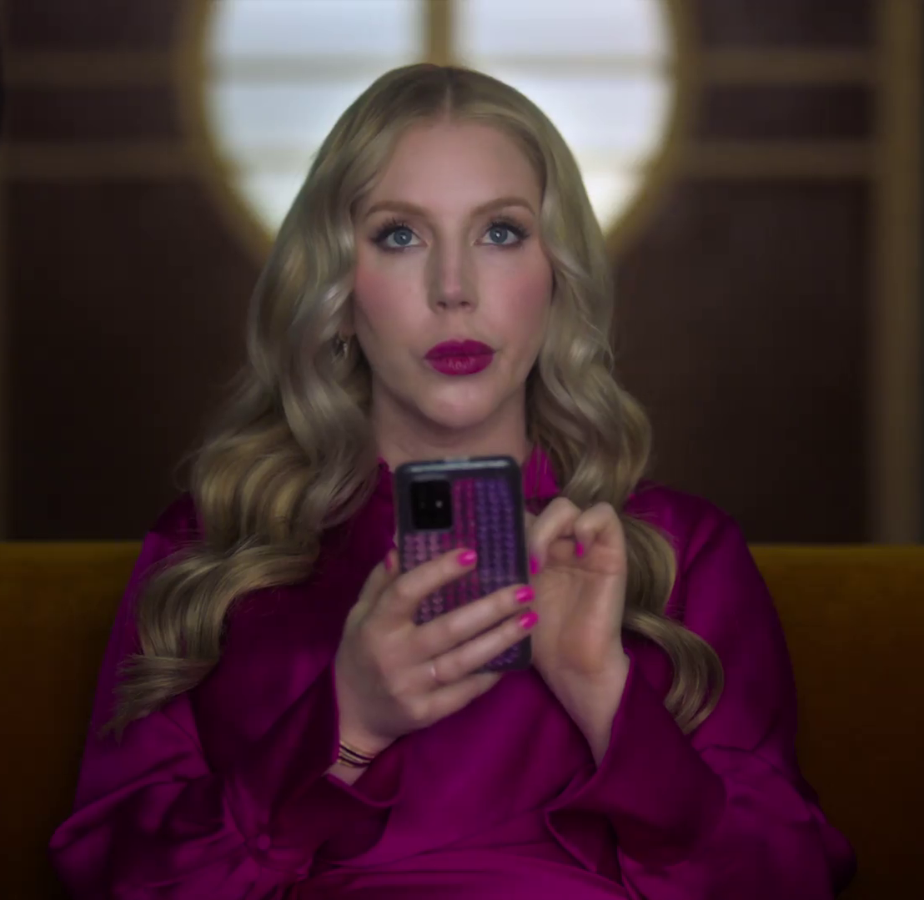
5. Short ads serve many useful purposes within a campaign
Short ads may be useful at driving response, serving as a trigger/reminder and more efficient for communicating simple messages
Short ads can be useful for broadening reach/continuous presence – especially if budget is low
Now TV – Toughest Critic
Source: Millward Brown, 2014. Les Binet

Slide 14
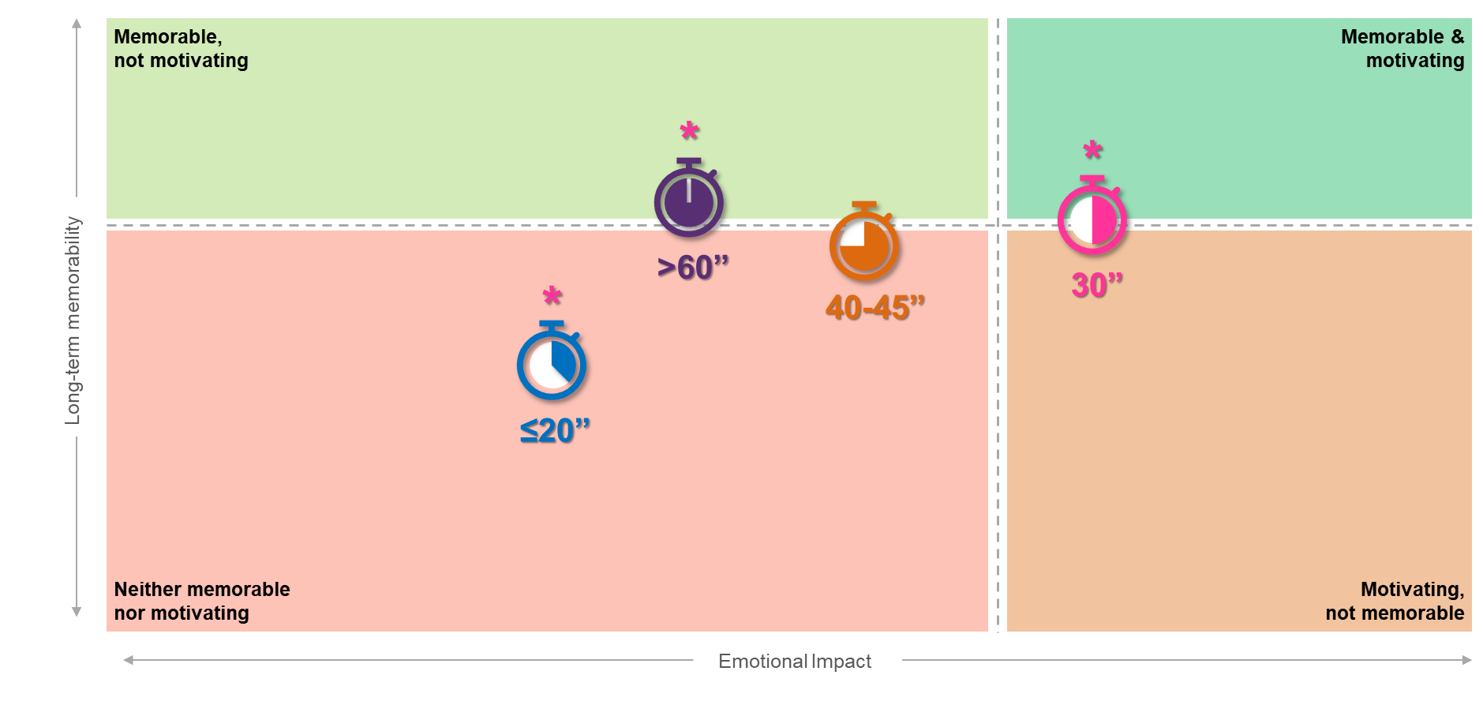
30 second ads deliver the greatest impact
Source: Creative Drivers of Effectiveness, 2023, Neuro-Insight/Thinkbox
Notes:
Thinkbox’s ‘Creative Drivers of Effectiveness’ study explores the factors most strongly linked to long-term memory encoding (LTME), a proven metric in driving decision making and future behaviour.
As one part of the study, research agency Neuro-Insight explored whether the duration of TV ads within their databank influenced both LTME and the emotional impact achieved. Analysis shows that 30 seconds is the optimal time to develop a narrative and build a strong connection with your audience and therefore deliver the greatest impact.
Ads under 30 seconds often fail to create a strong connection with the audience and develop a compelling narrative, causing the audience to be less involved emotionally and therefore less likely to store these stories into memory. Ads over 30 seconds were still memorable, however they lose their emotional impact slightly. LTME can be driven by pace, music and developing excitement but after 30 seconds these mechanisms can start to lose their strength.
For more insight into what factors to consider when it comes to creative executions, check out ‘Creative Drivers of Effectiveness’.

Slide 15




Having final branding on screen for longer (3+ seconds) drives the strongest impact
+11%
+11%
+3%
Emotional Impact
Personal relevance
Long-term memorability
This is due to conceptual closure…
Source: Creative Drivers of Effectiveness, 2023, Neuro-Insight/Thinkbox
Notes:
Neuro-Insight also explored the time length at final branding.
Analysis showed that ads that kept branding on screen for longer (in this case 3 seconds or more), delivered stronger levels of impact, with significantly higher levels of memory, emotion and relevance. This results is due to a phenomenon known as conceptual closure.

Slide 16
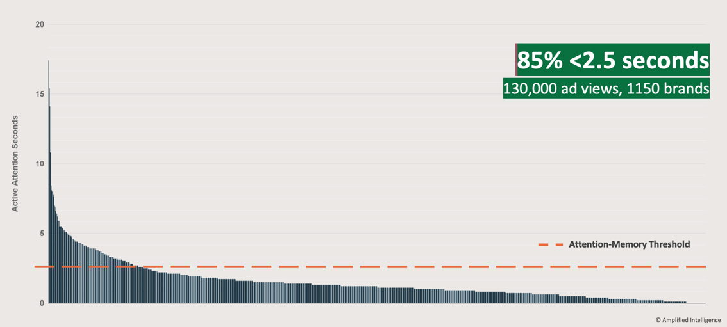
When ads don’t meet the Attention-Memory Threshold of 2.5”, it’s hard for mental availability to grow
Source: Amplified Intelligence
Notes:
https://www.thinkbox.tv/research/nickable-charts/effectiveness-and-planning/tv-at-the-heart-of-effectiveness-by-peter-field
2.5 seconds of attention may sound like a low bar for video advertising, but shockingly, Nelson-Field has also shown that most online ads fail to meet even the 2.5 second threshold [see chart above]. In a study of 130,000 online ad views (social and non-social) from 1,150 brands, some 85% of them failed to meet even this low threshold. This means those ad exposures were functionally incapable of building mental availability and therefore driving long-term demand growth. Of the 15% that did make the threshold, only a handful achieved what I would regard as a more healthy level of about 10 seconds or more.

Slide 17
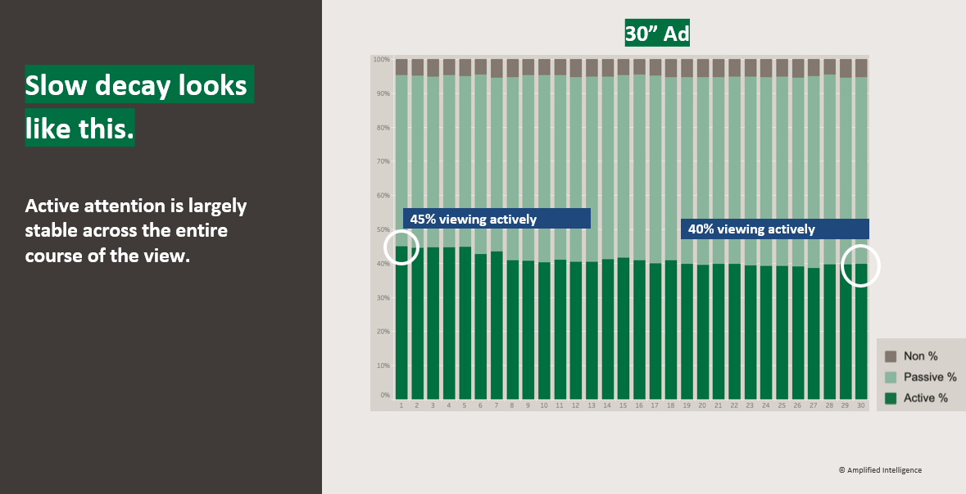
TV delivers stable levels of visual attention throughout an ad
Source: Amplified Intelligence
Notes:
https://www.thinkbox.tv/research/nickable-charts/effectiveness-and-planning/tv-at-the-heart-of-effectiveness-by-peter-field
But there are media where attention decay is much slower. TV is one of these, radio too, and non-skippable online video advertising. These forms of advertising perhaps begin with slightly lower levels of attention but what we start out with is more or less what we end up with [see chart above]. So here we can build mental availability amongst a large audience because a lot of them are seeing the ads right through from beginning to end, which makes a huge difference.

Slide 18

Summary
Time length should be as long as is required to effectively achieve the objective.
Longer ads: more memorable, more emotion, create more stand out and are better at driving brand fame.
Short ads: more cost efficient, good for simple messaging, better for low budgets, serve as a trigger / reminder for a longer ad.
Santander - Connections

