Slide 1


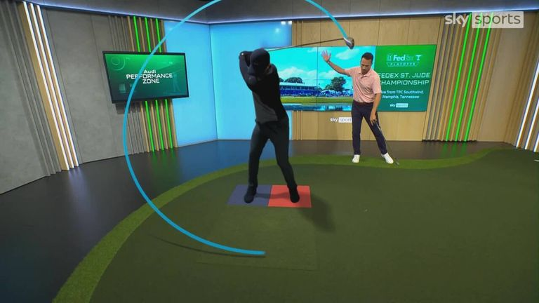
Audi Performance Zone
Challenge
Audi wanted to maintain their leadership position, reinforce their differentiation and bring their innovation credentials to life
Solution
They became the official Innovation Partner of Sky Sports
Created branded content that saw Audi-inspired technology become part of Sky Sports Golf coverage
Results
Double digit growth in desirability for Audi
Significant uplifts in brand metrics
Notes:
The Challenge
The car market is becoming increasingly competitive with new challenger brands coming to market and mid-market brands repositioning further upmarket. This means that premium brands like Audi have to work hard to maintain their differentiation.
For Audi, technology and innovation is where they shine. However, they are always on the lookout for ways to communicate their leadership in these areas. In 2023, Audi tasked their agency PHD to:
Drive engagement and desire for Audi
Bolster Audi’s leadership in electric vehicles
Bring Audi’s innovation credentials to life in an entertaining and compelling way
The TV Solution
AV has long been a powerful tool for building the Audi brand and PHD knew that the right solution would be able to communicate Audi’s leadership in technology and innovation. In 2022, they brokered a deal with Sky Sports to become their Official Innovation Partner. This was primarily executed through an in-coverage cricket innovation called the Power Meter, which measured the speed and power behind a cricket shot.
This proved successful, as it increased brand consideration and improved brand metrics, so they renewed the deal for 2023 but wanted to raise the bar even higher for year two. They created branded content that saw Audi-inspired technology become part of Sky Sports Golf coverage.
‘Force Plates’ inspired by Audi’s quattro technology, measured the force and balance that a golfer uses to create their unique swing. ‘Zen Eye’ mimicked the functionality of Audi’s Adaptive Headlight technology, showing the perfect pace and line for any type of putt. An entire studio became the ‘Audi Performance Zone’ as a dedicated space to host these innovations. There were 79 live Audi Performance Zone editorial segments in total.
The Plan
The branded content was filmed in Sky Sports Golf Studio and the content segment went out during coverage of the PGA Tour and an additional 14 tournaments. The content had a 6 second Audi ident at the beginning, there was Audi branding throughout and the innovations featured editorially.
Following the live broadcast, the content was made available on Sky’s EPG so viewers could watch on demand. The content was hosted on a dedicated Audi EPG tile and promoted via a TV ad and a Sky Sports homepage takeover.
They also created social branded content featuring Harry and Jamie Redknapp, who used Audi Performance Zone innovations to perfect their swing before they headed to The Belfry to play golf with the Audi Quattro Cup World Champions.
To support this innovative content partnership, Audi executed across a range of channels, including specially selected premium programming on Linear TV + access to top quality boxsets in BVOD and Now TV.
Results
Growth in awareness of the Audi e-tron range
Consideration for Audi was much higher for people with a long dwell time
Significant uplifts in brand metrics such as “Audi is innovative”, “Audi is modern”, “Audi is progressive”, “Audi is a brand for people like me”, “Audi is a prestige brand” and “Audi is leading in the field of EV”
Double digit increase in desirability
Audi have renewed their partnership for a further year
The campaign won ‘Best Use of Content’ at the TV Planning Awards 2024

