Slide 1
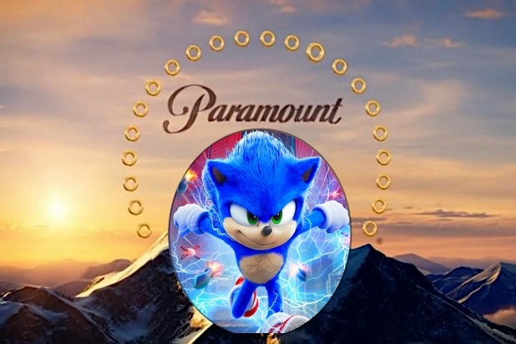
Paramount – A super Sonic ad break
Challenge
Paramount tasked Wavemaker to make Sonic the Hedgehog the biggest family movie at half term and set them ambitious box office targets
Solution
They opted for bespoke ad break takeover in The Masked Singer on ITV. Sonic cheekily commented on the other ads in the break before speeding them up to show a 120 second trailer for the movie
Results
Toped the charts on opening weekend with £5million in sales
Smashed UK box office targets, finally coming in at £19.1m cumulative
Notes:
The Challenge
Sonic the Hedgehog is one of the most iconic video game characters of all time and in 2020, 19 years after his first outing on a games console, he sped onto the big screen for his feature film debut. The challenge for Wavemaker was to present Sonic as a modern-day superhero, with whom both kids and parents could connect but in a crowded half term, vying for attention with lots of competitor films coming out at a similar time.
Paramount set Wavemaker the challenge of making the movie the number one family cinema choice for the February half term and set an ambitious box office target.
The TV Solution
The campaign was constructed around Sonic’s defining attributes – his cheeky playful character and his supersonic speed. Wavemaker felt that the simplicity and clarity of approach was so authentic to the Sonic brand that it would ignite interest amongst the retro audience of parents, whilst raising enough excitement to hook a new audience of modern-day kids.
Analysis showed that the best time to engage parents and kids was during family time viewing, of which Saturday evening was a key occasion. They decided to partner with ITV to create a supersonic ad break in the semi final of The Masked Singer – a primetime family entertainment show – airing the weekend before the movie’s theatrical release.
The Plan
On Super Sonic Saturday, throughout the day, they ran blipverts – two, three, four and 15 second blips of the film trailer. These encouraged viewing of and built anticipation for the ad break coming later.
The specially created ad break opened with a ten second ‘ITV proudly presents’ message which was voiced by Sonic himself. Then followed three ads for other brands (Compare the Market, Robinsons and Alpro) but with Sonic commenting on them, making cheeky remarks about the meerkats clothing and about him being thirsty, before speeding them up. The break ends with a 120 second trailer for the movie.
The fact that Sonic was present throughout meant he was woven into the very fabric of the ad break as if he cheekily owned the entire ad estate.
To support the ad break, there was social activity across Paramount’s Facebook and Instagram platforms which helped to fuel online conversation, as well as radio, OOH and press campaigns to drive awareness and impact.
Results
This innovative and unusual approach paid dividends. Sonic not only topped the charts on opening weekend, accumulating almost £5 million in sales, but he smashed Paramount’s UK box office targets, finally coming in at £19.1 million cumulative.
One year after launch, Sonic the Hedgehog sat at no. 2 in the annual box office film charts for 2020.
The reaction across social channels was incredibly positive, with a significant amount of Twitter chatter and a 5 x increase in Google searches.
The campaign was shortlisted in Best Use of Content at the TV Planning Awards 2021

