Slide 1
TV Response: new rules, new roles

Slide 2
Half of media-generated response comes in the longer-term
Longer-term response
Want
Need
Source: TV Response: new rules, new roles, 2015, GroupM/Thinkbox
Notes:
The longer-term impact (from 3 months after a campaign and up to 2 years) of communications tends to be bigger for products that are desired, compared to products which are necessary

Slide 3
Brand TV is the most cost efficient longer-term channel
Longer-term response
Efficiency index at driving brand metrics (higher = better)
Source: TV Response: new rules, new roles, 2015, GroupM/Thinkbox. Based on 7 brands
Notes:
PPC and Affiliates do not significantly drive longer-term response.
The analysis revealed the impact of Brand Response TV (BRTV) and demonstrated that it was the most efficient driver of long-term response overall. BRTV was responsible for 52% of the long-term media impact. This backs up findings from previous studies, including the IPA’s ‘Advertising Effectiveness: the long and short of it’ (2013) which found that TV advertising is vital for long term brand health.
TV advertising was 40% more efficient at driving long term response per pound than the next best forms of communication, which were outdoor and print. Online display was the least efficient generator of long term response with TV 180% more efficient.

Slide 4
TV accounts for a third of media-driven sales
Short to medium-term response
Source: TV Response: new rules, new roles, 2015, GroupM/Thinkbox. Based on 15 brands
Notes:
‘Other online’ media includes VOD, email, social
The base in this case is defined as underlying brand equity plus pricing and promotions. It therefore includes:
Previous customer experience
Longer-term advertising effect
Distribution / number of stores
Economic and external factors
Competitor impacts
Price changes and promotions
The analysis showed that on average, media drove 39% of sales in the short to medium term – i.e. within 3 months of a campaign finishing. The remaining 61% was comprised of the ‘base’ level of sales – which of course will have been significantly impacted by historical media activity, but also reflect elements such as seasonality, distribution or promotional activity.

Slide 5
DRTV is the strongest ‘demand generating’ channel
Short to medium-term response
Least efficient
Efficiency index (cost per response, lower = better)
BR online display
BR offline
BRTV
Demand generators
DR offline
DR online display
DRTV
Affiliates
Demand harvesters
Generic PPC search
Most efficient
Source: TV Response: new rules, new roles, 2015, GroupM/Thinkbox. Based on 15 brands
Notes:
Other offline includes outdoor, print, radio, DM & door drops
These results need to be balanced against the strength of each channel at driving longer term effects.
The study demonstrated that DRTV was the strongest of the ‘demand generating’ channels – ie. the media types that are most likely to stimulate response rather than harvest it. DRTV was comparable in terms of efficiency with affiliate advertising and search marketing, even though the latter are demand harvesters rather than response generators.

Slide 6
TV drives the highest volume of cost-efficient response
Short to medium-term response
Source: TV Response: new rules, new roles, 2015, GroupM/Thinkbox. Based on 7 brands
Notes:
Marginal cost per response curves capture the diminishing returns of each channel.
Due to its reach and scale, TV advertising keeps generating a cost efficient level of response at higher levels of spend than other media.
Over the short to medium term the point of diminishing returns is much lower for TV than it is for other media.
To put it simply, the point at which the efficiency of ad spend starts to decrease significantly (because you have reached saturation and/or are repeatedly talking to the same people) - is much lower for TV than for the other communication channels.

Slide 7
TV spend can be 2.7x more than online channels before inefficiency
Short to medium-term response
Indexed media spend at saturation
Source: TV Response: new rules, new roles, 2015, GroupM/Thinkbox. Based on 7 brands
Notes:
2.7 x more can be spent in TV than online channels before a significant decrease in efficiency is reached

Slide 8
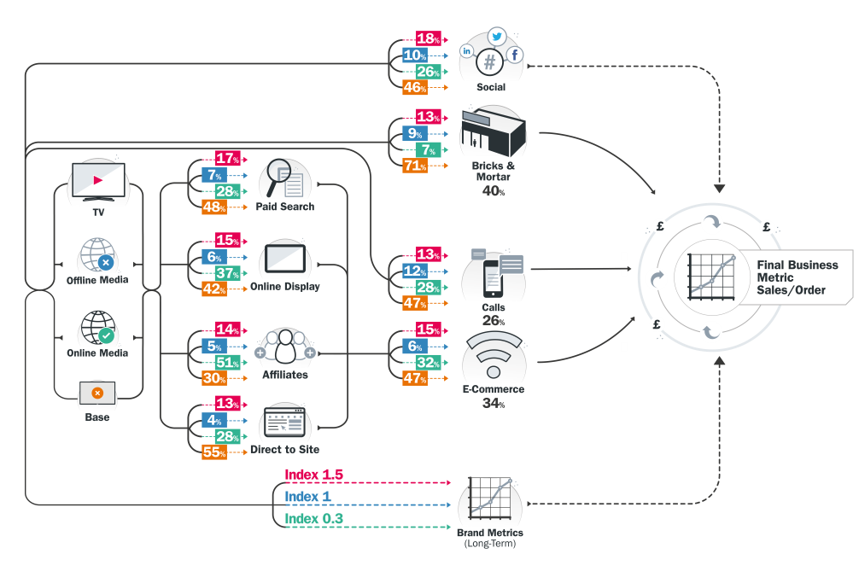
TV drives effect across the entire communications system
Short to medium-term response
Impact from TV
Impact from other offline media
Impact from online media
Base
Source: TV Response: new rules, new roles, 2015, GroupM/Thinkbox. Based on 8 brands
Notes:
Response = final business metric sale/orders
The study showed that TV has far reaching, but often hidden, effects across the communications system.
Some of TV’s effects are direct. For example, for every 100 people who visit a store to make a purchase 29 of them are there due to some form of short to medium term advertising; 13 of them have arrived there due to seeing a TV ad; 9 of them are there due to an offline ad; 7 of them due to an online ad. The remaining 71 people make up the ‘base’ which are people who’ve come into the store due to the underlying brand equity (i.e. previous experience of the brand or the long-term effect of advertising from two or more years ago) or due to the location of the store, pricing, promotions and so forth.
However, many of TV’s effects are indirect – TV ads are driving people to respond via online channels, therefore masking TV’s total response contribution and making it much harder to attribute to the final sale. A good example of this is TV’s effect on search – for every 100 people whose last click before purchase is from a paid search ad, 17 of them have clicked on that search ad due to seeing a TV ad, 7 are clicking due to an offline ad, and 28 people due to other online advertising. In the case of paid search, just under half of them make up the ‘base’ sales which is not attributable to short to medium term advertising.

Slide 9
TV drives response directly & indirectly through other channels
Short to medium-term response
TV’s contribution to media-driven response
Source: TV Response: new rules, new roles, 2015, GroupM/Thinkbox. Based on 8 brands. *Facebook metric is likes/comments
Notes:
So, let’s take those ‘base’ figures out of the equation and focus specifically on TV’s contribution to the media-driven bit of response (which after all is the response we can influence via advertising investment).
TV drove a response through several channels directly. It generated a quarter (25%) of all media-driven sales delivered via the phone, 45% of all media-driven sales via bricks & mortar and 29% of media-driven sales through web traffic driven direct-to-site – this included non-paid-for search.
GroupM also discovered that TV is drove an indirect response through online channels, generating 33% of media-driven sales via paid-for online search; 26% of media-driven sales via online display and a fifth of media-driven sales via affiliate marketing.
It also became apparent that TV had a significant impact on social media activity. TV was responsible for driving 33% of all media driven interactions for brands on Facebook. This could be likes or comments, for example.

Slide 10
DRTV has most effect on first viewing
Short to medium-term response
DRTV typical response curve
Source: TV Response: new rules, new roles, 2015, GroupM/Thinkbox. Based on 6 brands
Notes:
Modelling the level of response delivered per exposure for 6 direct response-focussed advertisers, GroupM found that approximately 90% of total response was generated after a viewer had seen an ad for the first or second time.
This turns conventional response planning wisdom on its head as the majority of direct response TV airtime is conventionally bought in daytime and optimised for frequency rather than reach.
Instead, direct response campaigns should maximise reach and minimise the number of times the same person is exposed to an ad more than twice.

Slide 11
BRTV needs a number of viewings to have significant impact
Short to medium-term response
BRTV typical response curve
Source: TV Response: new rules, new roles, 2015, GroupM/Thinkbox. Based on 6 brands
Notes:
For BRTV airtime, a number of viewings are needed in order for the impact to be felt.

Slide 12
‘Need’ products should consider investing more into Sunday
Immediate response
Source: TV Response: new rules, new roles, 2015, GroupM/Thinkbox
Notes:
Products that interest us, such as holidays or cars, are viewed as less of a chore. Subsequently, the times when we’re most likely to respond to these kinds of ad are inherently connected to our mood and frame of mind. We might be happy to while away an hour researching our next holiday on a Monday evening after work, but we probably wouldn’t do the same for our car insurance. Likewise, when Sunday rolls round, we’re often in more of a ‘doing mood’ – determined to get things done before the week ends.
It therefore makes sense to upweight ‘want’ brands earlier in the week (and on Fridays when we’re in a relaxed mood) over the products that we need – and vice versa.

Slide 13
DRTV performs strongly in peak, even with cost factored-in
Immediate response
9%
5%
1%
% of total DR impacts in peak
Source: TV Response: new rules, new roles, 2015, GroupM/Thinkbox
Notes:
Whilst we tend to associate DRTV with daytime, the research shows that peak is a particularly strong time for response. The rise in multi-screening means that people now regularly watch TV with an accompanying device, meaning the opportunity for response is just a click or tap away. Of course, peak airtime costs more than daytime, but even when the cost of the airtime is taken into account, late-peak airtime still offers a significant opportunity for response.

Slide 14
End breaks are more effective than centre breaks
Immediate response
Source: TV Response: new rules, new roles, 2015, GroupM/Thinkbox
Notes:
When it comes to response, end breaks are more efficient. Again, this is as likely to be driven by behaviour, with viewers waiting until their programme has come to an end before heading off on an online journey.

