Slide 1
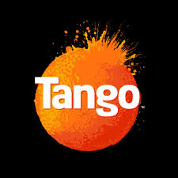
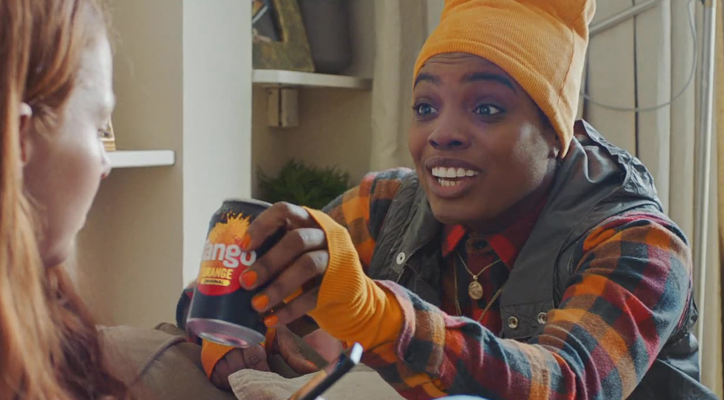
Tango: putting the fizz back
Challenge
Tango had been in decline for years and needed to make a serious comeback
They needed to increase consideration, reach a new younger audience and make Tango famous again
Solution
They unleashed Tango in big cultural moments, that mattered to young people and their mates, with a bespoke, integrated AV strategy
Results
Volume increased by 41.7%
Sales rose by 37.9%
Notes:
The Challenge
Tango rose to fame in the early 90s through a series of memorable and controversial TV campaigns. The strap line ‘You know when you’ve been Tango’d’ was etched into the nations’ consciousness.
Fast forward to 2019 and Tango was virtually unknown to today’s youth. With little brand investment, it lost both shelf space and market share and although awareness was high, relevancy and consideration were not. The brand was at risk of disappearing altogether.
Tango needed reviving and to become culturally relevant again, through:
Increased consideration amongst existing and new customers
Reaching a new, younger audience.
Making Tango famous again and increasing brand love
The TV Solution
By speaking directly to 16-24 year olds in a series of workshops, it became apparent that TV was important to them because of its social currency, but media habits were fragmented and social media was also incredibly important.
There were three key insights which shaped the entire campaign strategy:
Being ‘in the know’ with big cultural moments that drove live TV viewing
The virtual and physical worlds were blurred for young people, meaning a cross channel, integrated campaign was a necessity.
Awkward moments played a big part in their lives – but those moments were also seen as funny.
By overlaying the human insight with planning know-how, they decided to unleash Tango in big cultural moments that mattered to young people and their mates and to rescue them from awkward situations with the ‘Tang-guru’ - a cringe-busting hero who rescues people from awkward moments.
The Plan
Two ads were created featuring a teenaged girl getting stuck in controversial situations:
A 30” treatment about a rude message accidentally sent to her dad instead of her boyfriend
A 40” ad where the dad discovers her vibrator
m/SIX and VCCP created the TV creative as the ‘hero asset’ that could be leveraged on other channels such as social media, through GIFS and memes.
In order to best capture the attention of an audience of avid multi-screeners, the TV was carefully planned around moments where they were truly engaged.
The plan was:
Centred around unmissable programmes with exceptional talk-ability.
Unbound by weekly deliveries and strike weights – the programming had to be cherry-picked against those that over-indexed for the target audience. (Such as the final episode of The Big Bang Theory and the launch episode of Love Island.)
Focussed on ITV2, C4 & E4 at launch (usually ITV1 would be deemed critical for delivering fame and reach, but these channels were more relevant for the audience)
Centred around late peak airtime
Heavily invested in BVOD, with 20% of spend allocated. (This was significantly higher than the usual level of BVOD spend for Britvic). Much of the linear strategy was mirrored across BVOD.
Much of the TV activity was amplified by online social conversation and the ‘Tanguru’ started Tweeting on episodes of Love Island whenever the linear TV spots were running. Paid support behind these Tweets also generated huge amounts of audience engagement and TV amplified the effects of other media – which were phased in after a couple of weeks of TV.
Cinema ran the 40” more ‘risqué’ ad in contextually relevant films and Snapchat utilised bespoke assets from the TV content allowing Tango to be present in conversations of young people.
Results
Volume increased by 41.7% YOY
Sales rose by 37.9% YOY
Household penetration rose by 4.9 percentage points equating to 1.3 million more shoppers
Tango increased consideration amongst their key audience
Audiences loved the campaign, Tweets and comments
Tango reached 44% of all UK 16-34s through linear TV alone with just 135 TVRS
The campaign was shortlisted in ‘Best integrated campaign’ at the TV Planning Awards 2020

