Slide 1
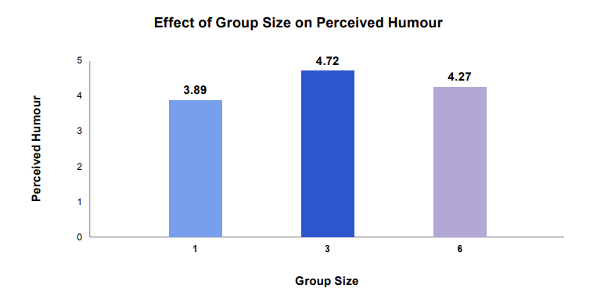
We tend to find humorous content more amusing when surrounded by others
Source: Zhang & Zinkhan (1991)
Notes:
Humour In Group Settings
We tend to find humorous content more amusing when surrounded by others.
Evidence: Work in 1991 by University of Houston psychologists, Yong Zhang and George Zinkhan, shows that the same piece of creative tends to be judged as funnier when it's viewed in a group.
Their experiment involved recruiting 216 people to watch soft drink commercials. They separated the participants into groups of one, three and six. Their key finding was that ads watched in groups of three were reported to be 21% funnier than those watched alone. They were 11% funnier than those watched in groups of six.

