Slide 1
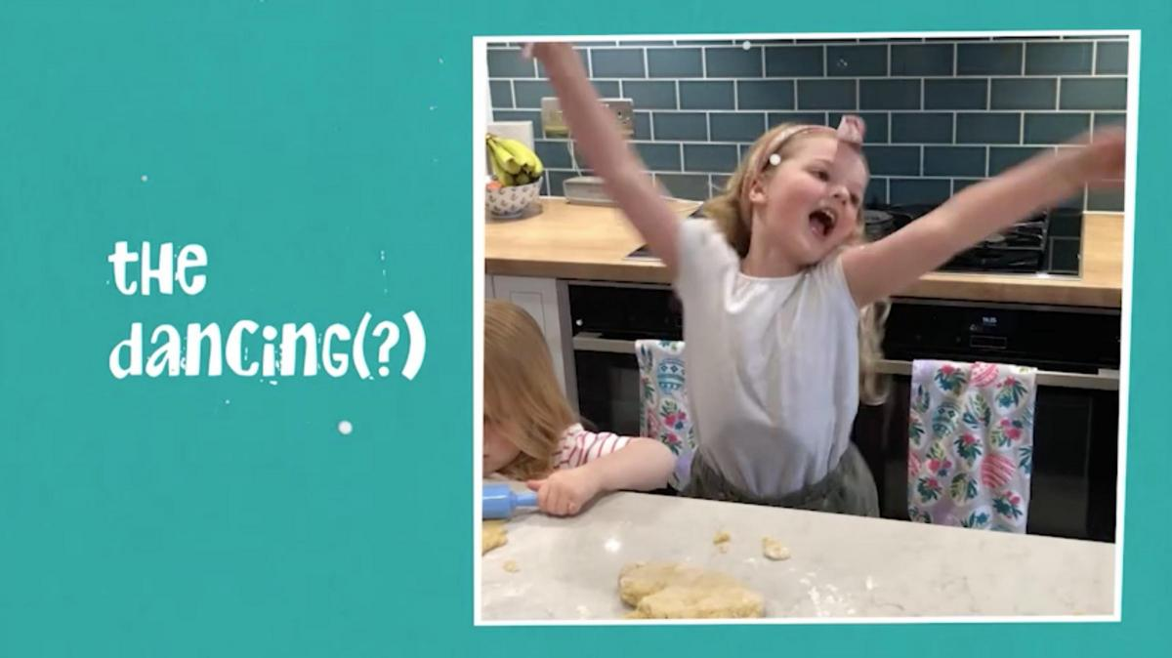
How Roberts Bakery rose to the occasion to help a ‘nation in knead’
Challenge
In response to the Covid crisis Roberts Bakery established a direct-to-consumer offering - Roberts Bakery Direct.
With speed being of the essence and with NO TV ready assets Roberts Bakery needed a way to raise awareness and solve their creative issue.
Solution
They launched #ShareYourBakes, offering would be bakers a chance to appear in their TV advert. The UGC solved the no TV ready assets problem.
Running exclusively on ITV gave Roberts Bakery access to a strong programme schedule with uplifted quality
Results
Increased brand awareness exceeding targets
Generated direct sales more than +50% vs. target
Awarded highly commended in the Best Integrated Campaign category at the TV Planning Awards 2021
Notes:
The Challenge
At the start of 2020, family-owned traditional bakery, Roberts Bakery were embarking on a shift in focus away from white bread (historically accounting for 70% of sales). Republic of Media originally developed a media strategy of ‘Breaking Beige’, which sought to reverse the stale conventions plaguing the bread category, by bringing colour to ‘everyday grey’, but…
In April 2020, Covid hysteria struck and cleared the supermarkets shelves. Panic buying meant everyday essentials such as bread and flour were in scarce supply. At this time of national crisis, a trend towards home baking emerged, sourdough starters trended on Twitter, while UK grocers saw flour sales double following ‘unprecedented’ demand.
As a response to this and virtually overnight, Roberts established a direct-to-consumer offering - Roberts Bakery Direct - complete with bread bundles, bread baking kits and a delivery partnership with Uber Eats to transport staple baked goods direct to the doors of consumers.
Republic of Media were tasked with creating a tactical campaign to launch the direct-to-consumer site while driving awareness of Roberts Bakery nationally. With continued market uncertainty and fluidity, Republic of Media knew that they had to act fast to turnaround a campaign, maximising the opportunity whilst at-home baking was still relevant. All of this was to be achieved within a media budget of less than £200,000.
The TV Solution
The objective for the tactical campaign was to drive awareness of Roberts Bakery among two distinct audiences: a broad, bakery-buying audience (females aged 25-54) and baking enthusiasts. Crucially, Republic of Media also needed to deliver traffic to the Roberts Bakery Direct site.
A combination of increased TV impacts and reduced ad revenue drove deflationary market conditions, creating a once in a lifetime opportunity for Roberts to deliver a national TV campaign at a fraction of the normal required cost.
To take full advantage of the captive, enthused baking audience and once in a lifetime pricing, Republic of Media knew they would have to move quickly. However, there was a potential stumbling block as they didn’t have a TV advert, nor the production means to create one. As one of the UK’s top commercial broadcasters and home of family favourites, ITV were approached to see what was possible. Against all odds and with a turnaround time of just two weeks, Republic of Media, ITV and creative agency, Propoganda, were able to make #ShareYourBakes into a reality.
The core premise of the campaign was to use #ShareYourBakes as the primary call to arms, enlisting the nation to share their own baking creations on social media using the dedicated hashtag. Doing so would give them an incredible opportunity to be featured in a special, premiere network ITV spot as part of the campaign’s finale. Audience participation via the hashtag meant Roberts could also guarantee valuable earned media coverage and relevancy.
The Plan
The campaign was planned in three different phases; The Preheat, Prove & Rise.
The Preheat
A two-week burst of airtime on ITV was used to raise awareness of the competition element with a #ShareYourBakes call to arms. Working with ITV to deliver a strong programme schedule with uplifted quality, meant that Republic of Media maximised Roberts Bakery’s 1+ cover quickly. The campaign also played out across YouTube.
Prove
Republic of Media used Captify’s search intelligence technology to keep Roberts Bakery integral to the baking conversation - intercepting searches around baking with online display advertising.
Rise
The campaign culminated with a user-generated advert, containing a montage of action shots of Roberts budding bakers, airing in a centre break of Emmerdale and a selection of prime-time spots with high social chatter. The advert also aired across Roberts Bakery’s owned and earned platforms.
Results
Brand awareness increased nationally exceeding targets
The campaign generated direct sales more than +50% vs. target
Drove a significant uplift in traffic towards www.robertsbakerydirect.co.uk
Website data also demonstrated the direct correlation between TV spots aired and traffic
The campaign was highly commended in the Best Integrated Campaign category at the TV Planning Awards 2021

