Slide 1



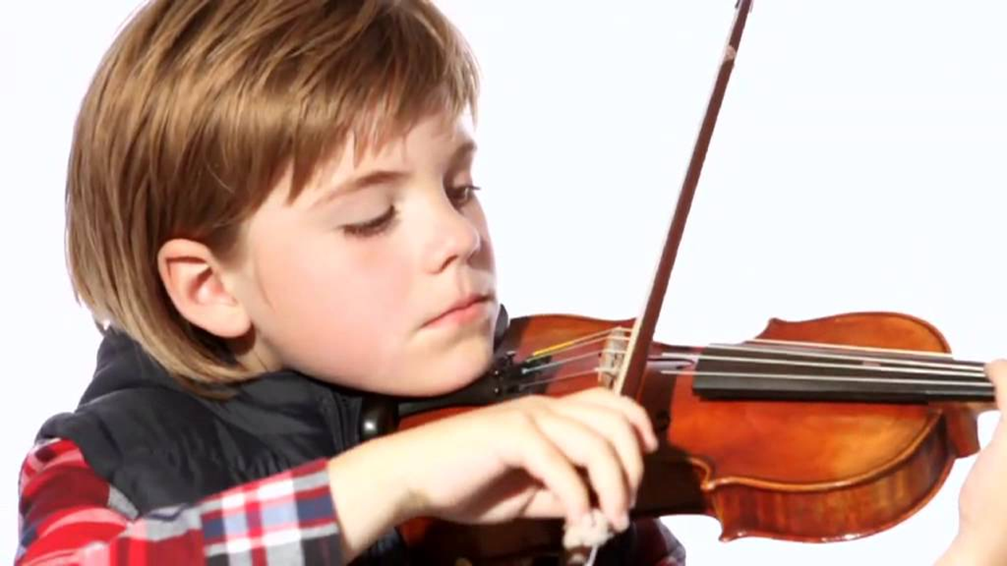
M&S do their thing – making the kids the stars of Britain’s Got Talent ad breaks
Challenge
M&S had lost market share in the kids’ clothing sector and wanted to reclaim it
Solution
Research found that 48% of kids wanted to be famous so M&S launched a talent show
The talent show aligned with BGT and the ads were designed to target mums and kids
Results
Market share increased by 7%
Drove 85,000 unique visits to itv.com/marksandspencer
Web traffic to kidswear increased by 21%
Notes:
Challenge
Kidswear had always ticked along nicely for M&S. Mums shopped there because they trusted the quality of the clothes and it was worth spending a bit more. However, times were changing and it was facing greater competition from the major grocers and suffering a subsequent loss of share. Mums were increasingly happy to buy clothes while they did their weekly shop; they had got used to tightening their belt recently and seemed to be pleased with the results.
Perhaps the most worrying trend through was that kids (6-12 year olds) who traditionally had little say in what they were wearing were now influencing where Mum bought their clothes. Data suggested that M&S did not tend to figure high in their list of priorities. M&S needed to speak directly to kids for the first time ever, and appear credible while doing so.
The challenge was to plan a campaign that spoke to both mums and kids, with a budget smaller than any other business unit in M&S and more challenging targets.
The Solution
So if M&S wasn’t cool to these kids what was?
‘Event TV’ is one of the areas guaranteed to reach and engage mums and their kids together and create exciting common ground for them. The imminent arrival of Britain’s Got Talent got the planning team thinking. Could some sort of M&S association with the property give it the injection of cool energy that kidswear required?
Qualitative research showed that fame is the new cool for kids. The latest Youth TGI statistics from 2011 supported the thirst for fame amongst young kids, with 48% claiming to want to be famous and listing reality show stars like Ant and Dec celebrities as among the people they most admire.
In summary:
M&S wasn’t cool for kids and mum had cheaper kidswear alternatives
Kids love the idea of being famous
The nation (mums and kids particularly) are passionate about talent shows
Britain’s Got Talent was on the way
Was there an opportunity to show that M&S loves talented kids?
Walker Media briefed ITV to create an integrated campaign with BGT at its heart, including TV and VOD spots, an online hub and the sponsorship of ITV’s first ever BGT You Tube page.
The bespoke TV commercial was shot during a Rankin kidswear press shoot – the brief was simply…‘you could be here next time….enter online now on the Do Your Thing hub at ITV.com’. It first aired in the centre break of BGT on 23rd April and then in a selection of hand- picked breaks specifically designed to target mums, kids and mums and kids together. The winner was then announced on the same day as the BGT winner.
Results
The fortunes of M&S Kidswear were transformed;
Market share increased by 7%
Web traffic increased by 21% to kidswear during the campaign period
Attracted 605 competition entries.
Drove 85,000 unique visits to itv.com/marksandspencer
Achieved desired customer take-out - a fun, modern and distinct ad (Source: M&S tracking)
To read the full case study and access the creative visit: https://www.thinkbox.tv/Case-studies/Marks-and-Spencer

