Slide 1

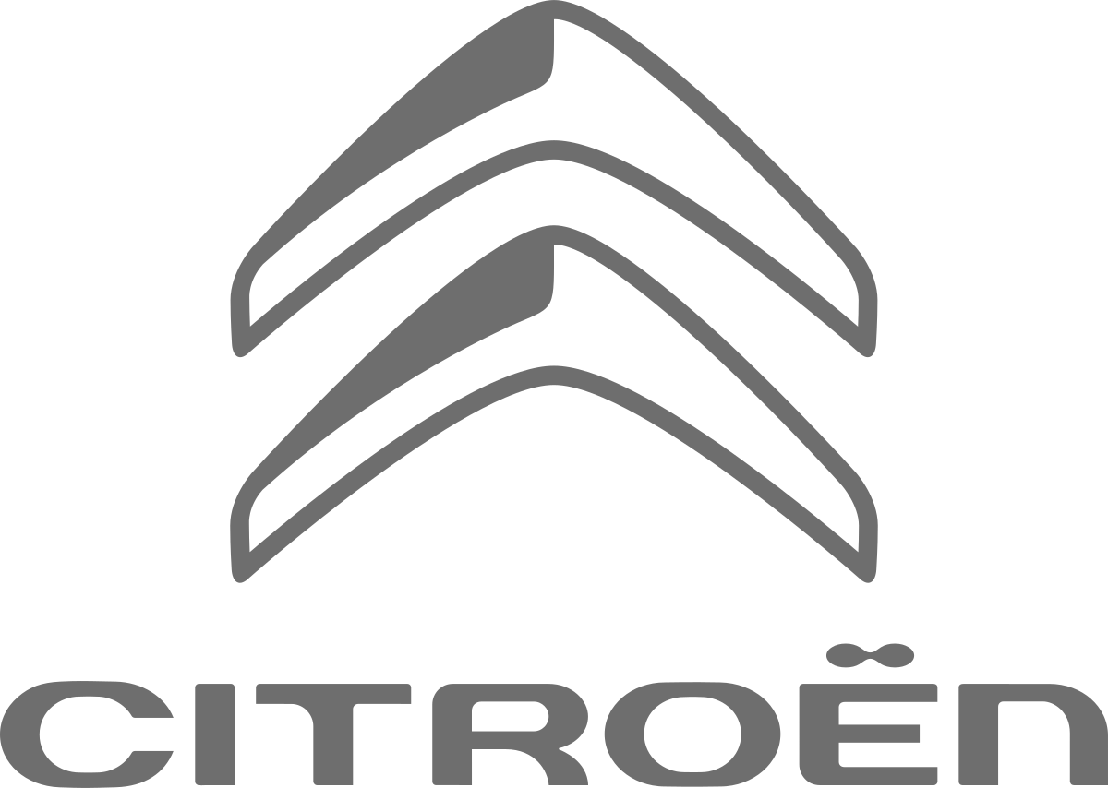
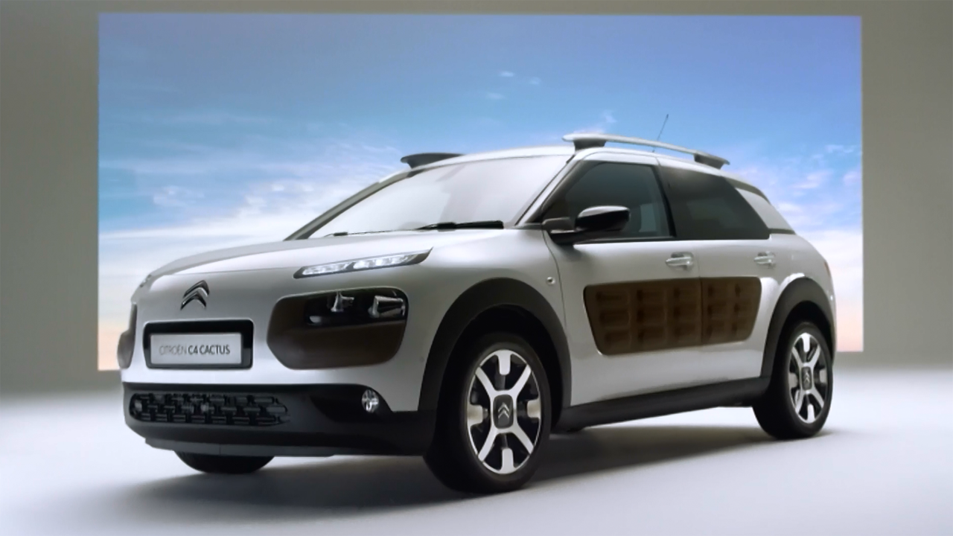
Citroën: capturing Cactus curiosity
Challenge
High targets for the first new model in nine years -aiming for five-figure sales numbers in 2015
Solution
Launched with an ad break takeover during The X Factor. Showcasing various elements of the car shown in five 2” mini blipverts and culminating in the reveal of a 30” ad which ran last-in-break
Staggered roadblock across other key stations and ITV’S Ad-Sync integrated into the plan
The linear TV campaign was planned to reach 77% of ABC1 Adults and to ensure lighter TV viewing audiences were also reached, VOD and Cinema complemented the TV schedule.
Results
The new C4 Cactus beat its sales targets by 20%
The most successful model launch in Citroën UK’s history
Notes:
The Challenge
The C4 Cactus was the first new model introduced by Citroën for over nine years. With the future of the brand greatly dependent on the success of this new launch, the campaign faced a tough test to hit huge sales targets and generate desire amongst their target audience.
The striking design of the C4 Cactus was a crucial feature that needed to be effectively promoted throughout the campaign. With a unique combination of the key features of a “Crossover” and a “Hatchback”; forming its own ‘Crosshatch’ segment, it was important to create a visually-impactful campaign in line with the car’s curious design. The challenge was how to take the car’s uniqueness and communicate it to the UK in an equally compelling and interesting way.
The Solution
Citroen’s media agency, OMD, devised a strategy based on the theme of ‘Stay Curious’. They felt that the car would appeal most to people who were open-minded, unconventional and naturally curious. Not only was the car radical in appearance but it had several design features that enhanced the driver experience and each one needed to be revealed.
They knew that TV needed to be at the core of the campaign. Not only could TV showcase the exciting new look but also TV was the only medium that could offer the impact, effectiveness and scale that was required for the launch and ignite the natural curiosity of its viewers.
Results
The most successful model launch in Citroën UK’s history.
The new C4 Cactus beat its sales targets by 20%.
25% 1+ coverage on launch night.
The second Ad-sync drove an incredible 158,642 interactions and 5,584 clicks to site.
Across Europe, Citroën UK had the most online showroom traffic (showroom visits, configurations and leads).
This campaign beat the last comparable C4 Picasso campaign by 52% in terms of sales and drove 11,500 leads and 15,000 online configurations of the car.
To read the full case study and access the creative visit: https://www.thinkbox.tv/Case-studies/Citroen

