Slide 1


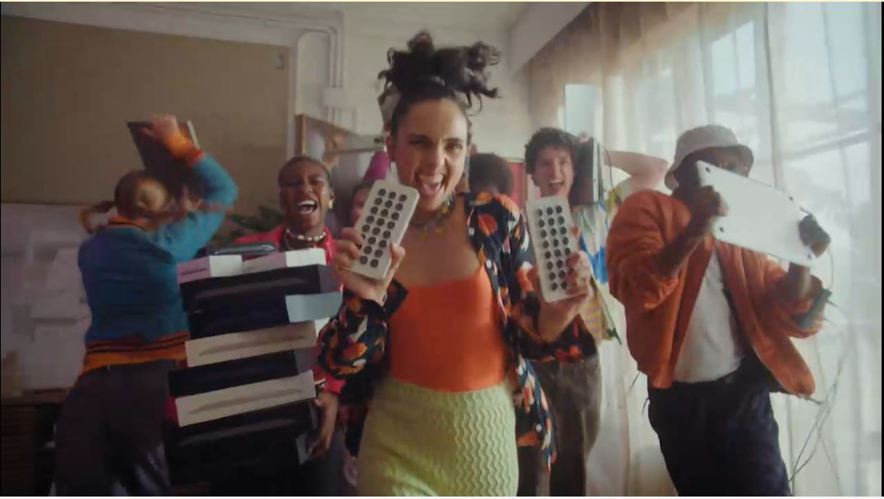
Back Market: TV’s trust building power
The Challenge:
6 million tonnes of e-waste (tech) finds its way into landfills each year. Back Market wanted to halt this and build trust and awareness in both the brand and refurbished tech.
The Solution:
Use TV to insert the brand into moments of family co-viewing to drive fame, awareness and trust in the brand among an audience of 12.3 million Chief Family Officers.
The Results:
Awareness lifts above target of 40%, 13% increase on target agreement with statement ‘Back Market is a brand I trust’ and increase site traffic of 46%.
Notes:
The Challenge
Every year in the UK, a huge 6 million tonnes of e-waste (tech) finds its way into landfill, with old phones, tablets and smart watches being binned off in favour of the shiny and new. Having launched in the UK in 2022, Back Market, were offering something new but also old to the market, refurbished tech. Back Market expertly refurbishes tech and offers it to the market at a more affordable price. Despite offering phones like new at a fraction of the cost and the obvious advantages of sustainability; there was an issue in the UK. Refurbished tech was unknown and untrusted; with 87% of the population saying they wouldn’t buy refurbished, 21% believing that refurbished meant stolen and 77% believing the product simply wouldn’t work. Refurbished tech had an image problem.
Back Market had been largely focused on digital marketing and was yet to really make an impact, stuck behind the likes of CEX and Music Magpie, brands that are both synonymous with refurbished tech in the UK. Back Market needed to drive awareness of their offering, build trust in the brand and drive web traffic.
The TV Solution
Armed with clear objectives of driving awareness, building trust and growing web traffic, Wavemaker UK got to work in understanding the problem at hand. Pre campaign research had indicated they needed to normalise refurbished tech by making it a purchase you can trust which would ultimately make Back Market the go to platform. With their current approach the campaign wouldn’t move the needle for Back Market, if they were going to hit their objectives, Wavemaker would need to get them acting like a category leader.
Leveraging Thinkbox research, it was clear to Wavemaker that only one channel would deliver the trust, fame and have an immediate impact on web traffic, TV. Wavemaker then used Cost of Living research to highlight that families were increasingly cash strapped but under pressure from Children for the latest tech and gadgets. This audience of 12.3 million were dubbed the Chief Family Officers- those in charge of the household buying and they could be captured in moments of co-viewing, putting Back Market right at the heart of the living room and the conversation.
The Plan
Using agency tools, Wavemaker allocated two thirds of the annual budget into TV. To maximise the impact of the campaign with the budget on hand, Wavemaker needed to normalise refurbished tech to as many people as possible as quickly as possible; all while balancing the line between effectiveness and efficiency. To achieve this, Back Market launched with a roadblock, cherry picking the biggest programming across linear to aid the goal of fast 1+ reach over the first three days of the campaign. This launch activity saw the campaign reach 28% of the population within the first 72 hours; making them the one of the top 3% most viewed advertisers across the 3-day period. The launch and wider campaign activity was selected to ensure that Back Market would have a foot hold in the market in the lead up to the key Black Friday and festive period. Launch activity was planned for October to negate the higher TV costs of September. This allowed the brand to remain on air for longer with higher weekly weights.
Leveraging Thinkbox research about the impact of longer ad lengths, the campaign kicked off with a 30” creative that was deployed to deliver impact and awareness from a standing start. After 2 weeks of sustained 30” messaging, reach curves started to plateau. This plateauing promoted a changed in second length to a 20” creative. This change ensured that the campaign delivered cost savings to the campaign with no impact on the brand messaging delivering maximum TVRs over a key period for the category.
Having launched the campaign with success, Wavemaker again turned to Thinkbox research that showed the environment for the brand was just as important as the channel it’s in. This promoted Wavemaker to focus on the biggest and best cultural moments over the period. This would see Back Market positioned alongside some of the UKs biggest known brands. This approach saw the campaign feature is some of the biggest shows across the campaign period like Bake Off, the Rugby World Cup and I’m a Celebrity. By using historical Barb data, Wavemaker were able to profile the core audience of Chief Family Officer. This created a hitlist of programming that would reach families in moments of shared viewing and help to shift perceptions of Back Market and refurbished tech with both the ‘wanters’ and the ‘buyers’. This approach meant Back Market featured in 8 out of the 10 top shows with the highest family co-viewing like The Voice, The Masker Singer and Great British Bake Off; all with a position in break to place them right next to the content to drive home the perception of quality.
Results
With the aim or rising brand awareness, Wavemaker’s meticulous approach to planning saw Back Market smash its targets and lift brand awareness over the campaign benchmark of 40%. Along side this, the campaign needed to foster trust in refurbished tech and Back Market being the place to get it. The campaign was again a raging success delivering 13% increase in target with audience’s agreeing that ‘Back market is a brand I trust’. Finally, Site traffic for the brand increased by 46% over the course of the TV campaign with it on average delivering 920,000 site visits a week.

