Slide 1


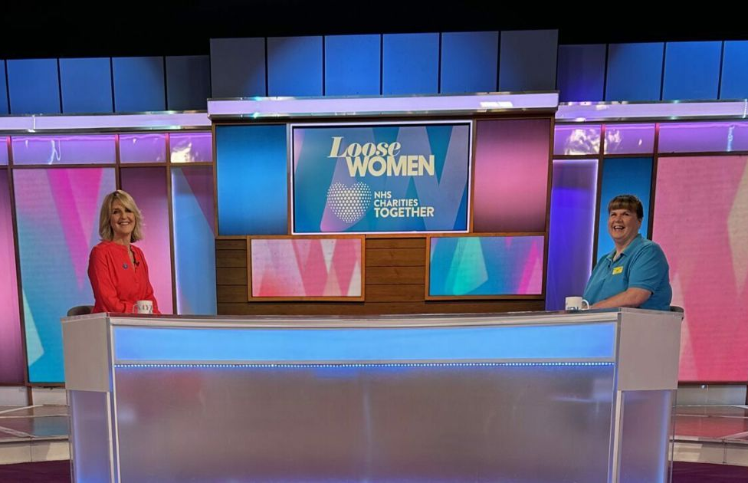
NHS Charities Together caring for the NHS
The Challenge:
NHS Charities Together needed to raise their profile and increase awareness of what they do
They wanted to galvanise audience engagement and inspire a new wave of supporters by building emotional connections
The Solution:
They partnered with Loose Women on ITV1. December 19 opted for a content integration approach, weaving NHS Charities Together’s impact stories into the programme’s natural flow to earn attention through editorial integration
The Results:
16% of viewers indicated clear donation intent
68% of viewers endorsed the collaboration as appropriate and authentic
Notes:
The Challenge
NHS Charities Together is the national charity for the NHS, set up to help people who use or work in the NHS. They work with a network of over 220 local and specialist NHS charities across the UK to deliver the best health care for everyone.
In 2024, the challenges they faced included limited understanding, modest budgets and established competitors with loyal donor bases. They needed to raise their profile and increase awareness of what they do, particularly to those audiences most likely to support their cause.
Their mission was to create a lasting impact in the competitive charitable landscape with a campaign that was unique enough to stand out and create connection with their audience. They wanted to galvanise audience engagement and inspire a new wave of supporters by building genuine emotional connections.
The TV Solution
December 19 identified that the best opportunity to make an impact lay with ABC1 women aged 55+ who had a charitable inclination, so this group became their prime target audience.
After analysis, ‘Loose Women’ on ITV1 emerged as the ideal programme to partner with in order to meet their objectives. Not only is it watched by the people they want to reach, but the programme features authentic conversation, trusted voices and magazine-style storytelling, which felt suitable for the brand and also resonated with their target audience.
December 19 opted for a content integration approach, weaving NHS Charities Together’s impact stories into the programme’s natural flow in order to earn attention through genuine editorial integration.
The Plan
Contextual TV ads were created featuring ‘Loose Women’ hosts Kaye Adams and Brenda Edwards conducting interviews in the show’s familiar tone and style, with NHS staff and patients from an NHS Charities Together funded project.
December 19 prioritised daytime programming on ITV1 using a mix of 60 second and 30 second spots to build optimal frequency. Their programme selection was designed to mirror the editorial environment of ‘Loose Women’.
They amplified the TV campaign by extending the content onto ‘Loose Women’ social platforms and activity on Meta and YouTube reinforced their message.
Results
52% of ‘Loose Women’ viewers recalled the creative and 90% were able to identify the brand
36% of viewers interacted directly with the content, contributing to a 17 percentage point uplift in overall awareness
Analysis showed 60% positive responses, reflecting the emotional connection to their storytelling approach
16% of viewers indicated clear donation intent
68% of viewers endorsed the collaboration as appropriate and authentic

