Slide 1

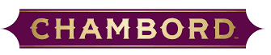
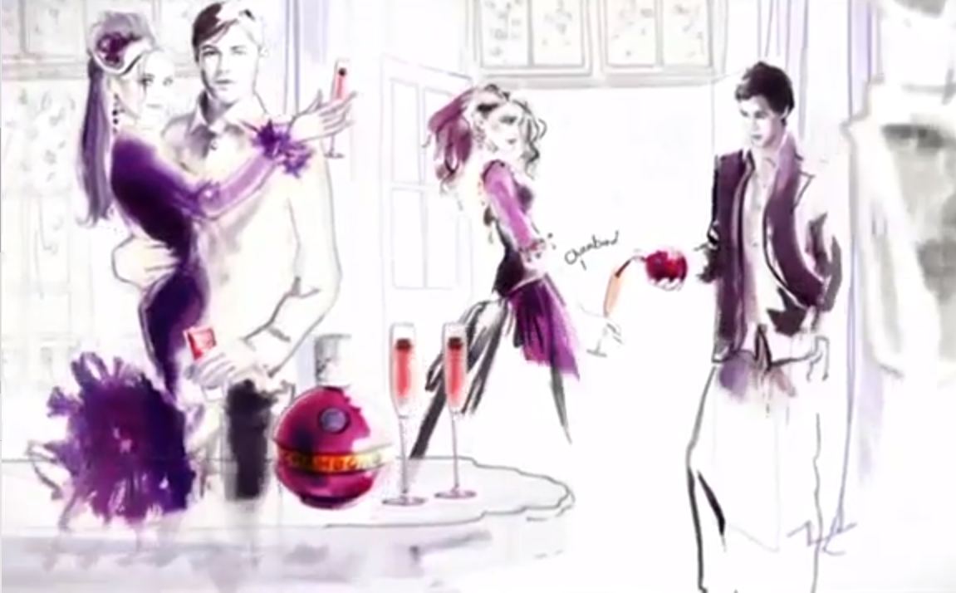
Chambord’s decadent TV debut puts the drink on people’s agenda
Challenge
Chambord wanted to establish the drink in the UK market and increase volume sales by 20%
Solution
Sponsored Revenge on E4 – a programme that aligned well with Chambord's brand values, as well as having many champagne drinking scenes
It would appeal to the right audience and the timing was perfect too – 22 shows across the summer
Results
Awareness increased by 42% and sales increased by 47% year on year.
Winner of ‘Best Newcomer’ in the TV Planning Awards
Notes:
The Challenge
Chambord is a French drink which, before this campaign, was virtually unknown in the UK. It’s a black raspberry liqueur best enjoyed as part of a cocktail with champagne and across the channel is considered decadent, flamboyant and a real treat.
Not only was awareness practically zero, but consumers didn’t know how to consume the drink, didn’t know what the drink stood for, where they could get it or why they should consider it for a night out. They needed to establish the drink on the market and get it on people’s agenda.
Their primary objective was to make more people aware of Chambord and consistently to remind them of it over a sustained period of time.
As Chambord had done next to no advertising over the past ten years, they set themselves the ambitious target to increase volume sales by 20%. To make this objective more challenging they had a budget of just £200,000 to do it.
The Solution
They decided that TV sponsorship was the best way to achieve their objectives and identified Revenge on E4 as being the perfect programme to associate the brand with. Revenge is an ABC Studios drama about the decadent and glamourous lives of a wealthy family and so fitted neatly with Chambord’s “why not?” proposition. Nearly every episode features a lavish party in which copious amounts of champagne is consumed and the show would appeal to the social, stylish 25 to 34 year old women that had been identified as Chambord’s target customers – women who like the odd luxury and would be inclined to buy a bottle of champagne on impulse on a night out.
Sponsoring the programme would provide a regular means of communicating as the series spanned 22 episodes. The timing was also perfect as it ran across the summer – a less competitive period for drinks brands and a time of year when consumers are thinking about a refreshing cocktail in the sun. It would mean using their entire media budget on this sponsorship but they felt it was such a perfect fit that it was worth the gamble.
The sponsorship also extended to on-demand so the association was re-enforced on a different platform.
Within a couple of weeks, the sponsorship had a profound impact which led Chambord to release additional funds for a spot campaign to run alongside the sponsorship. This increased the reach and embedded the message even more firmly. The campaign was low weight (due to limited budget) but was highly programme specific with a creative that matched the sponsorship idents so there was a synergy across the two elements which enhanced the results.
Results
Awareness increased by 42%
Smashed the sales target as sales increased by 47% year on year
Chambord was able to use the Revenge sponsorship to fuel its Facebook page with regular updates. As a direct result of going on TV and with no additional paid-for advertising, post engagement on the page increased by 50%, the total number of people talking about Chambord posts was up 37% and the top traffic driver to the Facebook page was channel4.com
Chambord’s TV debut was also heavily reported across the media & marketing press as well as the drinks trade press so there was lots of positive PR too
Winner of Thinkbox’s TV Planning Awards in the “Best Newcomer to TV” category
To read the full case study and access the creative visit: https://www.thinkbox.tv/Case-studies/Chambord

