Slide 1


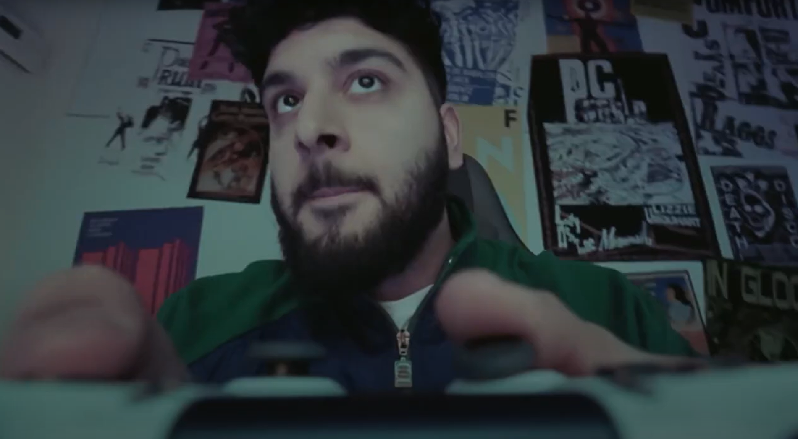
EE Game Store: TV reaching Gamers and Gifters to drive sales
The Challenge:
In 2023, EE launched their Game Store, having identified gamers as a key and new growth area. The store had seen initial green shoots with gamers, but it was clear the brand needed to supercharge their reach to create stronger and more sustained growth. The campaign needed to increase consideration and purchase intent from ‘All In Gamers’ and ‘Gifters’ while increasing sales.
The Solution:
Analysis of sales highlighted two clear audiences, Gamers and Gifters. TV had been avoided in the past. But Thinkbox’s Profit Ability 2 research and their own econometric analysis showed that TV delivered short term ROI and drove immediate sales through its ability to reach both gamers and gifters at the same, time in key programming like live sport and family viewing like Bake off.
The Results:
TV formed the backbone of the campaign and delivered success. Sales were up, smashing the target by 3x vs target. Huge growth in first choice purchase intent from All In Gamers, 200% above target. Consideration from new customers was double the target and even existing customer consideration jumped.
Notes:
The Challenge
In 2023, EE launched their Game Store, having identified gaming as a key and new growth area for the business. Setting up the store saw them competing with established retailers like Amazon, Curry’s and John Lewis. The challenge facing EE was that gamers were reluctant to let a new brand into the space. Since the launch of the store, EE had worked to establish awareness and consideration through social and platform partnerships. This had created bursts of success, but nothing sustained in the way the brand had been hoping to see.
In 2024, EE changed focused and looked to bring TV into the mix. TV is a proven weapon that would move the dial on both brand building and sales, providing media agency WPP Media with a clear set of objectives. The campaign would need to increase consideration, increase purchase intent from ‘All in Gamers’ and increase sales.
The TV Solution
Armed with a clear set of objectives, WPP Media got to work in crafting an approach to the problem. Analysis of sales highlighted two clear audiences, gamers themselves and gifters. To be successful, WPP Media and EE Game Store needed to speak to and convert both groups, even more so when heading into the golden quarter in the lead up to Christmas. With both audiences needing unique messaging to deliver success, WPP Media crafted a consumer journey across platforms and devices underpinned by linear TV.
TV had been avoided at launch in 2023, as it was deemed that the gaming audience wouldn’t resonate with the channel. But by using Thinkbox’s Profit Ability 2 research, along with EE’s own econometric analysis, WPP Media presented a clear argument.
TV delivers a short term ROI and drives immediate sales throughout the Golden Quarter. Along with this, TV provided the ability to leverage high profile co-viewing moments, which would enhance recall and attention.
By building specific audiences to overcome the fragmentation of viewing, WPP Media were able to craft an audience that allowed them to pinpoint key viewing moments across all broadcasters. By focusing on big sporting moments, EE Game Store would be able to reach both gamers and gifters at the same time. Coupled with the top programming, WPP Media would be able to deliver against their steep targets.
The Plan
With a clear approach laid down, WPP Media put their plan into action. EE’s Game Store campaign kicked off on Saturday 1st November with a 30” creative. Launching right in the thick of the major retailers’ festive campaigns helped frame the campaign. Kicking off in November would allow EE to run a heavy weight campaign and gain a significant share of voice advantage across the month.
With a focus on ABC1adults, WPP Media crafted a plan that would allow targeting across ABC1adults, 1634s and ABC1Men, ensuring access to key programming for success. Along with this, WPP Media wanted to ensure they delivered appointment to view programming throughout the month, while ensuring the campaign still packed a punch in the final week.
This approach saw the campaign launch in Gogglebox to reach the gifters audience and followed up with a spot in live football on Sky in the game between Tottenham and Aston Villa to reach the key ‘All In Gamers’ audience segment.
This approach continued with a focus on reaching the ‘All In Gamers’ segment en masse with more live sport. Spots were bought in the UFEA Nations League match between England and Greece, ensuring they maintained a good share of voice across the month of November.
By holding some budget back for the final week, EE and WPP Media were able to finish the campaign with a bang in the lead up to Black Friday and Cyber Monday. WPP Media ensured a presence in the key family programming across the week to hit the gifters audience segment. This included a spot in the final of The Great British Bake Off on Channel 4, followed by one on Black Friday in Gogglebox.
The attention then moved to the ‘All In Gamers’ segment, with spots in the London derby between West Ham and Arsenal. This final week of activity ensured that EE Game Store stood out in a saturated market. The campaign was supported with integrations across VOD, SVOD and Cinema.
Results
The campaign was a massive success in establishing EE Game Store, with TV forming the backbone of the campaign, proving it could still resonate with gamers.
With an objective of increasing sales, the campaign smashed the target delivering 3x the sales vs the target.
There was remarkable growth in first choice purchase intent among the ‘All In Gamers’ - 200% above target.
Consideration also jumped among new customers, double the target. Even with existing customers, consideration also jumped.
‘Moving into the TV space was our next step in growing EE’s presence in the gaming vertical since its launch in 2023. Targeting families in the connected home, we focussed on the storytelling power of TV to perfectly illustrate EE’s ability to ‘do more’, and deliver the seamless gaming experience that gamers crave. The results didn’t disappoint, with TV’s transformative ability helping establish EE Game Store as a premium destination for gamers through increased awareness and consideration, most notably shown by the closing gap between us and the established competitors. We’re excited to see what TV can being to our future Game Store Activity.’
Laura Stone, Senior Media Manager, EE

