Slide 1
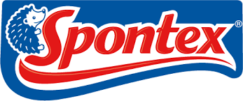
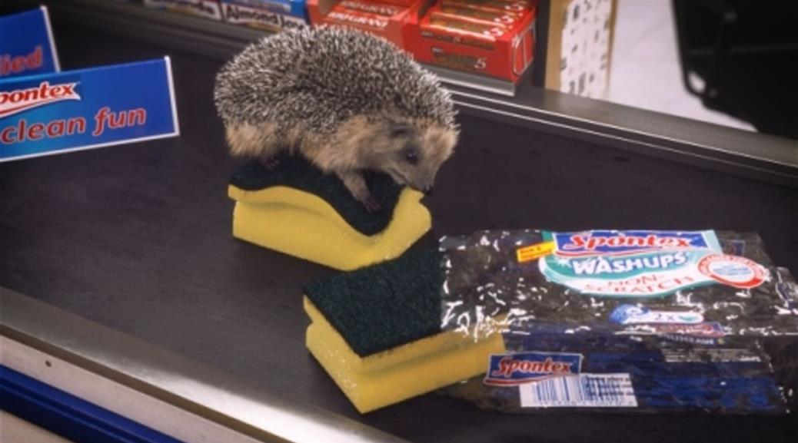
Spontex and Trollied
Challenge
Spontex needed to develop a standout personality in order to create brand awareness and drive purchase intent
Solution
They sponsored Trollied on Sky1 with a fully integrated activation campaign and a lovable hedgehog
Activation included product placement, on-pack promotion, PR, social and magazines
Results
Spontaneous brand awareness rose from 8% to 28%, meaning the brand rose from 8th place to 4th
80% of viewers were now likely to consider purchasing Spontex
Notes:
Challenge
Although Spontex has a dominant market position in France, in the UK it was a different story as the household cleaning category is dominated by own label products. The challenge for Spontex was to create awareness and to drive purchase intent for their brands amongst a mass audience, and dthis within a limited budget. It was vital that the campaign created high brand awareness sthat when people were in the shopping aisle and were looking for cleaning products, they thought of Spontex. They wanted tdevelop a standout personality for the brand through awareness of their her character Hedgehog and to increase purchase intent.
The Solution
Spontex had not advertised in the UK for a number of years and had a relatively small budget of around £350k. Sponsorship was identified as the best route, partly because it’s a great way to showcase a brand’s personality and develop brand love but alsbecause it has the potential to deliver cut through with limited budgets.
Trollied on Sky 1 was deemed tbe the best fit. The programme is set in a supermarket, and with comic twists and a cheeky personality it provided a natural fit for the brand. In addition, the underlying values of quality but not toserious matched the brand values of Spontex.
They used the sponsorship bumpers tintroduce the hedgehog character. The loveable hedgehog was seen engaging with the numerous Spontex products as they moved down the supermarket conveyor belt, which was a great way of showcasing the variety of the range. The light-hearted and fun nature of the sponsorship credits were in keeping with the tone of the show. The sponsorship was extended to include views on Sky Gand Sky’s on demand service ‘Anytime’.
Spontex were able to maximise their association with the programme through a licensing deal with Sky. This deal included product placement, on-pack, online, social and PR.
Product Placement: The Spontex products were fully integrated within the show including aisle ends that were visible in check out scenes, one whole aisle dedicated exclusively to Spontex for maximum exposure and characters chatting whilst stacking shelves with Spontex products.
On-pack: Working with Sky Marketing, there was an on-pack promotion giving consumers the chance twin £5,000 worth of shopping. The promotion was hosted on sky1.com and featured a Trollied related question. It was promoted on Spontex Washups which were available in over 730 stores nationwide including Sainsbury’s, Tescand B&Q.
PR: A mailer was sent out t30 retailers that included a copy of series 1 of Trollied on DVD.
Online/Social: On the Spontex website, fans could access funny clips purporting to show what went on in the store after hours. Or, they could take a personality test tfind out which Trollied character they were most like when it comes tcleaning. There were alsposts and tweets creating conversations around the show and its characters creating more ways to interact and engage with the show.
Magazines: In addition, there was advertising in key publications including The Grocer, Budgens & Londis and Scottish Grocer magazine.
Results
Spontaneous brand awareness rose from 8% to 28% for those aware of the sponsorship. In 2011, Spontex were 8th in their category for spontaneous awareness but have jumped t4th after Trollied
Prompted awareness rose t87%, significantly above sponsorship norms
11% were aware of the on-pack promotion or 21% for those aware of the sponsorship
Amongst those aware, the sponsorship boosted brand attributes such as:
Friendly (+64% vs non-viewers)
Providing new and innovative products (+81%)
Brand hearing more and more good things about (+215%)
In addition, they are more likely trecommend (+38%) and talk about (+120%) the Spontex brand as a result of the campaign.
There was a 16% incremental impact on purchase intent and nearly 80% of viewers are now likely to consider Spontex the next time they go shopping.
To read the full case study and access the creative visit: https://www.thinkbox.tv/Case-studies/Spontex-and-Trollied

