Slide 1

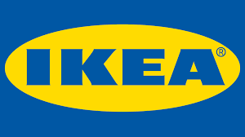
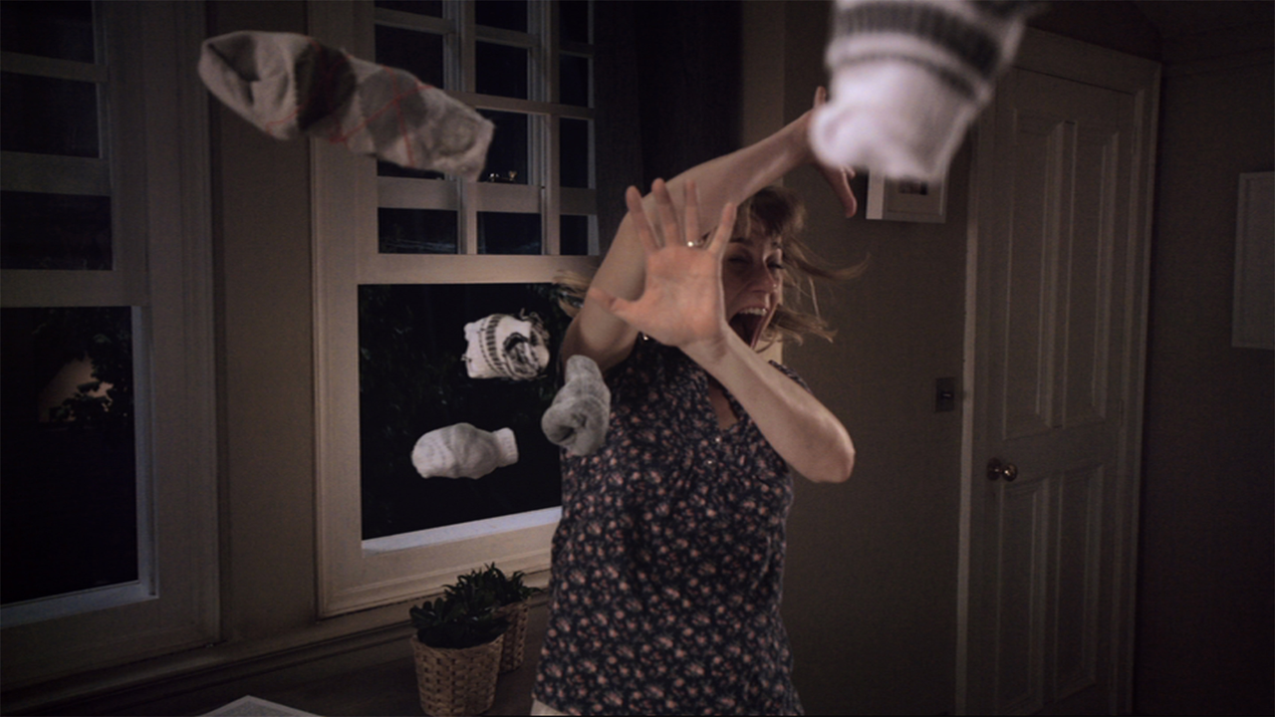
IKEA’s TV campaign created success in the bedroom department
Challenge
IKEA wanted to be synonymous with the bedroom, making IKEA the destination for bedroom furniture
Solution
Created an innovative partnership with Channel 4 over ten months, that encouraged viewers to go to bed at the optimum time for happiness
Every night, at 10.30pm, the IKEA clock encouraged viewers to go ‘Happy to Bed’
Results
People exposed to the campaign were 52% more likely to consider a trip to IKEA
Advertising contributed to a 13% value growth in the bedroom department at IKEA, which equated to £14m in incremental sales
Notes:
Challenge
IKEA came to Vizeum with a distinct challenge. They wanted to make themselves synonymous with the bedroom: Think bedroom Think IKEA. Vizeum used sleep psychologist’s research to understand more about the bedroom and IKEA’s place in it. They gleaned three valuable insights which could consequently feed into the TV solution. They were:
A good night’s sleep is directly linked to an individual’s happiness
People that go to bed at the optimal time of 10:30pm are the happiest (Source: Peter Hames), but the average UK bedtime is 11:41pm (Source: Professor Leeds)
Everyone has their own personal ‘bedtime ritual’ and the whole bedroom is involved in going to sleep
They needed to engage people during their bedtime ritual to persuade people that investing in their bedroom was a great way to invest in their overall happiness and that as the only complete bedroom specialist, IKEA was the best place to go to make that investment.
There were therefore three objectives that the TV solution needed to achieve:
Explicitly link the bedroom to happiness – Happy to Bed
Establish IKEA as an integral part of the bedtime routine – particularly 10:30pm
Make IKEA THE destination for bedroom furniture
The Solution
The big idea for the TV solution revolved around IKEA owning bedtime (as close to 10:30pm as possible) and help people go Happy to Bed. Vizeum knew that TV is the last media they consume before commencing their bedtime routine, and the decline in TV consumption post-11:00pm mirrors consumers bedtime habits. Therefore any campaign that tried to own bedtime had to be led by TV. Therefore they developed an integrated plan with TV at the heart of it which sought to deliver the prompt for people to go Happy to Bed.
The innovative part of the campaign was the partnership that Vizeum formed between IKEA and Channel 4 where they ran a 10” spot first in break in the ad break closest to 10:30pm every night for ten months. This wasn’t your typical 10” spot however, instead with creative agency Mother London they created an IKEA Happy to Bed clock that prompted viewers to go to bed at the perfect time.
Visually the clock was a throwback to the BBC clock that was a big part of British culture for 40 years, but delivered in the style of that reflected the face of one of IKEAs most popular clocks the SKOJ wall clock. The visual of the clock was accompanied by a sonic logo and the spoken words in a soothing voice “It’s 10:30pm – it’s Happy to Bed time”. To ensure that the correct time was aired, 25 different spots with 25 different voiceovers were shot.
In support of the Channel 4 partnership, there was also a 540 TVR TV campaign. The campaign launched with a 60” spot in X-Factor and the 60” spots ran solus for the first week supported by a 30” launch in the second week running 1:1 and from the third week onwards the 30” ran solus. The spot campaign was designed to generate awareness of the Happy to Bed proposition. There was emphasis on late peak which helped the campaign deliver a high level of cover around family bedtimes. It was also important to deliver the Happy to Bed message as prominently as possible to prompt an earlier bedtime therefore position in break was crucial and 84% of the campaign was delivered with a position (first, second, pen, last).
Results
People who were exposed to all elements of the campaign were:
40% more likely to be interested in IKEA’s Happy to Bed range
52% more likely to consider a trip to IKEA in the coming months
(Source: EMR third party research)
Advertising contributed to a 13% value growth in the bedroom department at IKEA
This equates to £14m in incremental sales
To read the full case study and access the creative visit: https://www.thinkbox.tv/Case-studies/IKEA

