Slide 1
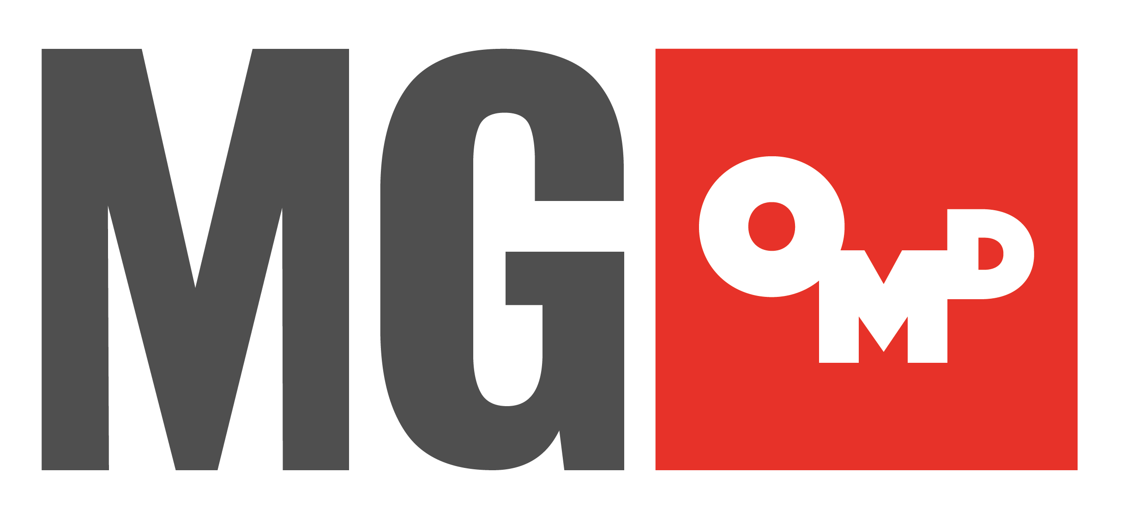
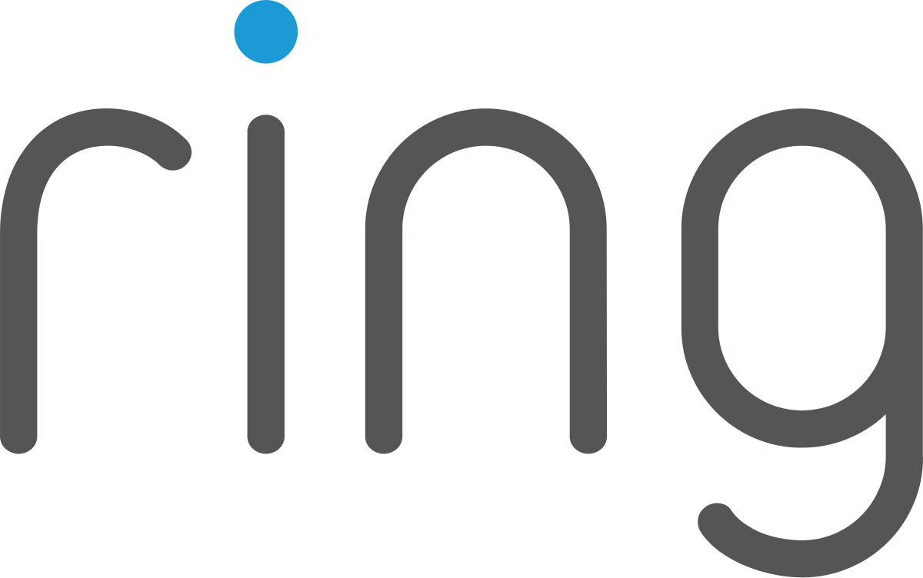
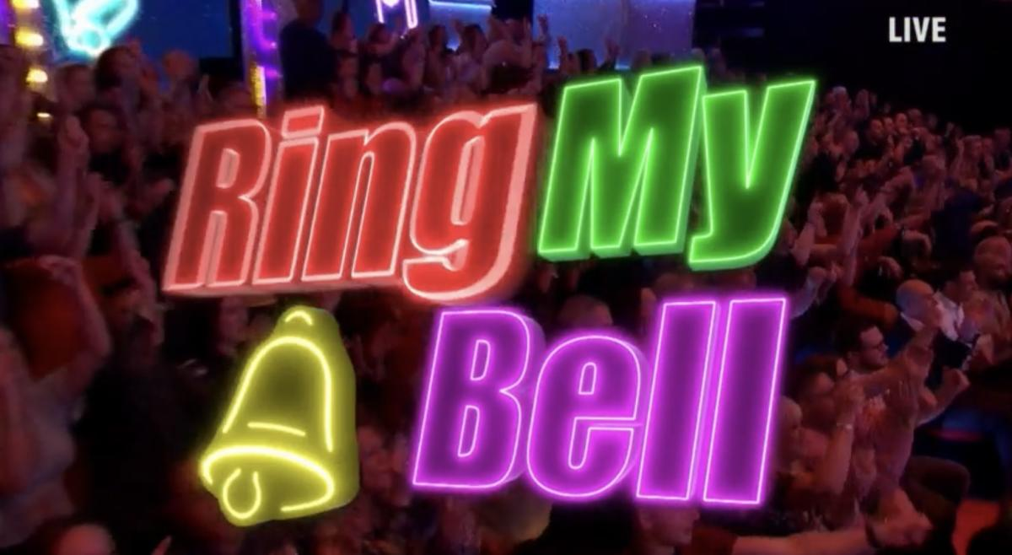
Ring.Com: Ringing the bell of mass awareness.
The Challenge:
Ring were being outspent 2:1 by competitors and were at risk of losing their position as number 1 in the home security sector. They needed to increase awareness against a budget reduction of 45% year on year.
The Solution:
Created a game show in Ant & Dec’s Saturday Night Takeaway called ‘Ring My Bell’ that used a real-life Ring doorbell feed.
The Results:
Activity reached 17 million viewers on linear, 23 million on social media with 78% positive sentiment. 50% increase in attention vs start of campaign, 150% increase in buzz and delivered an ROI of 10:1.
Notes:
The Challenge
Having launched in the UK in 2016, Ring’s video doorbells were now synonymous with home security, with front doors up and down the country adorned with ring devices keeping an eye on the coming and goings. At the end of 2021, Ring were still encountering an awareness problem. Despite being one of the biggest players in the market, they still only had an aided awareness of 50%. With new players in the sector like Verisure and Arlo, outspending Ring 2:1 with similar products at a lower price; Ring’s position as market leader was under threat.
It was clear to Ring, that in 2022, they would need protect their position as number one and leading smart security brand in the UK. Armed with clear objectives of growing awareness by 10% to 60% against a backdrop of a 45% reduction in spend year on year; Ring tasked media agency MGOMD with finding a way to hit the objectives.
The TV Solution
With the objective of growing awareness, MGOMD got to work in understanding how they could reach the 10% growth target with the reduced budget. With strategic pillars that would drive awareness with brand impact and product relevancy by building understanding of the product with real world examples. MGOMD believed that a traditional mass awareness campaign would be out of reach on TV given Ring’s budgets that year. To get around this, MGOMD knew that they would need to outshine the competition rather than outspend with buzz.
To create this buzz, MGOMD felt they needed to infiltrate culture by authentically entering cultural moments that would drive talkability and earn disproportionately high attention for Ring. Being a digital first brand, the obvious solution would be a social content partner but with such hard targets and a desire to infiltrate culture, Ring wanted to test a new format and use the fame and reach potential of a broadcast platform to put Ring at the hear of the nation’s favourite TV Show.
The Plan
With an iconic mnemonic device in their distinctive chime, MGOMD focused on finding a way that they could get the chime front and centre. Couple with the idea that few things get running like a doorbell while waiting for favourite takeaway. With few takeaways more famous than Ant & Dec’s Saturday Night Takeaway on ITV.
By collaborating with ITV Commercial and editorial to create a brand-new product placement segment that placed Ring authentically into the heart of the show, with a in show game called ‘Ring my Bell’. The game would see Ant & Dec go live to the view of a Ring video doorbell from a member of the audience. If the person recognised the doorbell as their own, they had to stand up, live on air, and shout ‘Ding Dong! That’s my doorbell’, promoting viewers at home to sprint to their neighbour’s front porch to ‘Ring My Bell’ for a change to speak to Ant & Dec and win a cash prize.
The idea although innovative and original, still needed to ensure that it delivered value, audience fit and fitted with the strategy for the activity. The product placement within the show would deliver 7 minutes of broadcast screen time, one brand mention within Ant & Dec’s script and 5 seconds of on-screen brand placement when the game begins. Along with this, ‘Ring my Bell’ game was an exact version of the Ring user experience, which would in turn deliver 4 plus minutes of exposure during the gameplay. This demonstrated a 10x cost per saving per TVR vs an equivalent exposure within this highly popular property.
When it comes to audience fit, Ant & Dec’s Saturday Night Takeaway attached 7.3 million viewers per episode, dominating with a 35% share of viewing. With Ring’s target audience of ABC1ads 25-54s made up 25% of that audience, allowing Ring to reach just under 2 million people in one hit. Couple this with Saturday night being the biggest shared viewing moment on television, with an average of 58% joint viewing. Partnering with the show allowed Ring to drive home their values of community, connectiveness and the home.
Finally, the partnership was able to deliver on the strategic pillar of building brand love and trust. With Ring My Bell, Ring were able to form an association with the familiar and trusted cultural icons, Ant & Dec. This allowed Ring to build fame and build associations of joy and entertainment, something competitors weren’t able to leverage. By integrating the product into the show, Ring were able to remove any barriers to understanding how the product worked.
Results
With combined impacts for the product placement reached over 17 million people, it placed Ring at the heart of entertainment in one of TV’s biggest shows whilst delivering an authentic product demonstration, live on TV. #RingMyBell reached over 23 million on social media with 78% positive sentiment.
Ring also saw an immediate spike in interest with a 30% uplift in branded search queries over the weekend of the first episode. With a key metric for the campaign being attention and buzz, ring saw peaks of +50% in attention vs the start of the activity and +150% in buzz against Ring’s target audience.
With a 50% reduction in budget and an 150% uplift in attention for the brand. Ring’s activity within Saturday Night Takeaway brought in an ROI of 10:1. This ensured that Ring would remained as number one in the hoe security sector while injecting the brand with personality.

