Slide 1


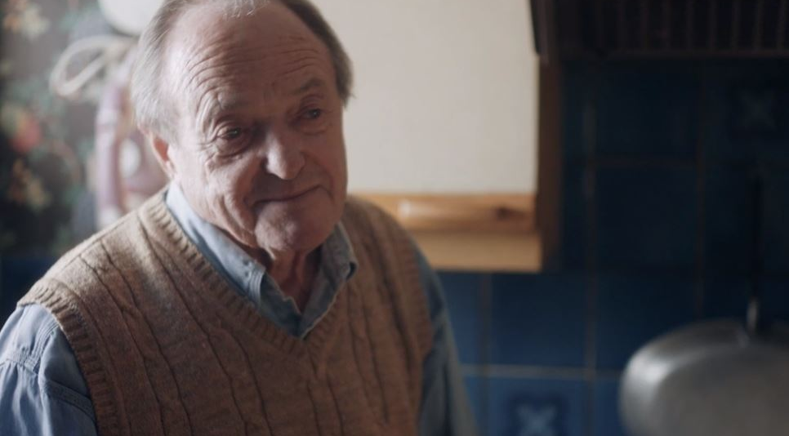
Age UK tackled the issue of loneliness
Challenge
Age UK wanted to recruit volunteers for their Call In Time service to help fight loneliness
Solution
MG OMD decided to use the power of one persons story to move the nation
Launched with a 3 min ad break takeover in Good Morning Britain on ITV - right target audience of ABC1 55+ women, right time of day for charitable action and within an episode dedicated to loneliness
60 second cut placed in other poignant programming for the audience including ‘When Phillip met Prince Phillip’ and ‘The Queen at 90’
Results
33,000 volunteer enquiries in just 4 weeks, 13% came directly from the Good Morning Britain ad break and fundraising increased 4% YoY
Web traffic increased in December 2016 by 24% YoY
Time pledged to the Call In Time service equated to 2 million hours in 2017, consideration for volunteering increased by 15%
245% more calls YoY from lonely older people wanting to receive the service
Notes:
Challenge
Age UK is the country’s largest charity, dedicated to helping everyone make the most out of later life. In 2016, they were launching a new campaign at a very busy time of year, December. Their budget was a lot less than other charities (3% share of voice) so they knew they needed to do something a bit different to stand out.
The main objective of the campaign was to recruit volunteers to Age UK’s ‘Call In Time’ service, where people befriend a lonely or isolated elderly person and call them for a chat every week.
Solution
Manning Gottlieb OMD decided to reject the traditional charity approach of focussing on the scale of the issue and to use TV and the power of one story to move the nation.
MG OMD worked with Drum to create a film focussed on Roy, aged 83, whose individual story, portrayed by James Bolam, made the plight of the one million lonely people in the UK more personal and so more likely to instigate action. They launched with a full three minute ad break takeover in Good Morning Britain on ITV, the programme profile was for the right target audience of ABC1 55+ women, right time of day for charitable action and within an episode dedicated to loneliness in the UK, the perfect environment.
They produced a 60 second cut down which they placed into other poignant programmes for their target audience of ABC1 55+ women including ‘When Phillip met Prince Phillip’ and ‘The Queen at 90’.
Using Age UK’s data they created a loneliness index to produce a real-time loneliness map of the UK which they pushed out across 120 geo-targeted areas using supporting mediums:
Bespoke DOOH ads
Geo-targeted ads on mobile with the bespoke statistic to their location as well as details on how they could help
Facebook with a live stat of how many people were chronically lonely within their area
Unruly ran localised messaging for the first time across online sites
Spotify, they overlaid the loneliness statistic onto Christmas Playlists creating poignancy through juxtaposition
The loneliness map was also hosted on the Age UK website and distributed through their social channels and CRM. This enabled people to look up their area at a postcode level and reveal the depth of loneliness in their neighbourhood.
Results
They saw the largest number of volunteers the charity had ever had experiencing 33,000 volunteer enquiries in just 4 weeks, 13% of which came directly from the Good Morning Britain ad break
Fundraising increased 4% YoY
Web traffic increased in December 2016 by 24% YoY and exceeded the click through rate benchmark for charity brands by 276%
Volunteer time pledged to Age UK’s Call In Time service equated to 2 million hours in 2017 and consideration for volunteering increased by 15%
245% more calls were generated than the previous year from lonely older people wanting to receive the service
For the full case study and to view the ad campaigns visit: https://www.thinkbox.tv/Case-studies/Age-UK

