Slide 1
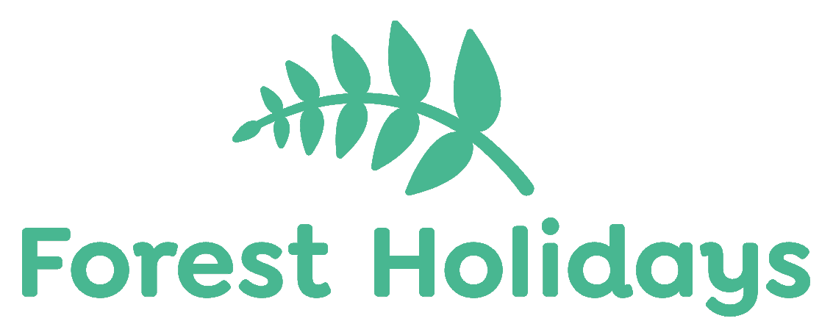


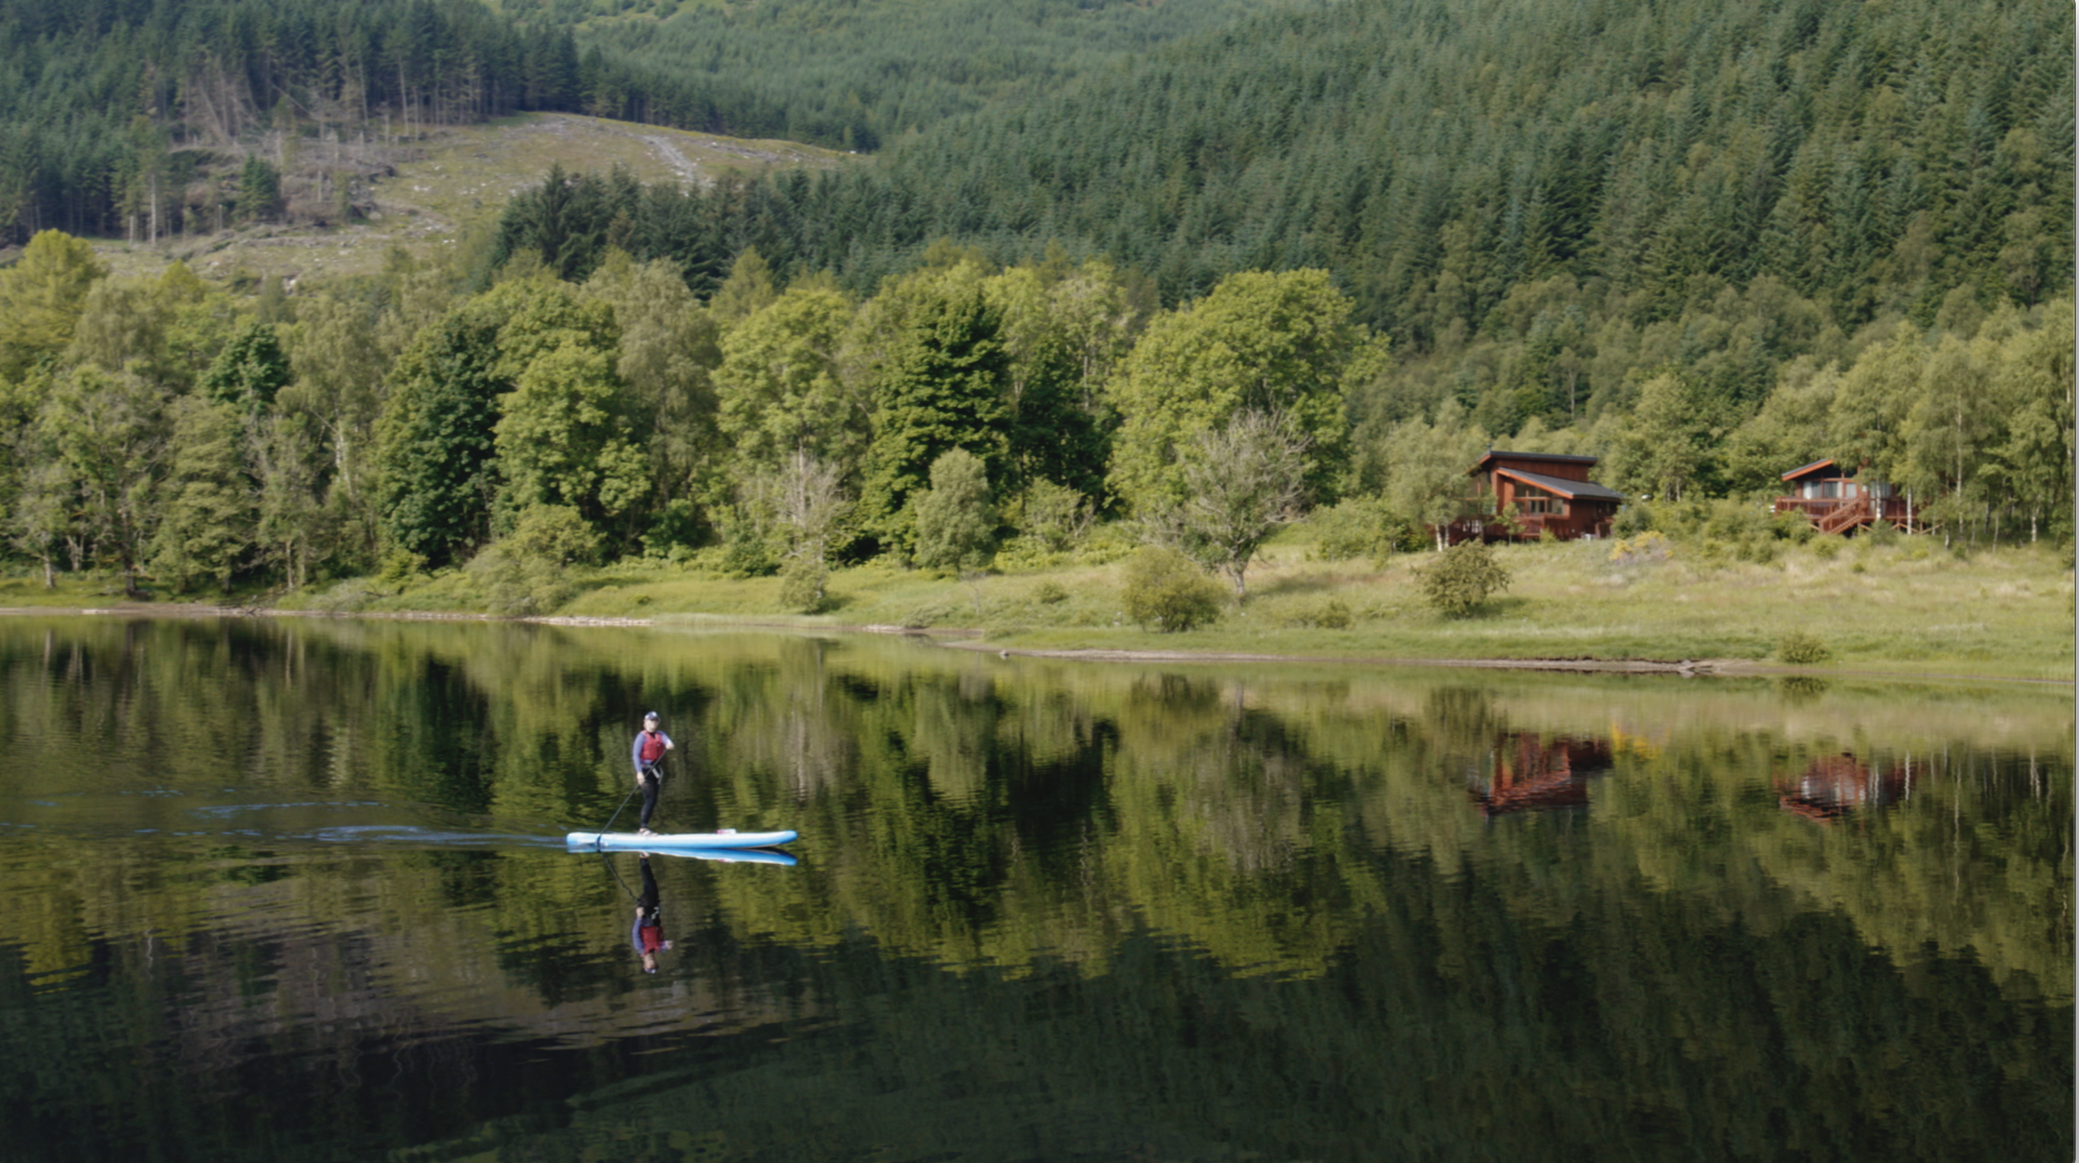
Forest Holidays: quiet persuasion in a noisy holiday market
Challenge
Forest Holidays wanted to show that their locations provide real access to natural forests and an experience of nature that’s very distinctive
Solution
During lockdown, they filmed the beauty of the environment and turned the footage into a compelling TV campaign that quietly proposed the idea of a different kind of holiday in nature
Results
Brand consideration grew by 51%
Visits to website were 66% higher than ever
Achieved an occupancy rate of 99%
Notes:
The Challenge
Forest Holidays was set up in the 1970s as a joint initiative with The Forestry Commission. Over the years, it has built its reputation by word of mouth and direct marketing, but by 2019 had only 4% awareness.
The UK holiday market is highly fragmented and competitive. The market is over supplied and for the wary holidaymaker intent on finding a relaxing, peaceful break there are considerable risks which is why many people are drawn to brands that they know and offer reassurance.
The Covid lockdown of 2020 and a whole season closure might have been a disaster for a small brand like Forest Holidays. Instead, it provided an opportunity to develop a new plan that would see them emerge stronger.
As a result of the lockdowns, the British public were very receptive to the idea of a low environmental impact, non-overseas travel holiday so, as the holiday market reopened, Forest Holidays needed to get their message across to a mass audience. Their key objectives were to drive consideration and build the brand.
The TV Solution
During lockdown, when all 11 sites were empty of people, the team at Forest Holidays filmed their estate including video footage using a 4G drone camera. This captured the beauty and peace of the forest and gave them a treasure chest for communication.
The TV Works proposed an unusual strategy. Use this amazing footage to talk about the benefits of a holiday that’s more peaceful, more natural and which involves no overseas travel (reducing carbon etc). The very quietness of the forest would contrast with the flashy lifestyle holiday campaigns that kick off on Boxing Day television.
The Plan
Working with media partner AMS, the launch was planned for Christmas 2021, with the campaign running into 2022. AMS had no hesitation in recommending TV as the lead medium and identified the key audiences predisposed to premium staycations – cash rich, time poor, decision makers.
The budget was loaded towards peak mainstream TV with a 60/40 split between brand and activation. The remaining budget was deployed on paid search, social media, email marketing and DM.
The campaign began on 26th December 2021, and ran for two months. It was front loaded with peak spots to create salience rapidly and then, as the campaign went on, lower cost airtime was introduced to increase efficiency and improve cost per response.
Results
Prompted awareness among the core audience of ABC1s grew by 42% compared with the category average of +2%
Brand consideration grew by 51% compared to a category decline of -28%
Brand search was up significantly, 93% higher than forecast
Visits to the website were 66% higher than ever measured before
It was the highest ever booking volume in the brand’s history, up 46%
The business achieved an occupancy rate of 99% across its 11 locations
Forest Holidays secured nearly 30,000 new customers in 2022, a 24% uplift year on year

