Slide 1
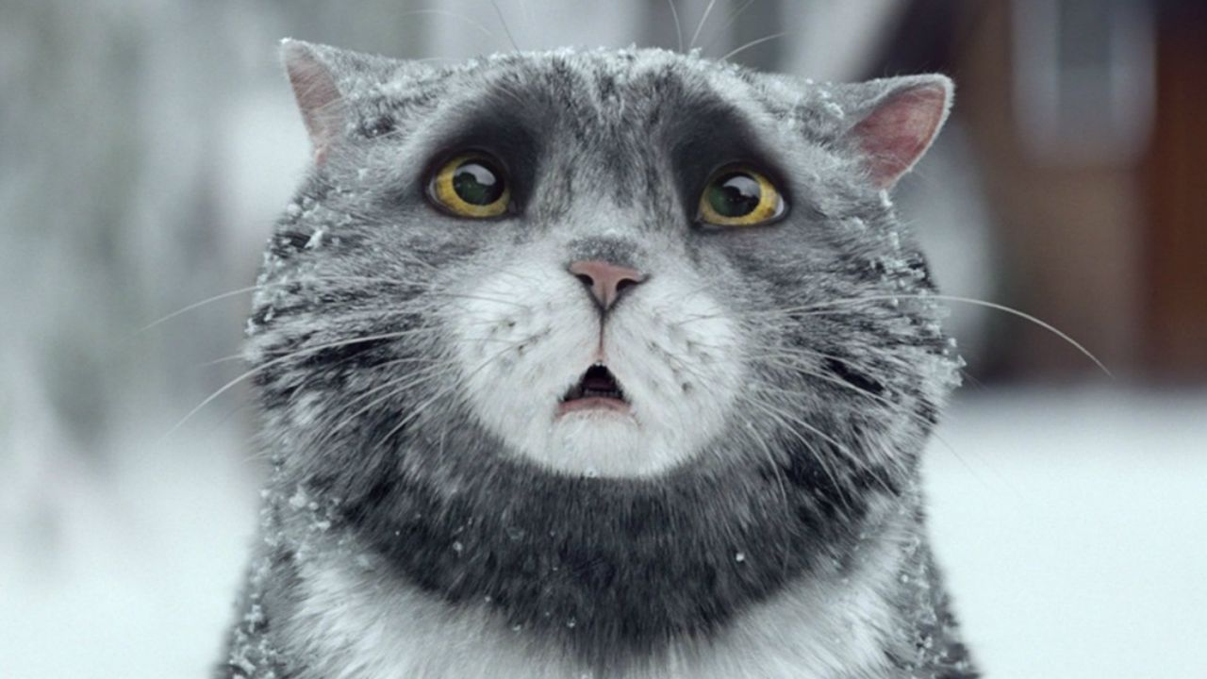
Sainsbury’s brilliant use of TV helped deliver their best Christmas ever
Challenge
Sainsbury’s were facing tough competition, as discount brands began to compete with the “big four”
Solution
Sainsbury’s revived Judith Kerr’s much loved cat, Mog, in a 3½ minute Christmas film
The campaign launched simultaneously on 83 channels at 7:15pm, reaching 84% of people watching commercial TV at that time
Results
Sainsburys market share increased by 1% over the festive period - the only one of the “big four” to do so
Purchase consideration increased by 4.2 points
Christmas week sales rose 2.6% - an additional £36m
Notes:
The Challenge
Towards the end of 2015, Sainsbury’s were facing a challenging time. Grocery retail had seen discount challenger brands competing with the ‘big four’ supermarkets. This was magnified in the run up to Christmas, a period when some weeks see sales 50% higher than a typical week.
For Sainsbury’s, these difficult seasonal trading conditions were made harder by two things: firstly, having the lowest media budget of the major supermarket brands; secondly, to respect its long-standing relationship with the Royal British Legion, Sainsbury’s were launching its Christmas campaign after Armistice Day, up to 10 days later than competitors. It was therefore vital that Sainsbury’s launched with a bang to kick-start both the campaign and weekend trading performance immediately.
The business objectives of the campaign were to increase both purchase consideration and market share while driving talkability amongst families.
The TV Solution
With its seasonal positioning, ‘Christmas is for Sharing’, Sainsbury’s strategic solution was to be grounded in storytelling with an aim to bring families together.
This was done by giving the nation a story to share that would help parents spend more time with their children. In partnership with Harper Collins, Sainsbury’s revived Judith Kerr’s much loved cat, Mog, bringing her back to life for a new generation. A brand new book was created which, alongside a cuddly toy, was available to buy in store or online with all profits going to Save the Children to help support child literacy.
A 3½ minute film, ‘Mog’s Christmas Calamity’, was created to launch the campaign. It was made by the producers of Paddington Bear, with Emma Thompson providing the voiceover and an original score from Oscar-winning composer Rachel Portman.
Sainsbury’s worked with their media agency, PHD, to create maximum impact at launch. PHD knew from past Christmases that Thursday and Friday were critical days because, after the first 48 hours, social buzz and conversation would dip. This meant they had to ensure as many people as possible had seen and were talking about Mog on these two days.
The Plan
Knowing that the first 48 hours were key, PHD needed to maximise reach within this timeframe. The aim was to share Mog’s story with as many people as possible, using TV which would deliver high reach very quickly.
Using IPA Touchpoints, PHD identified a sweet spot at 7pm when families were spending most time together. This meant the launch couldn’t wait until the typical 9pm spot when audience numbers were higher.
To maximise the reach in one evening, Sainsbury’s launched its campaign simultaneously across 83 channels on 12th November at 7.15pm. Over 84% of people watching commercial TV at that time witnessed the unveiling of Mog’s calamitous Christmas. The multi-channel spot reached 11.5m adults in 3½ minutes. This was no easy undertaking with a number of hurdles to overcome, including peak time programmes being re-cut to fit the plan and entirely new ad breaks being scheduled that didn’t already exist.
At the same moment the TV spot launched, the film was synced through native players on Facebook, Twitter, YouTube skippable and VOD. This delivered 8% incremental reach by midnight on launch night. The following day the ad ran again in full during Coronation Street, appeared in a YouTube masthead and the conversation was continued through a promoted Twitter trend. This resulted in 55% adults having seen the ad within those critical 48 hours.
The campaign continued right up to Christmas Eve and saw further high rating spots of the full length ad, as well as higher frequency cut downs. This was supported by VOD, OOH and an interactive Skype masthead which generated UGC - the best of which was edited into a 60” TV ad and broadcast just before Christmas Day.
Results
Mog’s Christmas Calamity sold 450k copies and became the UK’s best-selling book for four weeks in a row – Its first week sales were the highest for a children's book since J K Rowling's Harry Potter spin-off The Tales of Beedle the Bard in 2008.’
The cuddly Mog toy sold out in just one week
Purchase consideration increased by 4.2 points (Source: YouGov)
Sainsbury’s market share increased over the festive period by nearly 1% - the only one of the ‘big four’ grocers to do so, putting it back in second position
Sainsbury’s Christmas sales rose 2.6% in the week leading up to Christmas, which meant an additional £36m compared to 2014
The campaign raised over £1.6m for Save the Children to support child literacy
Highly commended in TV Planning Awards ‘Best use of TV AND…” category
Sainsbury’s chief executive Mike Coupe said he believes their festive campaign featuring Mog the cat was the…
To read the full case study and access the creative visit: https://www.thinkbox.tv/Case-studies/Sainsburys-best-Christmas-ever

