Slide 1
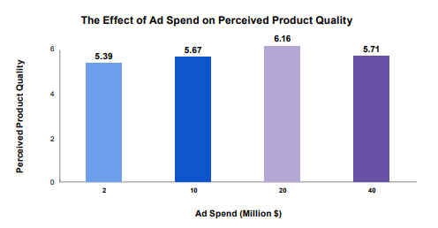
The effect of ad spend on perceived product quality
Those who read that the campaign cost $20m rated the brand 14% higher than those who saw a $2m spend
Source: Adapted from Kirmani & Wright (1989)
Notes:
Interestingly, the scores generally increased with perceived spend. Those who read that the campaign cost $20m rated the brand 14% higher than those who saw a $2m spend. The psychologists argued that the credibility of a communication is in proportion to its perceived expense.
Surely, they said, only marketers who genuinely believe in the quality and long-term success of their product would invest so heavily. This is relevant to media selection as viewers instinctively understand – or at least believe – that TV advertising has higher capital costs than media such as radio or print.

Slide 2
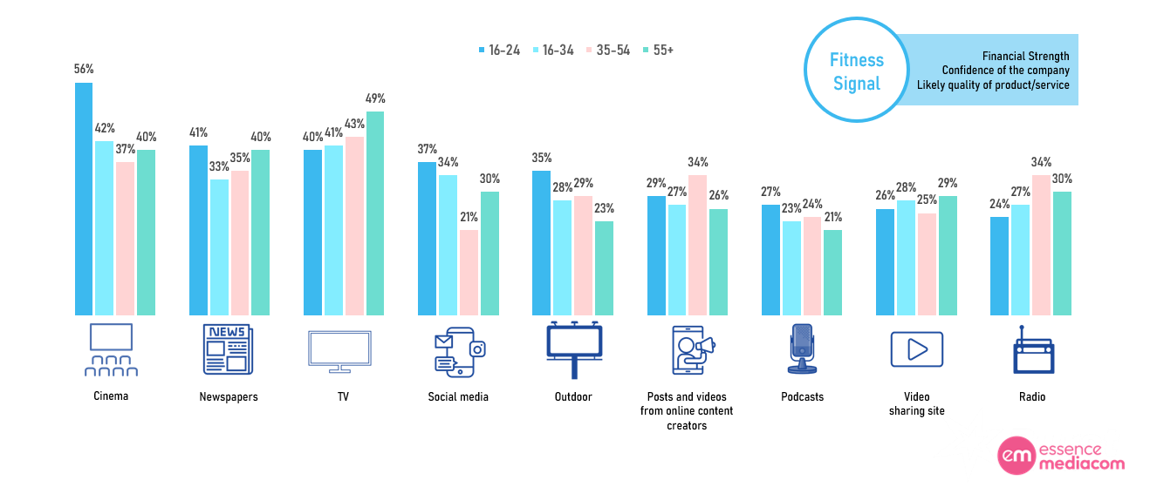
Cinema, news and TV dominate across age groups. Stature matters even to younger audiences
Source: Signalling Success 2, EssenceMediacom/Burst Your Bubble 2023. Base: UK adults (n=2,751)
Notes:
In a 2023 update conducted by EssenceMediacom and Burst Your Bubble, they replicated the study which used a fake brand (TIXE) and a generic description of the service it offered to isolate the effect of the media channel choice on consumer perception of the brand, specifically fitness signals and social signals. Fitness signals are about financial strength, product confidence and quality. Social signals are about fame, popularity, and success. Both are valuable signals but the ability of media to convey those signals varies greatly.
The updated study also featured OOH and cinema (which were excluded in the first iteration due to the pandemic) and featured additional channels such as podcasts, creator-led videos, video sharing sites and social media.
This chart shows that across different age groups, cinema, newspapers, and TV display the strongest fitness signals - the vital, unconscious information that helps consumers mitigate risk and maximise confidence in their brand choices.

