Slide 1
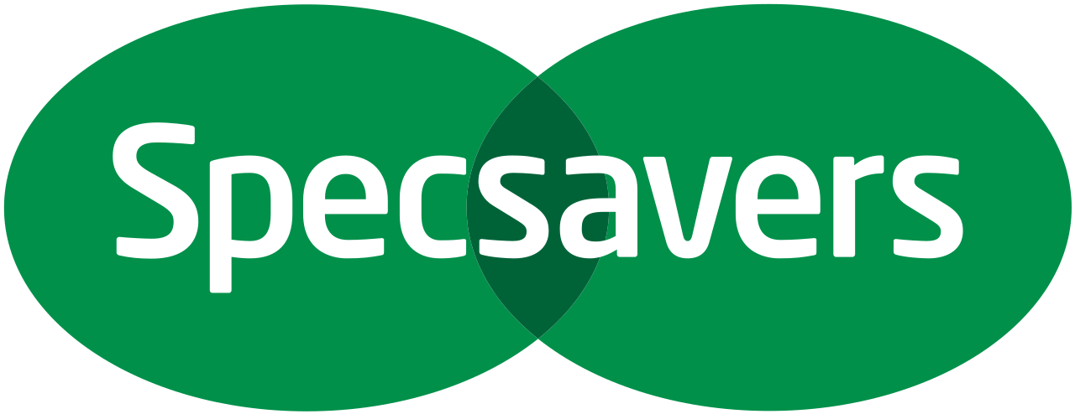
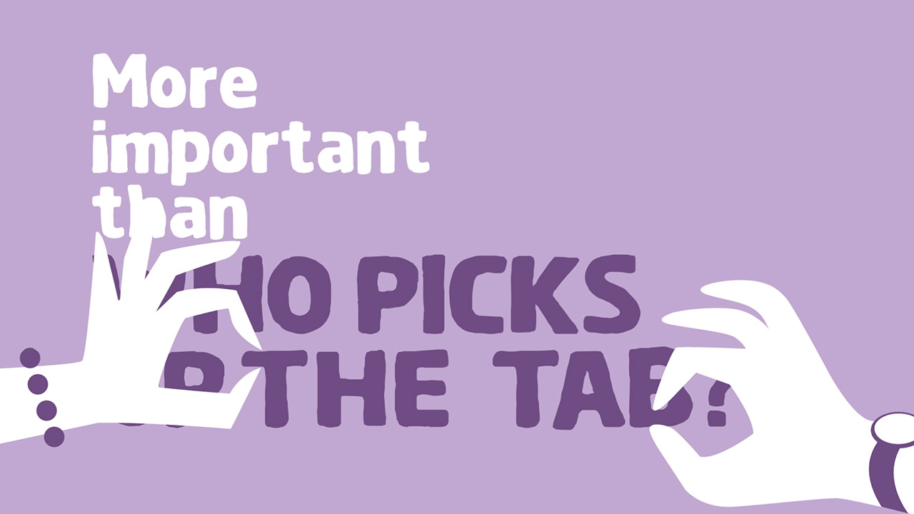
Specsavers’ quest to improve eye health
Challenge
Specsavers mission was to end avoidable sight loss in the UK by raising awareness of eye health and encouraging people to get their eyes tested
Solution
MGOMD planned a contextually relevant campaign, collaborating with Sky and Channel 4 to reference TV content & storylines
Specsavers ran 33 spots across eight days, which allowed them to reach 57% of the UK in high-interest and newsworthy moments
Results
After the campaign, 90% of people agreed that eye tests are an important general health check (source: TNS)
In the period immediately post campaign, Specsavers tested almost 40,000 more eyes than the same period the year before
Notes:
The Challenge
Specsavers have been around for over 30 years and with a track record of innovation in the optics industry, are now leading the drive to transform eye health in the UK.
In 2017, Specsavers’ mission was to end avoidable sight loss in the UK by changing people’s attitudes and behaviour around eye health. The stats show that 14 million people in the UK do not get regular eye tests, even though 250 people start to lose their sight every day. Specsavers set out to prove to eye test avoiders that an eye test is more important than what was distracting them. The challenge was how to get more people to get their eyes checked.
The Solution
Specsavers tasked their media agency Manning Gottlieb OMD to come up with a solution that would convince their target market of eye test avoiders that eye health was important. MGOMD found that their eye test avoiders spend about 4 hours a day watching TV and so this provided the key for communicating with them. They know that they’re interested in big programmes - cultural and sporting events that provide fuel for conversations and they had learnt from previous campaigns that high impact, talkable TV campaigns can change behaviour. Therefore, Specsavers decided to use the behaviour that had made them famous, which was reacting to topical events and becoming part of the conversation, but this time do it for an entire campaign.
MGOMD took the principles of the #Shouldve campaigns and applied them to broadcast TV to create interest, awareness, buzz and ultimately action. They created a new metric with which to plan TV, shifting the emphasis from reach to moments of maximum impact.
Results
Specsavers is a brand built and maintained by advertising. If the advertising stands out, the brand tends to grow. This campaign generated 13% greater ad awareness than their #Shouldve activity in 2017 and 14% more awareness than their 2016 eye health campaign run at the same time of year, on the same level of spend (source: YouGov)
The campaign drove 44% more buzz than their #Shouldve activity in 2017 and 50% more buzz than their 2016 eye health campaign at the same time of year (source: YouGov)
After the campaign, 90% of people agreed that eye tests are an important general health check (source: TNS)
In the period immediately post campaign, Specsavers tested almost 40,000 more eyes than the same period the year before
18% of customers tested in the campaign period were new to Specsavers
To read the full case study and access the creative visit: https://www.thinkbox.tv/Case-studies/Specsavers-quest-to-improve-eye-health

