Slide 1



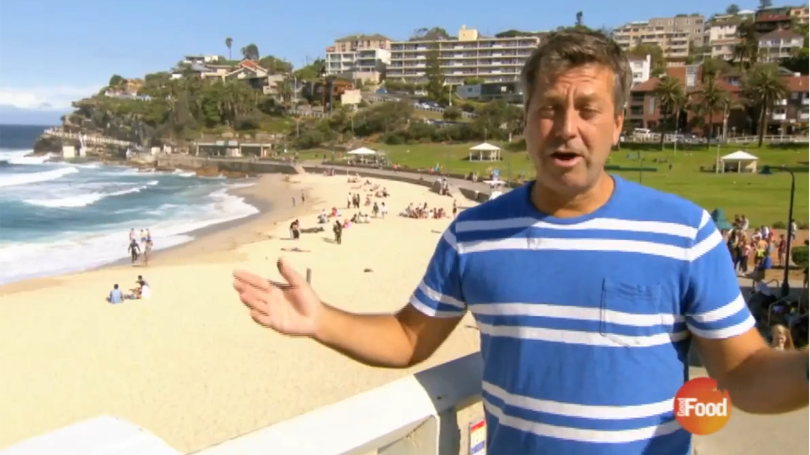
Tourism Australia and Emirates Airline co-fund cookery travel series
Challenge
Tourism Australia and Emirates came together with a single and shared objective – to promote Australia as a preferred travel destination for people who enjoy quality food and wine
Solution
They created a 10 part series with John Torode exploring his passion for cooking in Australia
The series was broadcast on the Good Food Channel and showcased the best of what Australia had to offer
Emirates Airline was product placed within the show
Results
Australia took the lead over USA as the long haul destination of choice amongst viewers
69% of long haul flyers said that the product placement made them want to fly with Emirates
Notes:
Challenge
Tourism Australia, Emirates Airline and the Good Food Channel came together with a single and shared objective – to promote Australia as a preferred travel destination for people who enjoy quality food and wine. Working with their agencies, Drum and OMD UK, it was agreed that an advertiser funded series that promoted the attributes of the country would be the best way forward.
They came up with the perfect person to front the series in John Torode, who is an Australian celebrity chef. He moved to the UK in the 1990s so is well known to UK audiences but was brought up in Australia and has a passion and love for his native country. In addition, as a chef he would be well equipped to explore the culinary scene in Australia.
The challenge was to create a series that demonstrated the benefits of visiting Australia but was compliant with Ofcom regulations. Every element needed to be editorially justified with no undue prominence and no overtly promotional language.
The objectives were as follows:
Inspire viewers to find out more and/or book a holiday to Australia
Encourage viewers to book their flights to Australia with Emirates Airline
Improve perceptions of the quality of Australian food and wine
Showcase the relationship between Australia’s people, produce and place
The Solution
A ten part series was created called John Torode’s Australia – a cookery series and travelogue. Over the 10 episodes, John revisited childhood haunts along with the people that inspired his passion for food and the places that shaped his early memories. He wanted to rediscover everything that is great about Australia, as well as demonstrating the origins and inspiration of some of the country’s best-loved dishes. His priorities were for top home grown produce including amazing coffee, world renowned wines, award-winning seafood and exceptional cuts of meat.
The series was co-funded by Tourism Australia and the Good Food Channel and Emirates Airline was product placed within the show.
The series was broadcast on the Good Food Channel. It started on Monday 3rd March 2014 and ran for two weeks with a show every night. The main showing was at 8pm and each episode was repeated more than once.
The series was supported by a branded microsite that offered information about the programme as well as recipes from the show and an Australian travel guide.
In addition, there was a competition to win a holiday to Australia.
Results
Across the two weeks, the show had 430,000 viewers which is 67% higher than the normal slot average
69% of long haul flyers said that the product placement made them want to fly with Emirates
1 in 5 viewers said that they were likely to go to Australia
Australia takes the lead over USA as a long haul destination choice amongst viewers
Perceptions of Australian food and wine overtook perceptions of USA offerings amongst viewers
To read the full case study and access the creative visit: https://www.thinkbox.tv/Case-studies/Tourism-Australia

