Slide 1

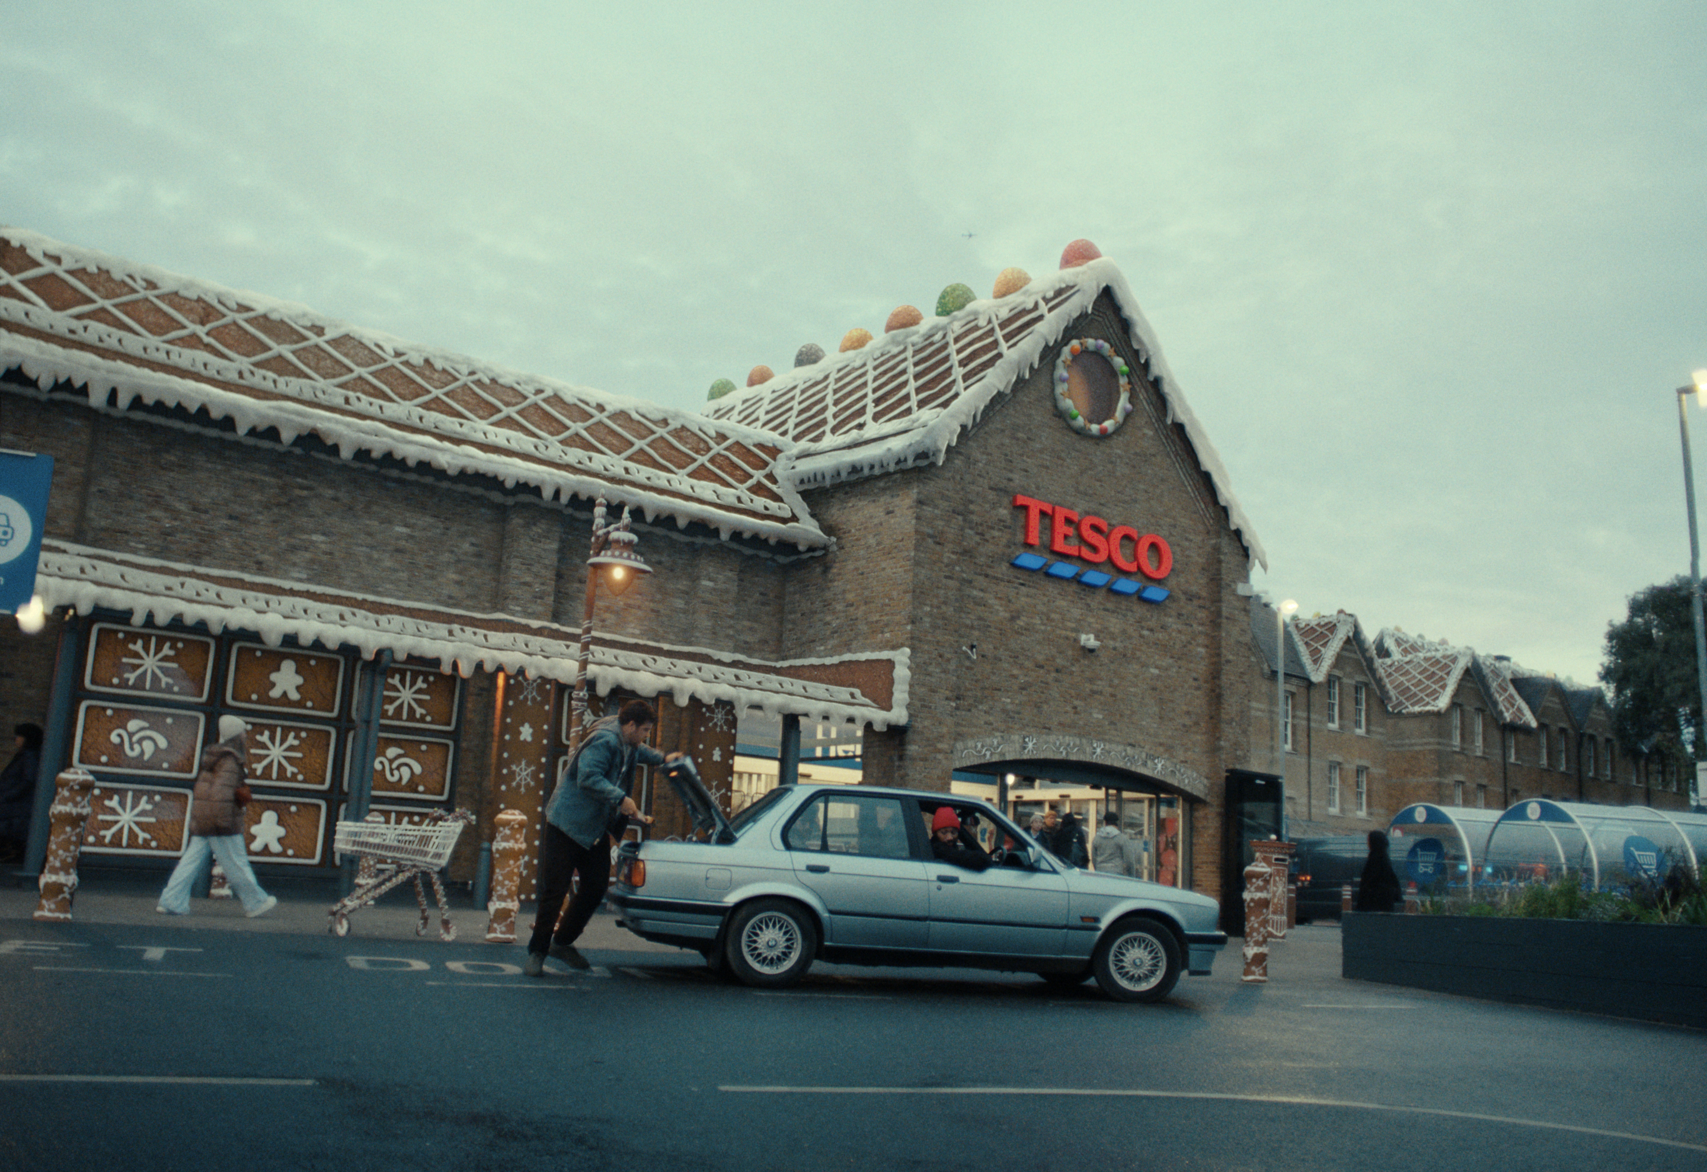
Tesco: Winning Hearts and Baskets at Christmas time
The Challenge:
Christmas is a key battle ground in the supermarket fight for supremacy. Tesco needed to drive emotional engagement and increase the frequency of shops throughout the 8 weeks leading up to the big day.
The Solution:
Using TV emotional power to keep Tesco top of mind and cut through with those who aren’t feeling the Christmas spirit through focused launch activity and a smart TV partnership.
The Results:
Delivered increase in perceptions that ‘Tesco helps you feel Christmassy’ increase in positive sentiment and peaked word of mouth. Increase in sales to the products featured in the creatives and it contributed to their biggest ever Christmas and the highest market share since 2016.
Notes:
The Challenge
Christmas is the key battle ground for supermarkets in their fight for market supremacy. The campaigns have their own core messaging, separate from those running the rest of the year. In 2024, Tesco faced two challenges in the lead up to the big day. Firstly, they needed to drive emotional engagement with the campaign. And secondly, they needed to increase the frequency of shops throughout the 8 weeks leading up to Christmas rather than just the focus of the day itself.
The TV Solution
With clear objectives in mind, EssenceMediacom got to work in understanding the problem at hand. Having broken the challenge down into a two- pronged approach. Firstly, Tesco needed to drive emotional engagement. The insight behind the campaign creative was that people’s festive spirit fluctuates across the Christmas period. Traditional Christmas advertising has you believing that when the Christmas spirit hits, you feel it all the way to the big day. That is not how it happens in reality. To combat this, EssenceMediacom undertook some observational work that monitored people’s ‘Christmas temperature’ through the festive period. The major finding that came out of the work was the importance of certain sights, sounds and smells that trigger our Christmas spirit, with Gingerbread being the food that did the heaviest of lifting. This saw an idea created which heavily featured the festive staple. The creative was heavy on the emotion and there was only one channel that would deliver the emotional cut through and win the hearts of the nation, and that was TV.
The second prong was focused on increasing the frequency of shops in the lead up to the big day. Analysis of first party Clubcard data and past product purchasing behaviour saw two key segments identified. They were ‘Restockers’, main shoppers who restocked on the essentials across the festive period and ‘Convenience’, those who were looking for easier options to celebrate Christmas. Winning over these segments would mean success for Tesco.
The Plan
With a clear strategy in place, EssenceMediacom got to work in putting the plan into action. To launch the activity, EssenceMediacom and Tesco needed to lead with impact and scale. The campaign was launched with a bespoke, co-branded ident that introduced the brand and transformed ITV IP into a gingerbread version, visually bring the world of Tesco Christmas into the real world. The film premiered in the first break of The Martin Lewis Money Show on ITV delivering 1.5 million houseperson. This was coupled with a spot in the Great British Bake Off on Channel 4 reaching a further 2 million housepersons. Rather than focus heavily on the launch day activity, EssenceMediacom took a ‘launch week’ approach. This saw them deploying a range of second lengths from the hero creative across key programmeming to reach as many people as possible. This launch activity was extended into BVOD environments to ensure the creative and campaign was truly unmissable. Reach extending placements across ITVX surge, Channel 4 Streaming’s surge boost and Sky surge were all deployed. Along with integration of YouTube and social formats that would increase creative awareness.
Once the campaign messaging had bedded in, Tesco and EssenceMediacom moved onto the next challenge, sustaining the impact with engaging media activations. To drive buzz and extend the hero of the creative, gingerbread, further; EssenceMediacom introduced a cross-channel partnership with Sky and ITV. This partnership saw Tesco’s gingerbread infiltrate iconic programming like I’m a Celeb, The Chase and Sky Sports News, and transform the show sets into gingerbread. These aired within the shows breaks themselves blurring the lines between content and commercial airtime, dialling up the relevance. This partnership was flighted from 23rd November to 22nd December to maximise the contextual opportunities. This activity delivered 557 houseperson ratings. VOD was added to this to add incremental reach through genre and programming buys designed to increase relevancy and stand out. This content from the partnership was also shared across social with the talent involved posting and then was complimented with activations across other channels. This included a front page wrap with the Metro that was scented like gingerbread, CGI social content turned iconic Tesco stores into gingerbread and PR stunts with real world objects appearing as gingerbread.
Having emotional engaged the nation, EssenceMediacom still needed to deliver with the objective of higher frequency of shops. Competitor strategy, flighting and purchase behaviour all helped to determine the campaign flighting and weekly ratings. Increasing Tesco’s SOV during the key trading period would be key to winning the festive season. This saw EssenceMediacom upweighting second lengths, to maximise spend in key trading periods and successfully increase share of voice. The plan was crafted to ensure that reach across all AV environments, not just linear, were optimised vs effectiveness. This identified Convenience Shoppers as being the harder audience to reach on linear so key programmeming was identified using Barb data. This saw Tesco show up with product lead creatives, hand selected to convince shoppers to shop with Tesco. To help with phasing the campaign, EssenceMediacom created a seasonal purchase index from Clubcard data. This allowed them to highlight when certain products were most likely to be bought and capitalise on demand.
Results
The two-pronged approach was a massive success for Tesco. With the approach laid down by EssenceMediacom, Tesco were able to deliver against their objectives of winning hearts and baskets. With regard to driving emotional engagement; the campaign smashed targets showing uplifts in perceptions that ‘Tesco helps you feel Christmassy’. The partnership drove double digit YOY growth in positive Tesco social sentiment. And YouGov word of mouth scores peaked in November, providing the highest scores of any supermarket over the festive period.
In regard to winning shopping baskets, Tesco again smashed their targets. A sales uplift study showed that the products featured in creatives for the Convenience shoppers were up as well as with the Restockers audience. Overall food sales were up both in store and online. All contributing to Tesco’s biggest ever Christmas and highest market share since 2016.
Client quote
‘Tesco Christmas 2024 campaign was a triumph, delivering our best-ever festive performance and cementing Tesco as the nation’s Christmas supermarket. The single-minded focus on gingerbread, clever integrations in iconic shows and application of Clubcard data made this campaign unmissable.

