Slide 1


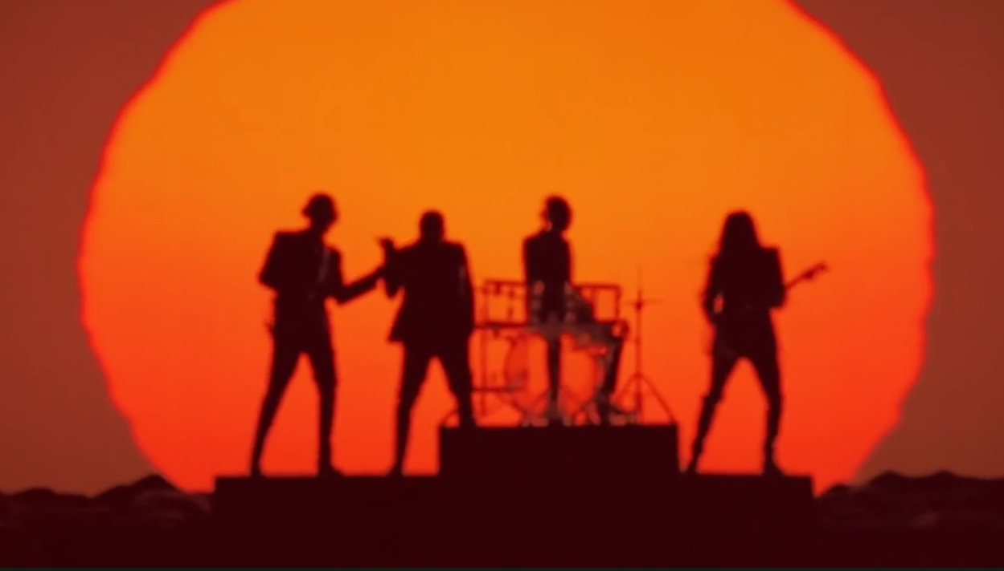
Columbia Records: ‘Random Access Memories’
Challenge
Columbia Records wanted to generate excitement surrounding Daft Punks latest album and drive sales.
Solution
Initial 10” mysterious creative to drive online speculation that was later followed up with a 60” trailer showcasing the album.
Final 100” ad takeover on C4 the night before the album was realeased
Results
The album sold over 165,000 units in week one.
Highest opening week since Amy Winehouse’s posthumous album in 2011.
It was the top selling album of the year.
Notes:
The Challenge
Daft Punk hadn’t released an album for 6 years and were but a distant memory for many fans. So the launch of their new album, ‘Random Access Memories’, by Columbia Records, needed to be impactful and to generate a significant enough buzz to get the band back on people’s radar. To make the challenge even more difficult, there wasn’t a huge budget to play with and as always with album releases, a limited window of opportunity to generate the necessary interest. They needed ideas that were smart yet cost effective.
The Solution:
Columbia Records’ media agency the7stars knew that, in order to generate hype and anticipation about the album on a limited budget, they needed to create a campaign that was great enough for it to go viral. They decided to create a strategy where the swell of communications was positive fan hearsay. Findings showed that music fans love being the first to discover and share exclusive content. They thought the best approach was to create great offline experiences and then leave it for the fans to speculate about them online. By generating enough intrigue amongst music fans, they would become free marketers for the band.
They knew that viral campaigns need time to build up before they tip into the mainstream so they started the campaign 10 weeks from launch date. The first thing they did was to air a mysterious 10 second ad. There was some music from the album featured but the ad had no release date and no web address or hashtag. This ad was aired in a roadblock on 7 key channels: Channel 4, E4, Film 4, More 4, 4 Music, Dave and Watch. It caused a flurry of speculation as music fans tried to find out more about the album launch. There was lots of online activity as a result of the ad airing that included blogging, tweeting and posting videos of the ad across the web.
Then, on the night before the pre-order release date, they ran another TV roadblock on 10 key channels – utilising the same channels as before plus other relevant ones such as Sky Atlantic and SyFy. This strategy enabled them to achieve reach which was as large as possible whilst also ensuring the ad appeared only in carefully chosen, highly targeted spots – preserving the mystique surrounding the release but ensuring the message was delivered to as many people as possible.
There was further TV activity with a 60 second trailer for the album. This ran in premium TV spots such as Game of Thrones and The Big Bang Theory.
The final ad was broadcast the night before the album was released and showed the unboxing of the album by Daft Punk. It was 100 seconds long and took over the entire break in the TV premiere of Social Network on Channel 4. This was the longest ever music ad on UK television.
The TV activity was supported by outdoor and cinema advertising. In addition, there was a product placement deal struck with the Lotus Formula 1 team at Monaco.
Results
The album sold over 165,000 units in week one - the highest opening week since Amy Winehouse’s posthumous album in 2011 and also the highest week one sales of any album outside the Christmas period
The album raced to number one, giving Daft Punk their first ever no. 1 album
52,000 albums were pre-ordered
“Get Lucky” (a track on the album) became the most streamed song on Spotify
To read the full case study and access the creative visit: https://www.thinkbox.tv/Case-studies/Columbia-Records

