Slide 1


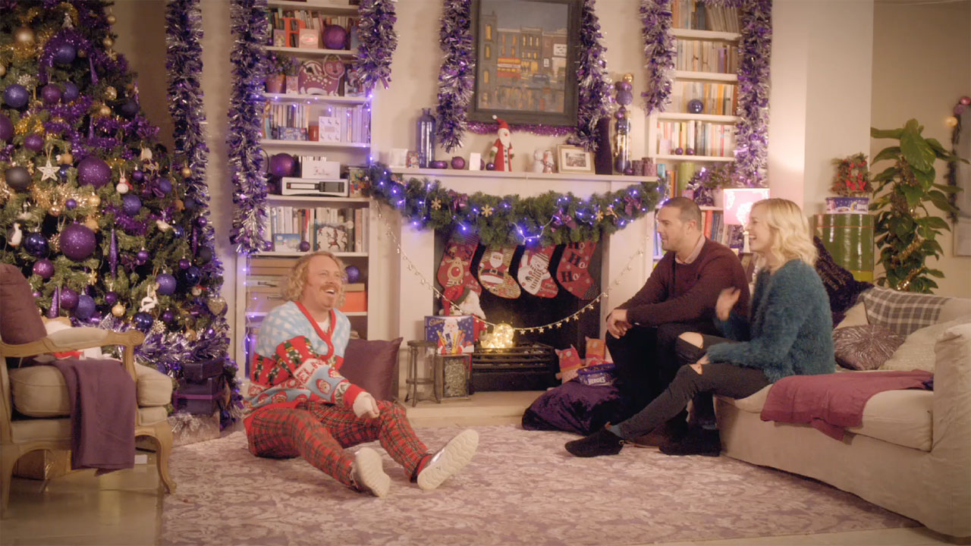
Cadbury’s Joyful Christmas
Challenge
Cadbury wanted to improve cut-through, increase purchase intent and to promote the idea that ‘Cadbury makes Christmas more joyful’
Solution
They partnered with ITV, using their talent to portray moments of traditional Christmas fun
These five films, which ran in premium breaks, were supported by sponsorship of ITV’s Christmas Specials
Results
Cadbury saw a 5.8% increase in sales driven by their Christmas range.
Purchase intent moved from 57% to 78%
Notes:
The Challenge
Cadbury’s market share at Christmas was under threat from increasing competition and the company’s limited development of new products during 2014.
With Cadbury’s traditional Christmas portfolio losing ground to competitors, there was a desire to redefine emotive advertising at Christmas for Cadbury and to deliver a greater share of top of mind availability.
The key objectives were to improve cut-through, increase purchase intent and to promote the idea that ‘Cadbury makes Christmas more joyful’.
The TV Solution
In order to drive this mental availability and emotional connection, the feeling of ‘joy’ was placed at the core of the campaign.
Due to its crucial combination of reach and emotional involvement, TV was deemed the ideal medium to communicate the association with ‘joy’ over Christmas time and help Cadbury deliver against their objectives.
PHD, Cadbury’s media agency at the time, felt that in order to meet the marketing challenge, they needed to create a campaign that was memorable, bespoke to Cadbury and highly engaging.
A collaborative partnership with ITV was chosen. This involved co-created, co-branded films starring ITV’s most famous TV personalities. The association was further bolstered by Cadbury sponsoring ITV’s Christmas Specials programming strand.
This TV solution would drive salience and brand preference as well as producing creative AV content that would get viewers talking. Cadbury wanted to make people laugh and also maximise their ability to differentiate and emotionally engage with consumers.
The Plan
The campaign wanted to focus on the universally relatable moments of Christmas joy that are familiar to family audiences. British households all share similar rituals and experiences during Christmas time and Cadbury’s agency Drum were inspired to replicate these Christmas celebrations in the creative. The enjoyment of festive chocolates is one of many such rituals shared by British families and was placed at the heart of the content tapping into these shared family moments.
ITV were chosen as a partner because Cadbury felt confident they could deliver their family target audience at scale. In the mini films, they used ITV talent who are household names including Fearne Cotton, Keith Lemon, Phillip Schofield, Stephen Mulhern, Paddy McGuinness and Christine Bleakley.
Five, largely improvised, short films revealed the celebrities enjoying festive stalwarts such as Charades and Secret Santa and showing off their best (and worst!) talents. The ‘Unwrap Joy’ campaign aired throughout November and December.
The films ran in premium breaks on broadcast TV and VoD, first or last in break and co-branded to maximise editorial integration with the channel. The films culminated in a Christmas Day celebration film which went out in the Christmas special of Downton Abbey on 25th December.
To support this campaign, Cadbury sponsored ITV’s Christmas Specials strand. This meant that Cadbury were able to showcase different products, whilst also visually linking to the films to ensure the two parts of the campaign supported each other. The sponsorship ran from 14thDecember until 4th January and Cadbury also received branding on the promotional trails for these shows.
To support the partnership, there was PR activity that featured behind the scenes footage and a poll about Britain’s funniest game. There was also social media with bespoke content.
Results
The reach across both parts of the campaign was over 85%
Cadbury saw a sales growth of +5.8% in the last 4 weeks of 2014 and gained a +0.2pp value share, driven by their Traditional Christmas range
Cut-through increased by 12% YoY
The content was successful in communicating the key campaign message: “Cadbury makes Christmas even more joyful”, meeting the target set and exceeding prompted message take out by 21% YoY
Purchase intent moved from 57% pre research to 78% post research, increasing to 87% for viewers exposed to both the sponsorship and the films
Spontaneous awareness of the sponsorship rose from 10% to 39%, rising to 62% for those who had seen both the ads and the sponsorship. With spontaneous awareness being a key test of mental availability, Cadburys achieved their communications objective
Shortlisted at the TV Planning Awards in the category ‘Best Use of Sponsorship or Content’
To read the full case study and access the creative visit: https://www.thinkbox.tv/Case-studies/Cadbury

