Slide 1
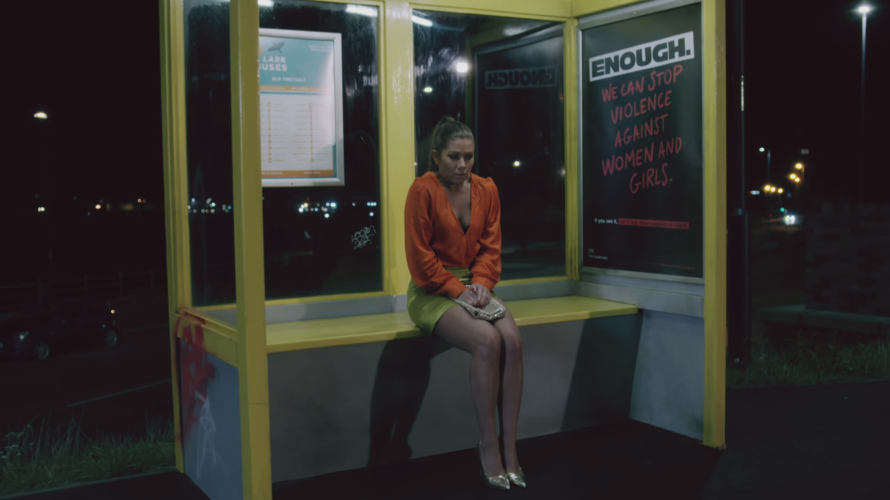
Home Office: partnership shows that VAWG behaviours are being challenged.
The Challenge:
With Violence Against Women and Girls endemic in the UK, the Home Office wanted to increase awareness and challenge perpetrator behaviour.
The Solution:
A two-pronged campaign with a broad audience targeted on linear and BVOD as well as a partnership with Channel 4 and Hollyoaks for a special episode ‘Long Walk Home’.
The Results:
Campaign evaluation showed that it effectively shifted audience attitudes and behaviours. This included prompting men with more problematic views to reconsider past actions.
Notes:
The Challenge
Violence Against Women and Girls (VAWG) is endemic in the UK with a huge 75% of women having experienced violence and harassment and 80% of girls saying sexual assault is commonplace.
The scale of the issue meant that society has become desensitised to it. Bystanders intervene in fewer than 10% of incidents; just one third of women report harassment to the police; and around 40% of young men struggle to identify some types of sexual harassment.
The Home Office created a campaign to empower society to challenge VAWG, and tasked media agency, MGOMD with crafting a media approach that would raise awareness of VAWG, encourage conversation and challenge perpetrator behaviour.
The TV Solution
With the clear goals of enabling conversations about VAWG behaviour, MGOMD got to work in understanding the challenge at hand. Research highlighted that just telling people about VAWG wouldn’t be enough. The campaign also needed to tackle men’s deep-rooted belief that VAWG is a woman’s issue and their lack of understanding of the impact of VAWG on women. With these insights from behavioural science, MGOMD needed a campaign that would generate mass awareness to engage ‘bystanders’ with multiple opportunities to see the campaign.
It was clear to MGOMD that the only channel which could ensured these objectives were met, that was TV. No other channel would build scale as quickly as AV, with TV reaching 93% of all individuals in a week. With the campaign needing to drive conversation, TV was also the perfect channel, with shared viewing accounting for 85% of TV viewing.
The Plan
With AV forming the backbone of the campaign, MGOMD knew that getting people talking off the back of the campaign would be difficult against a backdrop of a reduced budget and a winter World Cup disrupting programming patterns. Targeting a board audience with a focus on men 18-39, MGOMD planned the campaign with a frequency of 2, which, based on agency planning tools, would prime viewers and complement the wider campaign channels.
With the campaign needing to reach peak awareness by the start of the World Cup, VAWG kicked off the campaign on the 25th October. MGOMD had to be smart with the planning of the campaign to ensure they were able to reach this goal. With a focus on co-viewing moments, MG were able to leverage Barb data that showed that ITV was the perfect channel for delivering this goal with shows like the Martin Lewis Money Show and weekend entertainment like Ninja Warrior and The Voice being the key to achieving the fast reach. Building on the co-viewing moments, VAWG then sought out appointment to view programming that would promote water cooler conversations with spots in the likes of Bake Off, I’m a Celeb and Premier League football (key for reaching the younger male audience). To combat the shifting viewing habits of the younger audience, MGOMD took the campaign to BVOD. Using an in -house planning tool, Multi-Screen Optimiser, MG were able to establish the optimal budget splits, at 24% into BVOD, to ensure that lighter viewers were captured across these environments.
MGOMD also focused attention into sport programming. It would allow the campaign to tap into moments when men are together in appointment to view programming while also capturing lighter viewers. It also provided a perfect contextual fit as research showed an uptick in harassment that comes with live football. The same research also showed that sporting content, either live sports or documentaries indexed highly for men with more ‘problematic views’. Buying into programming like Italia 90: When Football Changed Forever and programming on Eurosport and ITV4 allowed the VAWG campaign to infiltrate these environments and get the conversation going. With the cost of linear access to football being out of reach, MGOMD took the campaign to BVOD firstly with spots on Amazon Prime’s coverage of Premier League Football and then a simulcast cast package of World Cup Football on ITVX. MGOMD were also able to secure a presence within university bars with a Sub TV buy, which even included spots in matches broadcast on BBC, a non-commercial station.
Having ignited the conversation with broad targeting on linear and BVOD,. MGOMD turned their attention to educating a younger audience. To do this, MGOMD searched for a partnership that would allow them to authentically showcase what VAWG behaviour’s look like. A soap opera was seen as the perfect environment for this story to be told. Partnering with Channel 4, Lime Pictures and Hollyoaks would allow the VAWG campaign to do just that. Working closely with Channel 4, MGOMD were able to integrate the messaging of the campaign into a special episode of the show called ‘Long Walk Home’. The episode would follow beloved character, Maxine, as she navigates her journey home from a night out. It showed her thinking though all the decisions that some women are forced to make on journeys home, like avoiding a park or getting a bus rather than a cab – however in this storyline, despite making all the ‘right’ choices, Maxine is still harassed and attacked. It’s juxtaposed the journey of male character, Romeo, as he makes the same journey home without needing to make the same decisions as Maxine. The next episode explored the themes of male allyship and intervention, encouraging those who witness these problematic behaviours to call them out. The campaign was visually integrated into the show with outdoor posters in Hollyoaks Village for a month and seeded out powerful content across social media channels of the cast themselves. Channel 4’s home page featured support information from the Home Office on support services, reporting violence and guidelines for those worried about their behaviour.
With partnerships being shown in research to increase campaign talkability by 10%, and Channel 4 research showing that contextual placements drive positive brand metrics,; MGOMD started a second strand of AV airtime in the week leading up to the start of the World Cup. These included: spots in Hollyoaks the day before and the day after the special episode, sponsorted social posts by the Hollyoaks casts, a linear spot in ‘I’m a Celeb’ (which was featuring Owen Warner, the actor who plays Romeo) and a contextual linear spot in the Handmaid’s Tale, the perfect environment for the campaign to be showcased given it’s subject matter. Along with this, the episode was picked up on Gogglebox with the contributors talking about the episode and storyline and an interview on Lorraine that further drive conversation about the campaign.
Results
The campaign was extremely impactful in driving conversations about the topic of VAWG. From a media point of view, the campaign over delivered if with +25 TVRs and 6% more reach than planned for the activity. Across BVOD the campaign also delivered 1 million more impressions than was planned. Taking the campaign to Out of Home TV screens like those in Student Unions also proved to be successful, with the activity over delivering by 5% vs the plan.
The choice of TV to target the younger male audience in the right environments also proved to be extremely powerful. The TV ads helped increase and encourage intervention while also showing uplifts in self-reflection on personal behaviours and agreement that the behaviours shown in the campaign are a form of abuse. Finally, the AV partnership with Channel 4 and Hollyoaks ignited social conversations with spikes in the hashtag #Enough after each element of the partnership went live.

