Slide 1


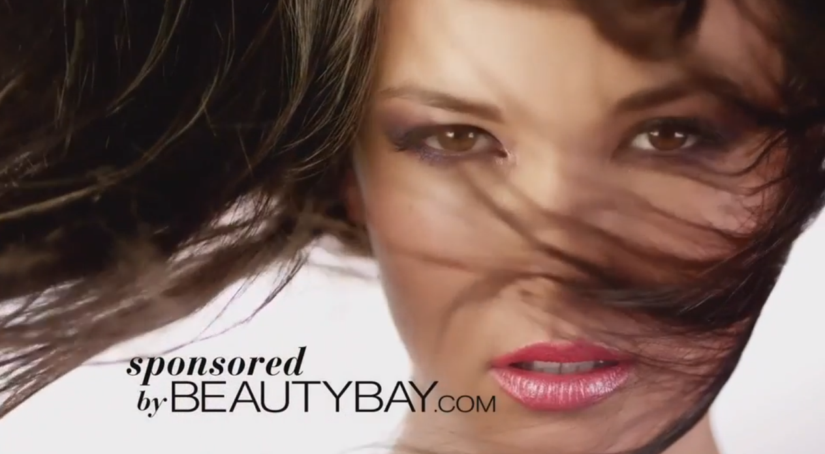
BeautyBay.com teamed up with Girls Aloud to deliver great results
Challenge
BeautyBay.com wanted to improve brand loyalty and trust as well as generating new interest amongst 16-34 women
Solution
They sponsored the Girls Aloud Christmas Special on ITV1 as well as the Shazam mobile stream running alongside the programme
BeautyBay was integrated into the Shazam dual screen experience, which enabled viewers to gain exclusive access to content at 3 points during the programme.
Results
Website visits were up 235% week on week.
Sales increased by 48% year on year.
60% interacted through the Shazam Tag.
Notes:
The Challenge
BeautyBay.com is an online luxury beauty and cosmetics retailer that has been growing steadily since its launch 15 years ago. However, they had reached a point where brand recognition and trust needed reinforcing to further combat potential customers hesitance to buy from online stores they had not previously heard of – a common challenge for lots of ecommerce retailers in today’s market.
BeautyBay.com had a healthy customer base and lots of satisfied customers but was looking for a way to reach a wider audience that would not already be aware of them in the luxury beauty market. Mainly, those consumers that remain loyal to high street brands they have grown to trust and are reluctant to buy online.
With other retailers within the beauty retail market being increasingly active on TV and so improving their own trust and recall measures, BeautyBay.com wanted to respond with their own strategic activity. It was important to improve trust metrics in order to increase the site’s desirability to both potential customers and suppliers.
The challenge therefore was to develop something big and bold. They wanted to gain market share, encourage better dialogue with cosmetics companies as well as grow the brand so that it became as big as and more trusted than other competitor brands. As Christmas was approaching, a campaign that delivered on these objectives in time to impact on seasonal gift sales would be of massive value.
They needed an environment that would capture the hearts of 16 to 34 year old women and encourage them to engage, explore and talk about the brand. They wanted to establish credibility, drive fame and show people that BeautyBay is an exciting and fashionable place to go to for cosmetics. And, they needed to do all this on an efficient limited budget.
The Solution
Beautybay.com worked with their agency Mediacom to find a solution that would achieve all their objectives. They knew they needed TV, as it is the best medium for generating trust and, in Mediacom’s experience, often the best way to harness the power of TV on a limited budget was through sponsorship. Mediacom identified the Girls Aloud Christmas Special on ITV1 as providing the perfect combination of the right content, audience and timing. This was a one off programme celebrating 10 years of the popular girl band.
The programme aired at peak time on a Saturday night in mid-December, timed to engage with a make-up savvy audience in the vital run up to Christmas. The environment was perfect as, despite 10 years in the business, each band member still looks gorgeous with Cheryl Cole having a particularly high profile and an existing relationship with L’Oreal.
Mediacom worked to create a commercially innovative partnership that would reward fans of the group as well as stimulate interaction with the BeautyBay brand. So the deal didn’t just include sponsorship of the programme itself; they also sponsored the Shazam mobile stream running alongside the programme.
The Shazam mobile stream enabled viewers to gain exclusive access at 3 points during the programme to:
access never-before-seen footage of the girls
buy the special edition Ten Album
win a chance to meet the band at a secret gig
redeem a 15% discount voucher on all BeautyBay.com products
share the Girls Aloud and BeautyBay.com content via social media
BeautyBay was integrated into the Shazam dual screen experience through eye-catching branding, giving them the opportunity to engage consumers, encouraging them to explore their product range and even to make immediate purchases using the unique discount code.
All these elements combined to allow BeautyBay to extend the reach and depth of its campaign, creating an innovative and interactive consumer experience and giving the brand a clear association as a pioneering and bold business.
Results
Website visits were up 235% week on week
Sales increased by 48% year on year
10% redeemed the voucher
60% interacted through the Shazam Tag (of which over half was to watch more content)
20% of all sales were derived via the Shazam tag
The programme achieved a 20% share at its peak amongst 16 to 34 year old women
To read the full case study and access the creative visit: https://www.thinkbox.tv/Case-studies/Beauty-Bay

