Slide 1
30-second TV ads consistently account for half of all impacts
Source: Barb, 2015-2025, Individuals, Proportion of Impacts (R/W) by ad duration
Notes:
30-second TV ads consistently account for half of all impacts
Our latest Chart of the Month shows how the 30-second spot continues to be the most popular time length in UK ad breaks.
The main shift since 2015 has been less use of 40 to 50-second ads on TV. The prevalence of shorter time lengths (20-second, 10-second and under) and 60-second ads has remained stable, while there has been a small increase in the use of 60-second+ ads.
For more insights on time lengths in TV advertising – the pros and cons of different ad lengths, their storytelling ability – you could do worse than go here where we go into the topic in more depth https://www.thinkbox.tv/research/thinkbox-research/a-matter-of-time-the-importance-of-time-length-in-tv-advertising/

Slide 2
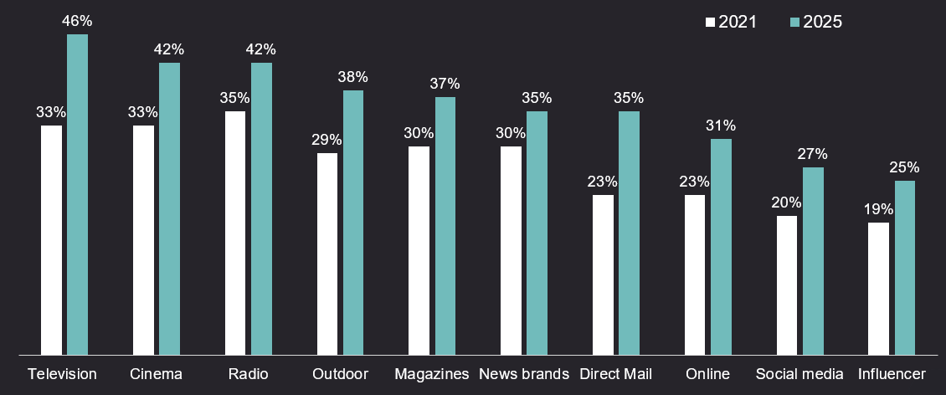
TV advertising is the most trusted medium
Source: Credos Trust Tracker (Advertising Association).
Q. To what extent, if at all, do you trust each of the following types of advertising in relation to products and services? (very trusting / fairly trusting), Kantar, 2025, n= 2,534
Notes:
One factor is becoming a clear differentiator in advertising: trust. As uncertainty grows and consumer confidence declines, it’s playing an increasingly critical role in shaping brand preference and driving profitability.
This month’s chart of the month highlights data presented at LEAD 2026 from the 2025 Credos Trust Tracker revealing a key trend: trust in advertising has increased across every media channel since 2021.
One channel stands out. TV is the most trusted advertising environment. Between 2021–2025, trust in TV grew faster than any other medium, reaching 46%, outperforming online ads (31%), social media (27%) and Influencer content (25%).
To dive deeper into why trust matters for brands and why TV continues to lead, read more here: https://www.thinkbox.tv/why-tv/unrivalled-trust

Slide 3
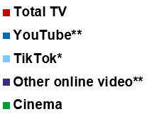
Total TV is fundamental for getting ads seen
12%
14%
48%
Individuals
Ad time per day:
16:38
16-34s
Ad time per day:
8:58
85%
33%
Source: 2025, Barb / Broadcaster stream data / UK Cinema Association / Ipsos Iris
**YouTube ad time modelled at 3.33% of content time (Enders Analysis, 23rd October 2024) and excludes those estimated to be on the YouTube Premium tier. *TikTok ad time modelled at 3.4% of content time using agency and broadcaster estimates. **Other online modelled at 3.33% of content time.
Notes:
The time people spend watching different video content is useful to know. But the most important analysis for advertisers is the time spent watching the advertising.
In 2025, total video advertising time in the UK reached nearly 17 minutes per person. Total TV (incl. Linear, BVOD, SVOD) accounted for 85% of this.
For younger audiences TV was still just under half of their total AV ad time.
Video sharing platform YouTube came a distant second with 12% of all AV ad viewing. Amongst 16-34s, this grows to 33%.
TikTok and other online video are minor players in the video advertising space. In fact, 16-34s spend more time with TV advertising than YouTube and TikTok's advertising combined.
This chart shows all the data. Total TV remains by far the primary means of getting AV advertising seen, whether you're 16, 36, or 56.
For more insights into 2025 viewing, watch "TV Now and Next".

Slide 4
We feel most relaxed when watching TV
Source: IPA TouchPoints 2025, Emoticons, Indexed by average share of each emotion using gross half hour claims.
Notes:
Contextual differences matter for brands. Evidence from Context Effects shows that the right in-home viewing environment can lift ad recall by up to 6.3 times. The study identified key contextual factors, mood is one of them. When we are happy in the living room, ad recall increases by 41%, 14% when relaxed and 49% when connected.
Data from IPA TouchPoints reveals that TV outperforms YouTube and Social Media in shaping positive emotional responses. Emotional responses on this chart are shown using indexes, scores above 100 indicate a higher likelihood of that emotion being felt, while scores below 100 indicate a lower likelihood.
Analysis shows that audiences are most likely to feel relaxed when watching TV (161), higher than both YouTube (123) and Social Media (113), TV is also the environment where people are least likely to feel sad (88) or stressed (52).
In contrast, YouTube and Social Media are much more likely to evoke negative emotions. Both YouTube (132) and Social Media (122) over-index for sadness.
To dive deeper into why mood and context matters, read more here: Context Effects
For all Chart of the Month’s from the recent months, download the slides from the link above, this includes:
December: TV is the battery that charges other media
September/October: Twice as many people trust brands advertised on TV than YouTube
August: ‘Cheap media isn’t cheap if nobody’s watching’
July: As your business grows, the ROI from a more balanced mix gets better
May/June: When TV is on air, digital channel performance is uplifted by 13.7%
April: Ads benefit from a premium environment
March: Viewing to ad-supported quality content grows
January/February: Ads are noticed more when people are relaxed and/or in a good mood

Slide 5
TV is the battery that charges other media
% average reduction in Purchase Intent over 8 weeks if TV is NOT included alongside…
Other online (search, display) | Audio (radio & streaming) | Social Media | Online Video | Print (physical) | OOH
Source: Staying Power: The longevity of advertising, Tapestry Research, 2025.
Purchase Intent (‘definitely consider’): All brands, among those exposed (nat rep, 18-75). Online Video is mostly YouTube.
Notes:
This month’s Chart of the Month comes from our latest study, ‘Staying Power: the longevity of advertising’, which explores how advertising continues to drive impact long after campaigns end.
Based on data from almost 20,000 UK adults aged 18–75, the research tracked post-campaign effects of advertising by measuring purchase intent over eight weeks from nine major brands — uncovering what really helps ads stay impactful over time.
Analysis revealed that campaigns using four or more media channels are twice as likely to make people definitely consider buying a product compared with single-channel campaigns (40% vs. 20%). And TV plays a crucial role in that mix as the battery that charges other media. When TV is included, it boosts the impact of other media on definite purchase intent by an average of 26%.
But when TV is excluded, the effect drops sharply across the board, with Print and OOH seeing the largest declines in definite purchase intent (-28%), whilst Other Online (mainly search and display) experienced the least (-9%).
For more insight on the longevity of advertising, watch Staying Power on demand: https://www.thinkbox.tv/news-and-opinion/events/staying-power-the-longevity-of-av-advertising
Source: A5 [Definitely consider]. How likely (if at all) would you be to consider [SELECTED BRAND] the next time you come to [CATEGORY OCCASION]?
Base: 19,251 respondents aged 18-75; 19,251 Wave 1, 5,569 Wave 2, 6,000 Wave 3, 3,595 Wave 4

Slide 6
Twice as many people trust brands advertised on TV than YouTube
% of people that trust brands that advertise on…
Source: Tapestry Research, 2025, ADS1a. Thinking about different places in which you see advertising, please tell us how you feel [TRUSTED] about brands that advertise [INSERT TYPE OF AD]. Social media e.g. Facebook, Instagram and TikTok.
Notes:
Twice as many people trust brands advertised on TV than YouTube
Trust in advertising is more important than ever. Amid growing uncertainty and declining consumer confidence, trust has become a key driver of business outcomes like brand preference and profitability.
Our latest Chart of the Month, features analysis from Tapestry Research and highlights where consumers place their trust when it comes to advertising platforms. We asked people about the different places they see advertising and how they felt about brands that advertised on those channels.
Analysis reveals that people are most likely to describe brands advertising on TV as trusted (24%), with newspapers and magazines coming in second at 20%. People are least likely to describe brands advertising on YouTube (12%) and social media (9%) as trusted.
To dive deeper into why trust matters and why TV continues to lead, read more here: https://www.thinkbox.tv/why-tv/unrivalled-trust

Slide 7
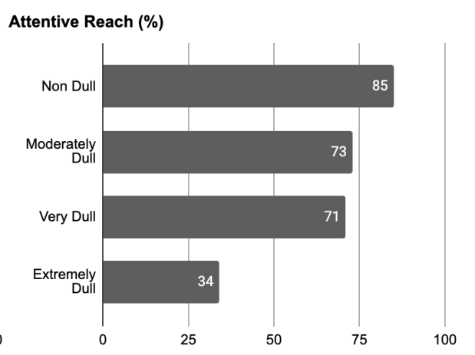
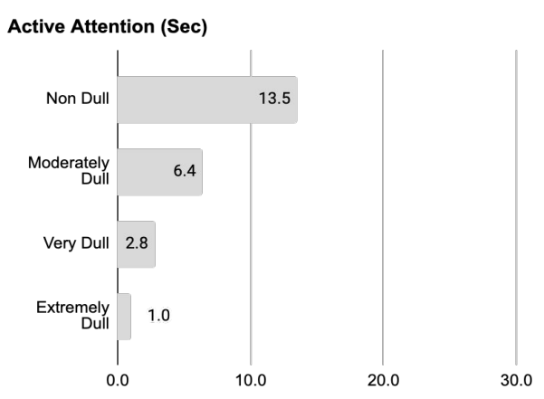
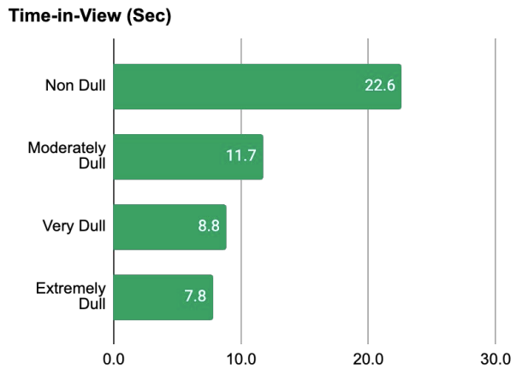
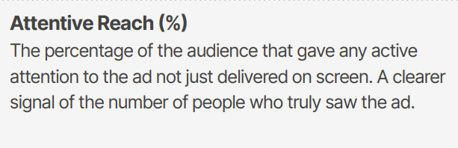
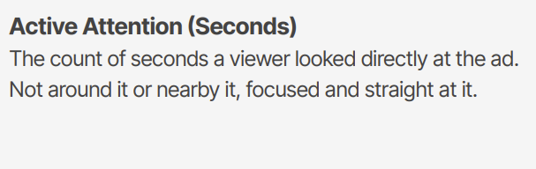
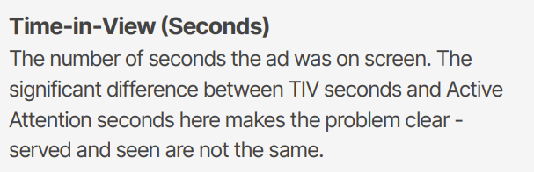

‘Cheap media isn’t cheap if nobody’s watching’
Source: The Cost of Dull Media, Amplified, 2025
Notes:
The Cost of Dull Media, a new report from Professor Karen Nelson-Field launched at Cannes, with contributions by Adam Morgan and Peter Field, reveals the staggering waste of attention and money on ‘dull’ media formats.
Analysing 190 campaigns across 12 countries and 60 ad formats, the work measured attentive reach, active attention and time-in-view. Campaigns were categorised based on attention volume into four 'dullness' quartiles: non-dull, moderately dull, very dull, and extremely dull.
'Non-dull' campaigns achieved the highest attentive reach, with TV, cinema, radio and premium video environments consistently falling into this category as high attention formats. The attention gap is dramatic: while 'extremely dull' formats deliver just one second of active attention on average, 'non-dull' formats provide 13.5 seconds - over 13x more time for a brand to land its message.
This matters because previous Amplified research demonstrates ads need at least 2.5 seconds of active attention for memory formation.
Despite this evidence, the industry continues pouring resources into low-attention (dull) environments. The report estimates a staggering $287 billion is spent globally on media formats that fail to capture meaningful attention. It would take an extra $189-billion in low attention media spend to match the effectiveness of non-dull media like TV.
As the report puts it: "Cheap media isn't cheap if nobody's watching."
For more information, read: https://www.thinkbox.tv/news-and-opinion/opinion/the-cost-of-dull-media-key-findings-every-advertiser-should-know

Slide 8
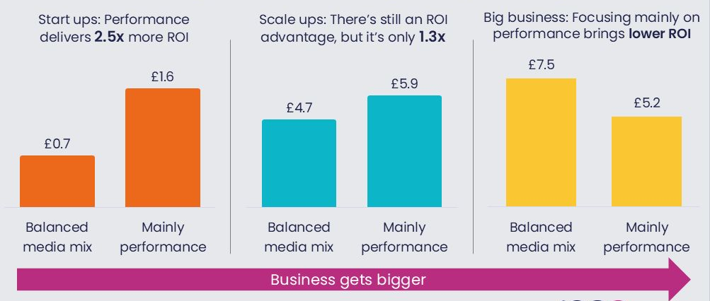
As your business grows, the ROI from a more balanced mix gets better
Source: Incremental ROI from Magic Numbers, Circana, D2D. VCCP, OMG, Ekimetrics via IPA ARC
Notes:
As your business grows, the ROI from a more balanced mix gets better
Analysis of the IPA ARC database by Magic Numbers reveals that while a performance-heavy media mix drives the best returns in the early stages of growth, the picture changes as businesses scale.
The month’s Chart of the Month shows that as businesses mature, a more balanced mix of brand and performance channels begins to outperform a solely performance-driven strategy, delivering a higher ROI.
This suggests that larger businesses may be missing out on significant value by underinvesting in reach-driven channels and richer creative formats.
Download the chart to explore the full analysis.

Slide 9
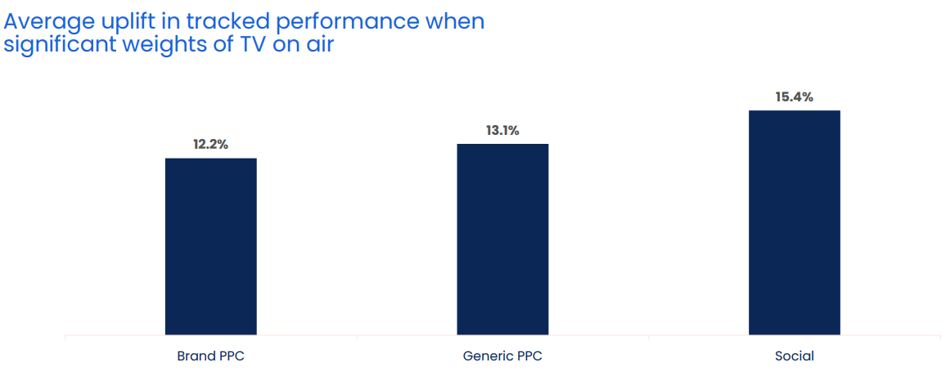
When TV is on air, digital channel performance is uplifted by 13.7%
Source: Why the Eff would you cut TV? GroupM, 2025
Notes:
When TV is on air, digital channel performance is uplifted by 13.7%
One of TV advertising’s most underestimated strengths is its halo effect — the way it boosts the performance of other media channels. While often misattributed, this cross-channel impact is both real and measurable.
According to GroupM analysis in ‘Why the Eff would you cut TV?’ presented at Thinkbox Trends in TV 2025, digital response channels see a clear uplift when TV is live. The study analysed the performance of TV, brand PPC, generic PPC and social across 14 brands, which included 1,489 weeks, and £283m total performance media spend.
Analysis found that on average, the performance of lower-funnel response channels improves by 13.7% when TV is part of the media mix.
More specifically, brand PPC, generic PPC and social saw an average uplift of 12.2%, 13.1% and 15.4% respectively in tracked performance when significant weights of TV were on air. This shows how TV makes digital channels work harder.
For a deeper dive on the consequences of taking TV out of the plan, watch ‘Why the Eff would you cut TV?’ on demand.

