Slide 1
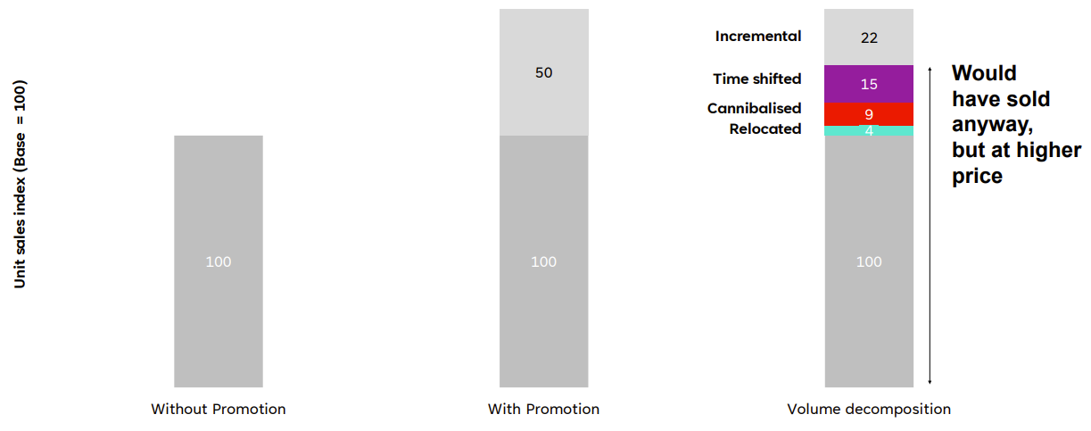
Price promotions have big, obvious effects, but not all volume is incremental
Source: Kantar x Binet Consulting, Kicking the Promotion Habit, 2026.
Author synthesis of Van Heerde, Gupta & Wittink (2003); Van Heerde, Leeflang & Wittink (2004); Dawes (2012); Ailawadi et al. (2007); Kantar/Worldpanel. Illustrative central case; Author calculations.
Notes:
Price promotions have big, obvious effects, but not all volume is incremental
This month’s Chart of the Month shows how price promotions drive sales uplift, but not all of it is truly incremental.
Showcased at this year’s IPA Effectiveness Conference, Les Binet and Dom Boyd explored why organisations continue to rely on price promotions, how they assess their effectiveness and what would encourage a shift towards more profitable growth. The study is based on 250 senior marketing and insight leaders from UK consumer goods business, conducted by Censuswide.
This chart shows how price promotions can deliver an immediate boost in sales, often making promotions look highly effective in the short term. But not all of these extra sales are genuinely new. Some are shifted from other stores or channels, some come at the expense of other products, and others are simply purchases brought forward or delayed.
This means much of the apparent uplift may be sales that would have happened anyway, just at a lower price. And over time, the overall benefit of promotions can look even smaller.
The research sets out a six-step programme for reducing reliance on promotions: improve marketing training; learn promotional best practice; use econometrics to evaluate price, promotions and advertising consistently; measure both short and long-term effects; assess pricing power; and reinvest money from ineffective promotions into brand building.
For more information, download the slides here: https://ipa.co.uk/news/kicking-the-promotion-habit

Slide 2
Short-term payback goes beyond ‘performance’ channels
+9.3%
Profit contribution in-year
Source: The Growth Gap, Thinkbox / WPP Media UK, 2026.
Profit Ability 2, April 2024 – Short term benchmarks: Ebiquity, Gain Theory, WPP Media UK. Adstock benchmarks: Ebiquity Long Term Multipliers: Gain Theory, WPP Media UK. Long-term distribution: Media Mix Navigator
Notes:
Short-term payback goes beyond “performance” channels
Correcting an imbalance in channel investment could deliver a 9.3% improvement in in-year profit contribution.
That’s one of the key findings from this month’s Chart of the Month, from our latest study, ‘The Growth Gap’ by WPP Media. The research explores how, with constrained budgets, you can allocate resource to balance immediate sales with long-term brand equity.
Economic uncertainty has pushed the industry towards short-term thinking, prioritising activity that is easy to measure and cut. This has often meant equating “performance” with channels such as PPC and paid social.
However, short-termism isn’t the problem; the problem is badly executed short-termism. Equating “short-term” with “performance”, and “performance” with search and social, brands risk underinvesting in other channels that can deliver strong immediate returns, including TV, audio, and print.
The analysis shows that this shortcut can lead to a sub-optimal channel mix, even when the focus is purely on short-term payback. Correcting this imbalance alone could deliver a 9.3% improvement in in-year profit contribution.
These findings come from an analysis of 624 brands and over 7,400 different campaign scenarios.

Slide 3

TV has the broadest cultural footprint
All adults
% Share of cultural entry points indexed vs. all media average (i=100)
 | Podcasts
 | Newspapers/magazines
 | Radio
 | Cinema
 | Content Creators
 | Video Sharing Sites
 | Social Media
 | TV
Source: Cultural Advantage, Thinkbox / everyday people, 2026.
Base: UK Nat Rep (n=2,000)
Notes:
TV has the broadest cultural footprint
This month’s Chart of the Month comes from our latest study, ‘Cultural Advantage’, which explores the cultural influencer of different media.
Using a framework developed by cultural insight specialists, everyday people and incorporating a diverse range of academic perspectives, the study tested seven ways media shape culture each varying in importance to people’s lives. In order of importance, they are: continuity, purpose, bonding, affirmation, transformation, bridging, and currency.
The analysis shows that each media channel has a distinct cultural signature. The larger the area represented in the chart, the broader and more holistic its cultural influence.
TV has the strongest and most comprehensive cultural signature of the channels studied, with particular strength in affirmation and continuity. This reflects its ability to create shared experiences and build lasting cultural influence over time.
Social media is especially strong on currency and bonding, reflecting its role in driving real-time conversation and connection. Content creators perform on currency and transformation, inspiring audiences and shaping perspectives.
While each channel brings different strengths, TV has the broadest overall cultural footprint, underlining its ability to create shared cultural experiences at scale.
Want to dig deeper into how different media channels create cultural advantage — and what it means for advertisers? Read Cultural Advantage: https://www.thinkbox.tv/research/thinkbox-research/cultural-advantage

Slide 4
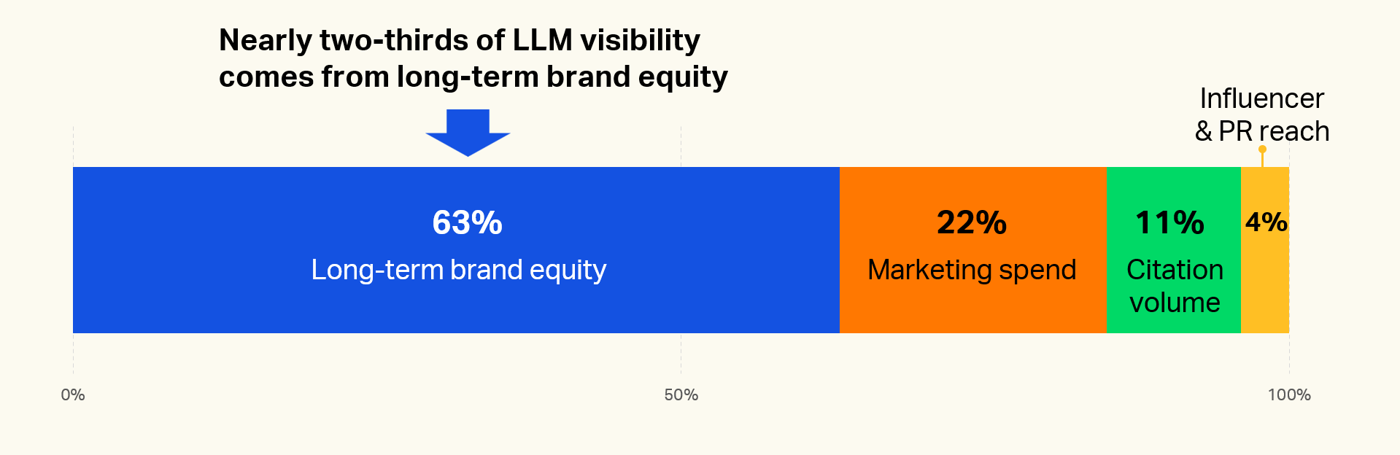
Brand building drives LLM visibility
Source: Charlie Oscar, WARC, What really drives LLM visibility, and what brands can do about it, March 2026
Notes:
Brand building drives LLM visibility
As consumers increasingly use AI to discover brands, long-term brand building is emerging as the biggest driver of LLM visibility for brands.
Research by Charlie Oscar, published by WARC at Cannes in June 2026, analysed 30 brands across six categories over eight months. The analysis found that:
63% of LLM visibility for brands is driven by long-term brand equity, the cumulative impact of sustained brand investment over time
Current marketing activity only contributes to 22% of LLM visibility
Reach via influencers or PR account for just 4% of LLM visibility for brands
These findings support work from Thinkbox:
1. Profit Ability 2 highlighted the case for long-term brand building by showing that the majority of advertising-generated profit comes from long-term effects, with brand investment continuing to deliver value beyond the immediate campaign period. While short-term activation can drive immediate returns, sustained brand building creates stronger memory structures, increases mental availability and drives future demand, ensuring brands are more likely to be considered when consumers are ready to buy
2. ‘Go Big or Go Home’ (Les Binet & Medialab) argues that the single biggest lever for growth is deciding how much to invest. The Growth Gap (Thinkbox & WPP Media) builds on this, exploring how marketers can balance investment between short-term sales activation and the long-term brand building that delivers sustained growth.
3. Cultural Advantage (Thinkbox & everyday people) found that creator-led activity has relatively limited long-term cultural impact compared with broad-reach brand-building media such as TV.
The message for marketers is clear: if you want your brand to be recommended by AI, invest in building brand equity. LLMs typically surface only a handful of brands, making long-term brand strength a critical advantage in achieving success via AI.
Download the chart to learn more

Slide 5
On average, brands could double their investment and still generate a profitable return, unlocking 11% headline profit growth
Headroom vs average
+275%
+131%
+67%
+0%
-29%
n/a
+100%
Source: The Growth Gap, Thinkbox / WPP Media UK, 2026.
Media Mix Navigator (7,488 scenarios, covering 624 brands across 12 media budget levels)
Notes:
On average, brands could double their investment and still generate a profitable return, unlocking 11% headline profit growth
This month’s Chart of the Month comes from our latest study, ‘The Growth Gap’ by WPP Media, which explores how, with constrained budgets, you can allocate resources to balance immediate sales with long-term brand equity.
The study analysed 624 brands and over 7,400 different campaign scenarios. It found that many businesses stop investing in advertising long before that investment ceases to be profitable. Current average brand annual media investment level is £15 million, but saturation point (when each £1 invested starts generating less than £1 in profit return) is at £30 million.
The study found that the average brand could double their advertising investment and still keep every pound profitable, unlocking 11% headline profit growth (c. £32 billion profit left on the table).
This varies by sector however. Travel brands could increase advertising investment by 275%, Retail by 131%, and Automotive by 67% and still see profitable returns. In contrast, proving the value of additional media investment for Telecoms, Finance, and FMCG brands is more complex. It requires factoring in customer lifecycle or assessing advertising’s impact on other metrics, such as price elasticity and distribution.
Want to know more? Watch Advertising Through Adversity on demand: https://www.thinkbox.tv/news-and-opinion/events/advertising-through-adversity-strategies-for-uncertain-times

Slide 6
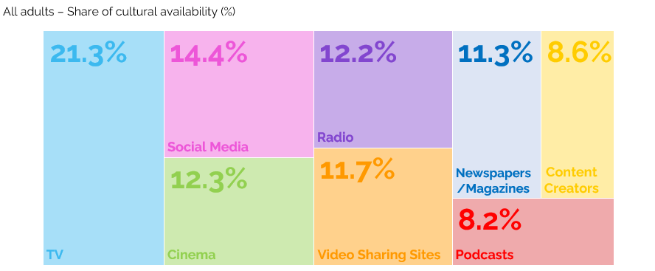
TV has the highest share of cultural availability
Source: Cultural Advantage, Thinkbox / everyday people, 2026. Base: UK Nat Rep (n=2,000).
Notes:
This month’s Chart of the Month comes from our latest study, ‘Cultural Advantage’, which explores what mechanisms drive culture and how advertiser can adapt effectively to create a strong cultural advantage.
Using a framework developed by cultural insight specialists, everyday people and incorporating a diverse range of academic perspectives, the study tested seven ways media shape culture each varying in importance to people’s lives. In order of importance, they are: continuity, purpose, bonding, affirmation, transformation, bridging, and currency.
Taking these into account, everyday people calculated an overall cultural impact for different media as well as understand different media’s impact on different types of cultural association.
Based on data from 2,000 UK adults aged 16+, analysis revealed that TV accounts for 21.3% of media’s cultural impact, followed by social media (14.4%), cinema (12.3%), radio (12.2%), video sharing sites 11.7%). The media with the least cultural impact are content creators (8.6%) and podcasts (8.2%).
Want to dig deeper into how different media channels create cultural advantage — and what it means for advertisers? Watch Advertising Through Adversity on demand

Slide 7
30-second TV ads consistently account for half of all impacts
Source: Barb, 2015-2025, Individuals, Proportion of Impacts (R/W) by ad duration
Notes:
30-second TV ads consistently account for half of all impacts
Our latest Chart of the Month shows how the 30-second spot continues to be the most popular time length in UK ad breaks.
The main shift since 2015 has been less use of 40 to 50-second ads on TV. The prevalence of shorter time lengths (20-second, 10-second and under) and 60-second ads has remained stable, while there has been a small increase in the use of 60-second+ ads.
For more insights on time lengths in TV advertising – the pros and cons of different ad lengths, their storytelling ability – you could do worse than go here where we go into the topic in more depth https://www.thinkbox.tv/research/thinkbox-research/a-matter-of-time-the-importance-of-time-length-in-tv-advertising/

Slide 8
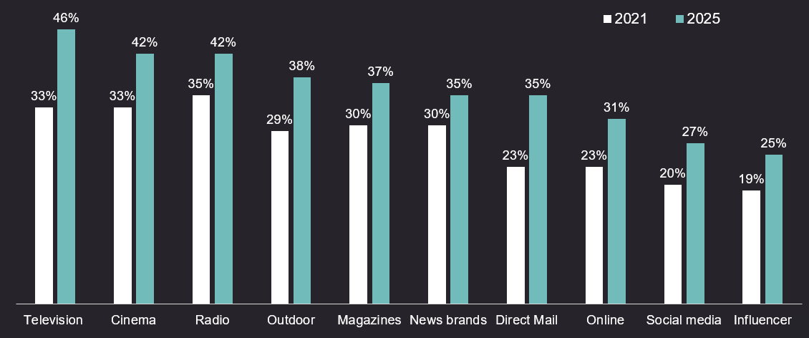
TV advertising is the most trusted medium
Source: Credos Trust Tracker (Advertising Association).
Q. To what extent, if at all, do you trust each of the following types of advertising in relation to products and services? (very trusting / fairly trusting), Kantar, 2025, n= 2,534
Notes:
One factor is becoming a clear differentiator in advertising: trust. As uncertainty grows and consumer confidence declines, it’s playing an increasingly critical role in shaping brand preference and driving profitability.
This month’s chart of the month highlights data presented at LEAD 2026 from the 2025 Credos Trust Tracker revealing a key trend: trust in advertising has increased across every media channel since 2021.
One channel stands out. TV is the most trusted advertising environment. Between 2021–2025, trust in TV grew faster than any other medium, reaching 46%, outperforming online ads (31%), social media (27%) and Influencer content (25%).
To dive deeper into why trust matters for brands and why TV continues to lead, read more here: https://www.thinkbox.tv/why-tv/unrivalled-trust

Slide 9
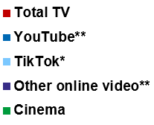
Total TV is fundamental for getting ads seen
12%
14%
48%
Individuals
Ad time per day:
16:38
16-34s
Ad time per day:
8:58
85%
33%
Source: 2025, Barb / Broadcaster stream data / UK Cinema Association / Ipsos Iris
**YouTube ad time modelled at 3.33% of content time (Enders Analysis, 23rd October 2024) and excludes those estimated to be on the YouTube Premium tier. *TikTok ad time modelled at 3.4% of content time using agency and broadcaster estimates. **Other online modelled at 3.33% of content time.
Notes:
The time people spend watching different video content is useful to know. But the most important analysis for advertisers is the time spent watching the advertising.
In 2025, total video advertising time in the UK reached nearly 17 minutes per person. Total TV (incl. Linear, BVOD, SVOD) accounted for 85% of this.
For younger audiences TV was still just under half of their total AV ad time.
Video sharing platform YouTube came a distant second with 12% of all AV ad viewing. Amongst 16-34s, this grows to 33%.
TikTok and other online video are minor players in the video advertising space. In fact, 16-34s spend more time with TV advertising than YouTube and TikTok's advertising combined.
This chart shows all the data. Total TV remains by far the primary means of getting AV advertising seen, whether you're 16, 36, or 56.
For more insights into 2025 viewing, watch "TV Now and Next".

Slide 10
We feel most relaxed when watching TV
Source: IPA TouchPoints 2025, Emoticons, Indexed by average share of each emotion using gross half hour claims.
Notes:
Contextual differences matter for brands. Evidence from Context Effects shows that the right in-home viewing environment can lift ad recall by up to 6.3 times. The study identified key contextual factors, mood is one of them. When we are happy in the living room, ad recall increases by 41%, 14% when relaxed and 49% when connected.
Data from IPA TouchPoints reveals that TV outperforms YouTube and Social Media in shaping positive emotional responses. Emotional responses on this chart are shown using indexes, scores above 100 indicate a higher likelihood of that emotion being felt, while scores below 100 indicate a lower likelihood.
Analysis shows that audiences are most likely to feel relaxed when watching TV (161), higher than both YouTube (123) and Social Media (113), TV is also the environment where people are least likely to feel sad (88) or stressed (52).
In contrast, YouTube and Social Media are much more likely to evoke negative emotions. Both YouTube (132) and Social Media (122) over-index for sadness.
To dive deeper into why mood and context matters, read more here: Context Effects
For all Chart of the Month’s from the recent months, download the slides from the link above, this includes:
December: TV is the battery that charges other media
September/October: Twice as many people trust brands advertised on TV than YouTube
August: ‘Cheap media isn’t cheap if nobody’s watching’
July: As your business grows, the ROI from a more balanced mix gets better
May/June: When TV is on air, digital channel performance is uplifted by 13.7%
April: Ads benefit from a premium environment
March: Viewing to ad-supported quality content grows
January/February: Ads are noticed more when people are relaxed and/or in a good mood

Slide 11
TV is the battery that charges other media
% average reduction in Purchase Intent over 8 weeks if TV is NOT included alongside…
Other online (search, display) | Audio (radio & streaming) | Social Media | Online Video | Print (physical) | OOH
Source: Staying Power: The longevity of advertising, Tapestry Research, 2025.
Purchase Intent (‘definitely consider’): All brands, among those exposed (nat rep, 18-75). Online Video is mostly YouTube.
Notes:
This month’s Chart of the Month comes from our latest study, ‘Staying Power: the longevity of advertising’, which explores how advertising continues to drive impact long after campaigns end.
Based on data from almost 20,000 UK adults aged 18–75, the research tracked post-campaign effects of advertising by measuring purchase intent over eight weeks from nine major brands — uncovering what really helps ads stay impactful over time.
Analysis revealed that campaigns using four or more media channels are twice as likely to make people definitely consider buying a product compared with single-channel campaigns (40% vs. 20%). And TV plays a crucial role in that mix as the battery that charges other media. When TV is included, it boosts the impact of other media on definite purchase intent by an average of 26%.
But when TV is excluded, the effect drops sharply across the board, with Print and OOH seeing the largest declines in definite purchase intent (-28%), whilst Other Online (mainly search and display) experienced the least (-9%).
For more insight on the longevity of advertising, watch Staying Power on demand: https://www.thinkbox.tv/news-and-opinion/events/staying-power-the-longevity-of-av-advertising
Source: A5 [Definitely consider]. How likely (if at all) would you be to consider [SELECTED BRAND] the next time you come to [CATEGORY OCCASION]?
Base: 19,251 respondents aged 18-75; 19,251 Wave 1, 5,569 Wave 2, 6,000 Wave 3, 3,595 Wave 4

