Slide 1
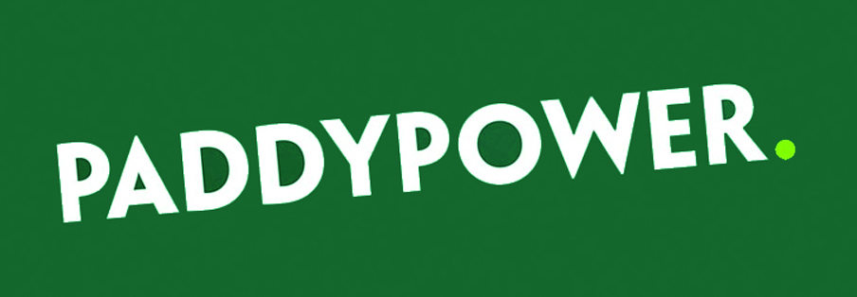
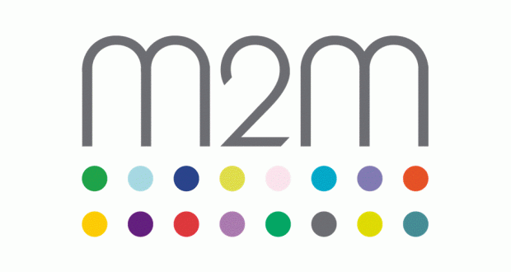
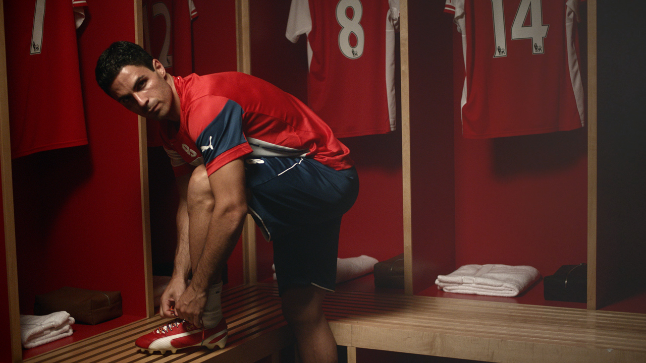
Paddy Power, Stonewall and Arsenal came together to try to kick homophobia out of football
Challenge
Paddy Power’s objective was to create a change in football culture by using their personality to address the issue of homophobia in football
Solution
With limited funds, they tactically bought one big spot during the England v Switzerland Euro 2016 qualifier and sent Rainbow Laces to every professional footballer in the UK
Results
Players from 75% of the Premier League clubs wore the rainbow laces
Over 100,000 people requested a pair of the laces
Notes:
The Challenge
Sadly, homophobia exists in football. Research showed that 70% of football fans who’ve attended a match have heard or witnessed homophobia on the terraces and more than 40% of fans think football is an anti-gay sport. Of the 5,000+ professional footballers in the UK, none has openly admitted to being gay. As it is extremely likely that some are gay, it seems that the environment that exists in football forces people to hide this fact.
The Irish bookmaker Paddy Power wanted to try and address this after they found that 57% of regular bettors thought “it was an issue that needs tackling”.
Their objective was to create a change in football culture so that, if a footballer did decide to reveal his homosexuality, the fans would support him. Paddy Power felt that they could use their brave, entertaining and imaginative spirit and their existing relationship with football fans to do something that would build genuine good will and support.
The Solution:
The campaign kicked off on Saturday 6th September on channels such as Sky 1, Sky Atlantic, Sky News, Comedy Central, Discovery and BT Sport to reach football fans. They targeted programmes that they knew people were actively engaged with and had a large social footprint.
On Monday 8th September, The Metro became the Metro Rainbow Laces Edition – devoting an entire edition to the cause with 36 brands supporting the campaign with paid for advertising and a two page video on the making of the Arsenal video.
Paddy Power had limited funds for this campaign and so were unable to buy lots of big spots. However, they wanted to buy one really big spot on a terrestrial channel to supercharge the campaign. It was important to get this spot right as it needed to ignite the campaign and get viewers talking about and sharing the video on social media. Their media agency M2M decided that the best spot would be the Euro 2016 qualifier on ITV that featured England v Switzerland on the evening of the 8th September.
The match offered massive scale for their core football audience but also would reach a wider audience. In addition, it would feature Alex Oxade-Chamberlain playing for England who was one of the players in the ad. They bought the half time break and the spot on ITV reached 5.5m people and generated a huge response on Twitter with #rainbowlaces trending. People were encouraged to share the video with as wide a group as possible. Across the week, the momentum was maintained building up to the Arsenal v Manchester City match where players from both clubs would be wearing the rainbow laces.
The video was also distributed on You Tube and Paddy Power’s owned social media channels alongside activity on BT Sport and Sky Sports.
Results
Players from 75% of the Premier League clubs wore the rainbow laces
70+ clubs supported the campaign
Over 100,000 people requested a pair of the laces
#rainbowlaces was used 70,000+ times
On 8th September, #rainbowlaces trended from 7am to 2pm following the publication of the Metro Rainbow Laces edition, but was the number 1 trend worldwide on Twitter once the ad ran in the England v Switzerland match on ITV
The video was viewed over 1m times on YouTube
A total of 52 brands got involved
The rainbow laces were written into the storyline of Britain’s biggest soap Coronation Street
Paramount Pictures created a special one off trailer for the Teenage Mutant Ninja Turtle movie and with the help of M2M, ran it directly after the Paddy Power film in the Arsenal v Manchester City match on BT Sport
Most importantly, the number of people who attend live football matches think that homophobic banter has decreased from 27% to 23%
To read the full case study and access the creative visit: https://www.thinkbox.tv/Case-studies/Paddy-Power

