Slide 1
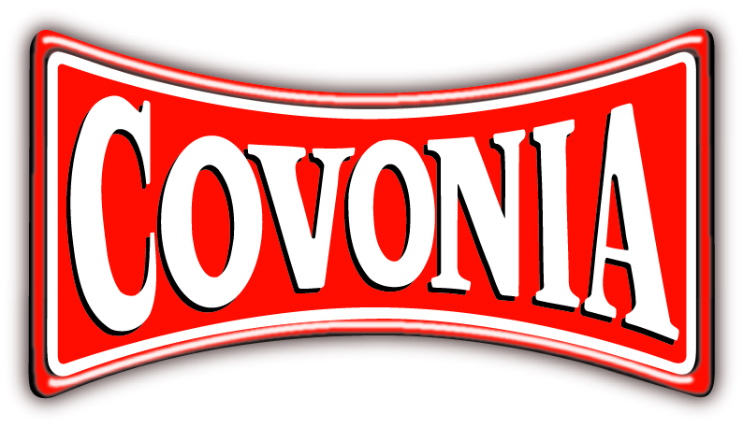
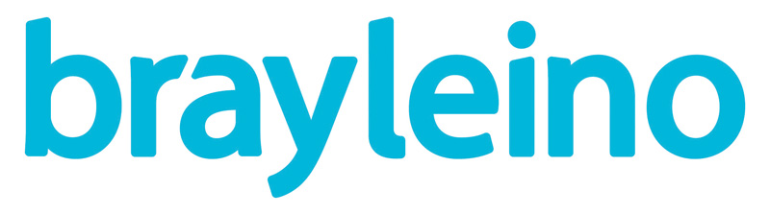

Covonia ran a bullish media campaign
Challenge
Covonia wanted to grow sales and close the gap on the brand leader
They wanted standout in their category and to maintain profitable growth and ROI
Solution
Based on audience data and research they used TV to target C1C2DE 35-54 yr olds running the campaign from Nov-Jan (prime cough season) using TV to help them create an emotional connection with the brand.
Results
Grew market by 2% and also grew share amongst core 35-64 age group
Achieved 24% market share with just 17% share of voice
Notes:
Challenge
Covonia is the no. 2 brand within the cough medicine market.
In 2017, they had some clear objectives:
- Grow ex-factory sales
- Grow share of market to close gap on brand leader
- Long term ambition to become the leader in the adult cough category, maintaining profitable growth and ROI
- Give the brand greater individuality and stand-out within the category
Solution
Their agency, Bray Leino, identified an opportunity to target C1C2DE 35 to 54-year olds. This audience were not only category users who also provided the necessary volume to reach the sales target, but they were not being spoken to directly by Covonia’s competitors. In addition, this audience felt like a good fit for the hard-working cough medicine.
Research revealed that most cough brands are seen as meeting functional needs but Bray Leino saw an opportunity to create a more emotional connection with the audience. They wanted to position Covonia as a unique cough remedy for people with fighting spirit – ‘Covonian spirit’.
They decided TV should be the lead medium for the activity since the target audience are heavy TV viewers (40+ hours a week) and previous data showed significant sales uplifts from previous TV campaigns. The campaign ran from November - January, to tie in with cough incident data from the past five years.
Through a disruptive challenge, asking consumers if they’ve ‘Got the bottle’ to ride the bull and ‘Feel the Power’, they were able to reinforce the established functional perceptions of the brand while also dialling up emotional engagement with the audience.
The TV activity was supported by and integrated with social media, outdoor, online, PR, VOD and POS. One good example was when Theresa May had a coughing fit during her speech at the Conservative party conference. Covonia did a Facebook post with the message ‘Cough Medicine for the many, not the few’.
Results
Covonia grew their market by 2% (source: IRI)
Covonia share increased amongst core 35-64 age group (Kantar WorldPanel)
Covonia achieved 24% market share with just 17% share of voice (source: Nielsen)
For the full case study and to view the ad campaigns visit: https://www.thinkbox.tv/Case-studies/Covonia

