Slide 1

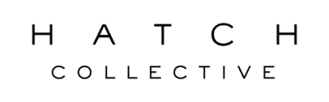
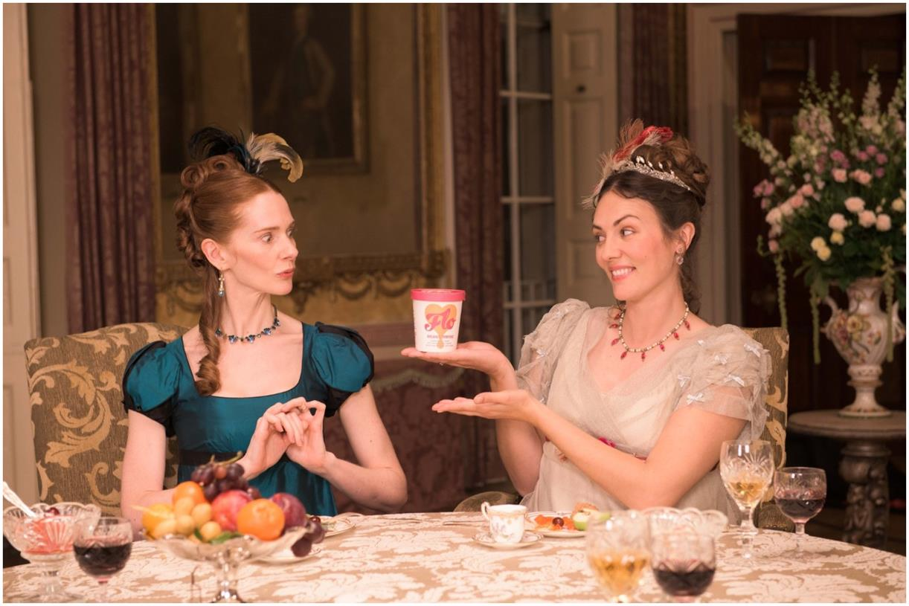
Here We Flo tries TV for the first time
The Challenge:
Here We Flo, an eco-friendly period care brand was launching into a market with very dominant brands.
They wanted to raise brand awareness, improve retail distribution and have a positive environmental effect.
The Solution:
They won Sky’s Footprint Fund Grand Prix prize which gave them access to £1m of airtime.
Hatch Collective created an impactful, humorous TV ad.
Campaign ran on Sky Linear, VOD & Sky AdSmart.
The Results:
50% increase in prompted brand awareness
158% uplift in consideration
Highest ever website engagement – site visits up +1,000%
Notes:
The Challenge
Here We Flo, an eco-friendly period care brand, entered a market dominated by traditional feminine hygiene giants.
Conventional period care products are made of over 90% non-biodegradable plastic and synthetic materials – and women use over 11,000 pads or tampons throughout their lives, all of which end up in landfill.
Here We Flo offer a sustainable alternative to this as their products use biodegradable, plant-based materials and they are officially a Certified B Corporation. However, with minimal brand awareness and poor retail distribution, it was going to be a challenge convincing a wider audience to make the switch.
By empowering girls and women to talk freely and openly about “Life’s Messiest Moments”, they were confident that they could tackle the long-standing stigma surrounding menstruation, whilst at the same time making a positive impact on the environment.
The TV Solution
As a new to TV brand, Here We Flo needed support to bring their products to the masses. Sky’s Footprint Fund therefore provided an amazing opportunity for them to try to secure funding to enable them to get their brand on to TV and in to people’s homes, which in turn would support them in gaining greater retailer distribution.
Working closely with Hatch Collective, they created the idea for "No More Period Dramas", a campaign which would tap in to the zeitgeist of TV period dramas, parodying the likes of iconic series such as Downton Abbey and Bridgerton.
Set within a stately home, the formal dining room provided an opulent and somewhat ‘inappropriate’ dinner party setting for the ladies around the table (in all their finery), to discuss what happens “down there” – much to the shock and embarrassment of the accompanying gentlemen who very quickly head to the smoking room for brandy!
With a truly brilliant concept, incredible styling and a 100% female production crew, Hatch Collective and Here We Flo were able to carry through the importance of female empowerment from the screen to behind the scenes and resulted in them winning the Sky Footprint Fund’s Grand Prix prize, which was worth £1m in airtime.
This open, honest and humorous TV ad not only resonated with the audience but also the industry as it was voted Marketing Week’s “most effective TV ad” in April 2022.
The TV activity was supported by print and social and the campaign led to Here We Flo becoming the fastest-growing period care brand in the UK.
The Plan
The campaign launched with a spot in a special 170” Net Zero Carbon ad break, which was scheduled to coincide with the COP26. It featured all five winners of the Footprint initiative and ran on Sky News and Sky Nature for two weeks.
Following the launch, Here We Flo ran their first-ever targeted solus TV campaign in March 2022 and again in April 2023 across Sky Linear, VOD and Sky AdSmart channels.
In addition to the TV ad, Hatch Collective also created a suite of assets which allowed Here We Flo to activate the campaign across outdoor and on their social channels. Taking inspiration from their ‘FLO Babes’, they brought to life customers’ very own period dramas. These funny yet very relatable anecdotes were projected on moving billboards across London (in bright pink of course!), and via on-trend TikTok filters on social, allowing Here We Flo to empower women, normalise menstruation and promote conversation.
Results
Brand Awareness: The campaign led to a 50% increase in prompted brand awareness amongst those exposed to the TV campaign, with spontaneous awareness 6x amongst Sky customers
Brand Perception: Exposure to the campaign positively impacted brand perception with consumers noting the ad's humour and its ability to challenge the typical portrayal of periods in advertising
Purchase Consideration: Purchase consideration more than doubled for those looking for period care products (+158%) with Sky customers exposed 82% more likely to consider FLO.
Customer engagement: During the TV campaign, Here We Flo saw their highest-ever website engagement with site visits, +1,000% YoY
Retailer success: The TV campaign helped open the door to conversations with new retailers and, since winning the Footprint Fund, the brand has extended its distribution to include Superdrug, Holland & Barrett, Boots and most recently Tesco & Ocado.
Industry Recognition: Here We Flo achieved some incredible industry praise and acknowledgement, with Marketing Week labelling it “April’s most effective TV ad” in 2022.

