Slide 1
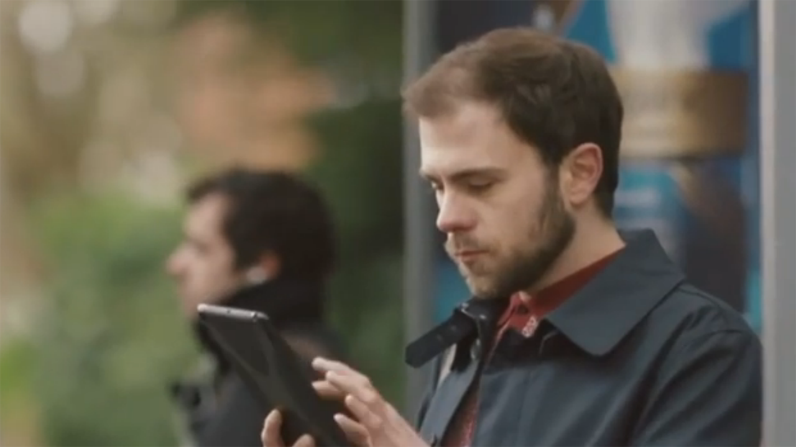
Regaine used targeted TV to drive sales
Challenge
Regaine wanted to drive sales and normalise conversation around hair loss.
Solution
They developed a highly targeted, low weight campaign in hand picked programmes focussing on sport
To encourage viewers to seek information online, they added a targeted VOD campaign on 4oD and ITV Player
Results
Achieved a 155% increase in ROI
Reached 60% of targeted ABC1 men 25-34
55% increase in branded search
Notes:
The Challenge
Despite affecting almost 8 million men in the UK, hair loss can cause significant anxiety. For male sufferers, finding a solution is a priority although scepticism around product efficacy consistently prevents trials.
A high entry price point along with a requirement for long term habitual usage to yield results meant that the challenge to drive uplift in sales for Regaine was a tough one. The brand had to be positioned as the effective go-to product for hair loss.
Following the launch of Foam, Regaine had high awareness levels of over 70% so the challenge was not in awareness but in overcoming the sensitivity of the subject and the scepticism of the category. Regaine is a trusted brand in this category and so were able to lead from the front and break down barriers.
The key objectives were to drive uplift in sales, normalise the category and also unlock trade relationships in order to support point of sale.
The TV Solution
Although previous campaigns had achieved strong awareness levels, to meet these new challenges they felt they needed to try something different. They knew that sports environments were particularly effective at delivering coverage against the male target audience as well as driving spikes in activity through search and online. So the TV solution was based around key sporting environments.
Working with their media agency Primus, they developed a highly targeted, low weight programme strategy buying around 40 ratings a month for a 6 month period. Every spot was hand-picked and featured programmes such as Champions League on ITV, Ten O’Clock Live and Comedy Gala on Channel 4 plus relevant programming on ITV4 and Sky channels. By buying TV spots around prominent matches, they were able to build fame and also heighten awareness of the issue. Sport was a highly efficient way of reaching the target audience of ABC1 men aged 25 to 34 and so 66% of all impacts were delivered here.
As hair loss is a personal and often embarrassing topic for sufferers, instead of consulting peers for advice, most research is conducted through the privacy of online. Regaine knew they needed to encourage men to seek out information online and so they executed a targeted VOD campaign on various sites including ITV Player and 4oD. The VOD activity meant they were able to drive awareness and also provide a more private environment to talk to men about personal care and a prompt for the research journey. In addition, the target audience fitted well with the average VOD viewer and complemented the TV activity well.
Results
The targeted TV approach increased annual ROI by 155%
The campaign achieved 60% reach against the target audience of ABC1 men 25-34
55% increase in branded search
88% increase in clicks
To read the full case study and access the creative visit: https://www.thinkbox.tv/Case-studies/Regaine

