Slide 1
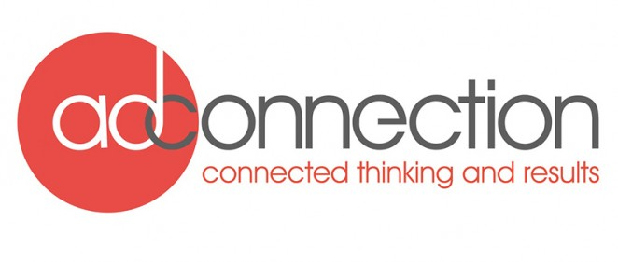

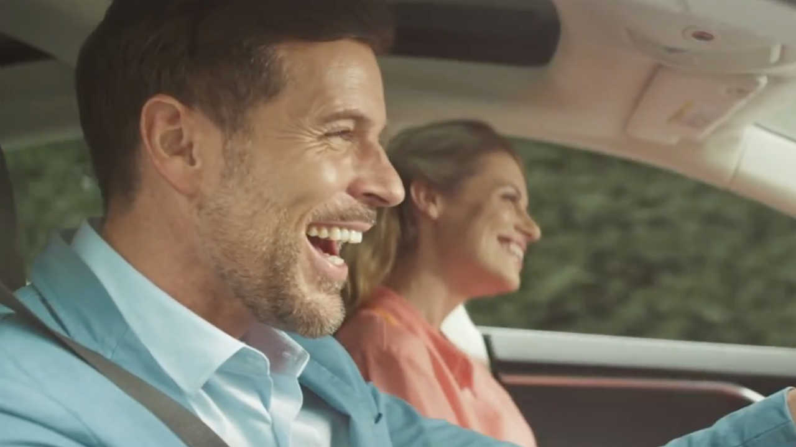
LeasePlan Go’s launch into the B2C market
Challenge
Raise awareness of brand in B2C market and drive web enquiries
Solution
Following the launch of a B2C brand, they developed a ‘symbiotic’ media buying strategy, by placing the rational ad in the same break following emotive premium car ads
2 week burst to maximise impact, coverage & frequency
Results
LeasePlan Go had 5,663 enquiries during the campaign
LeasePlan Go saw a 100% increase in spontaneous awareness
Notes:
The Challenge
Despite being the global leaders in the large B2B car leasing market, LeasePlan were yet to penetrate the comparatively small B2C market, which remained relatively untapped in the UK. So they decided to launch a dedicated B2C brand, LeasePlan Go, into the market in October 2014. However, this was made more challenging by the fact that consumer awareness of car leasing was very low and the advertising of general car brands was massive.
The huge amount of noise generated in the general car market meant that LeasePlan Go’s limited ad spend would have to work hard to gain cut through.
The Solution:
In order to implement this “symbiotic” strategy, LeasePlan’s media agency adconnection worked with the broadcasters’ sales houses so the campaign was able to follow quality car advertising eg. BMW and Jaguar, within ad breaks. The likelihood of appearing after a motors TV ad was increased by cross referencing motor TV advertising patterns with the consumption patterns of their target audience (Men, ABC1, aged 25-50). A plan was built that upweighted airtime on evenings across the week with a particular focus on Sunday nights.
An example of this strategy in action was the use of a centre break in the popular Channel 4 Sunday night show Homeland. Not only would this programme provide instant coverage and gains in brand stature, but, because adconnection were working with the broadcasters, they managed to place their ‘rational’ LeasePlanGo TV advert immediately after an ‘emotional’ Jaguar ad featuring Ben Kingsley. Other key environments included a Sky Sports football match between Barcelona v Ajax, an episode of Top Gear, an episode of Speed with Guy Martin, and the film Rambo: First Blood.
The campaign was initially concentrated into a 2 week burst to maximise impact, coverage & frequency against their target market. As LeasePlan Go were new to TV and product awareness was low, adconnection surmised that the effective frequency level should be four.
With TV engaging their audience and driving awareness and consideration, they also underpinned the campaign with digital activity around the spots to link people to the point of sale. The display impressions were bought 15 minutes around the TV spots to increase the likelihood of people seeing both the TV ad and an online display ad, thus increasing brand recall.
Results
LeasePlan saw a 100% increase in spontaneous awareness
Prompted brand awareness was up 29%
45% of their target audience saw the ad at least once, whilst 10% saw it three times
The LeasePlanGo ads that followed aspirational car ads generated a 51% higher response rate than those that didn’t
LeasePlan Go delivered 41% of their key impacts in breaks following a car ad and 17.5% in breaks immediately after a car ad
LeasePlan Go had 5,663 enquiries during the campaign
To read the full case study and access the creative visit: https://www.thinkbox.tv/Case-studies/LeasePlanGo

