Slide 1
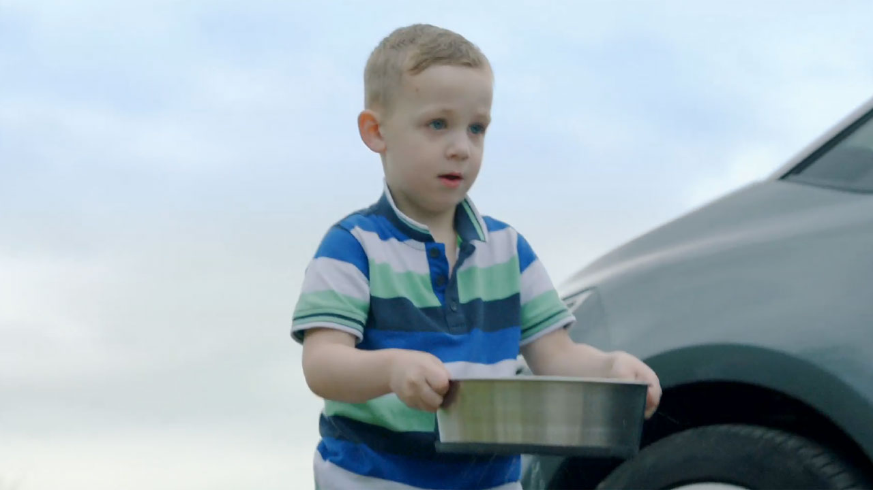
Welsh Water wowed Wales with their first ever TV ad
Challenge
Drive awareness of Welsh Water’s not-for-profit status by 5% and demonstrate how crucial water is to our everyday lives
Solution
A 60 second ad distributed through a high profile regional TV campaign
Results
Awareness of Welsh Water’s not-for-profit status had increased by 20% smashing the 5% target set
Notes:
Challenge:
Welsh Water is a unique, not-for-profit company that serves three million customers in Wales and The Marches. It is owned by Glas Cymru, a company with no shareholders and is run solely for the benefit of its customers. Any profit it makes is reinvested back in the business, which is a unique setup for the water sector
However, in 2016, they realised that very few people were aware of its not-for-profit status. They knew that awareness of this would translate directly into increased levels of customer trust. So, they challenged their advertising agency, Heavenly, to address this issue. The main objective was to raise awareness by 5%.
In addition, they wanted to demonstrate how crucial water is to our everyday lives and also to encourage people in Wales to have their say about how the company invests money in water and the local environment in the future.
Solution:
Heavenly devised a strategy based on the concept: “If Welsh Water is not for profit, then what is it for?” The answer they came up with was: “If not for profit, then for the future, for all of us, for Wales”.
They created a 60 second TV ad that captured the many ways that water is used in Wales – for work, for play, for living. The beautifully shot ad, produced by Orchard Media, starred Welsh Water employees and their families in everyday scenarios featuring water – rural, urban, inside homes and out to show the great diversity in Wales. They made English and Welsh language versions of the ad and they also produced a 40 second and 20 second cut down.
Results:
By the end of the campaign, awareness of Welsh Water’s not-for-profit status had increased by 20%, smashing the target set.
For the full case study and to view the ad campaigns visit: https://www.thinkbox.tv/Case-studies/Welsh-Water

