Slide 1
TV advertising’s ultimate nickable charts The lockdown edition
UPDATED January 2021

Slide 2
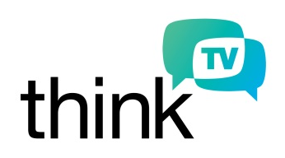
Who is Thinkbox?
Thinkbox is the marketing body for commercial TV in the UK, in all its forms. It works with the marketing community with a single ambition: to help advertisers get the best out of today’s TV.
Main shareholders
Associates & supporters
Member of
Notes:
Thinkbox is the marketing body for commercial TV in the UK, in all its forms. It works with the marketing community with a single ambition: to help advertisers get the best out of today’s TV.
Its shareholders are Channel 4, ITV, Sky Media and UKTV, who together represent over 98% of commercial TV advertising revenue through their owned and partner TV channels. Associate Members are TAM Ireland, Think TV (Australia), thinktv (Canada), TVN Media (Poland), TV Globo (Brazil), Tenk TV (Norway), TV 2 (Denmark), DSTv (South Africa), and Virgin Media. Discovery Networks UK & Ireland and STV also give direct financial support. Thinkbox are also members of The Global TV Group, of which Lindsey Clay is President.

Slide 3
TV viewing during spring 2020 lockdown
SECTION ONE
Cadbury ‘This Doesn’t Need to End’

Slide 4
During spring 2020 lockdown, linear TV viewing increased across the board
+23%
+13%
+18%
+14%
Source: BARB weeks 13-19 2020 vs weeks 13-19 2019. All data based on live & VOSDAL TV set viewing.
Notes:
With everyone spending more time at home, and needed information and entertainment, live and fast-playback (VOSDAL) TV set viewing has increased by 21% since lockdown on 23 March.

Slide 5
Light linear TV viewers saw greatest increase in viewing
+51%
+28%
+17%
Source: BARB weeks 13-19 2020 vs weeks 13-19 2019. All data based on live & VOSDAL TV set viewing. Consolidated & device viewing data not yet available for all weeks.
Notes:
Although viewing has been up across all audiences, lighter linear TV viewers are those which have seen the biggest increases.

Slide 6
Broadcaster VOD viewing surged during the first lockdown
Commercial Broadcaster VOD
+45%
Source: Commercial broadcaster data, weeks 13-17 2020 vs weeks 13-17 2019
Notes:
It’s not just linear TV which has seen a significant increase since lockdown. Commercial Broadcaster VOD viewing increased by 45% year on year during the first five weeks of lockdown.

Slide 7
Daytime viewing surged in the spring, particularly for ABC1s and 16-34s
Source: BARB weeks 13-19 2020 vs weeks 13-19 2019. All data based on live & VOSDAL TV set viewing. Consolidated & device viewing data not yet available for all weeks.
Notes:
With daily routines significantly changed, daytime viewing has seen extremely high year on year increases. The largest uplifts have been for younger viewers and upmarket adults.

Slide 8
During the first lockdown, shared viewing increased by 30%
+30%
+13%
Source: BARB weeks 13-19 2020 vs weeks 13-19 2019. All data based on live TV set viewing
Notes:
As households spend significantly more time at home, we’ve seen a very large increase in people watching TV together.

Slide 9
We turn to TV for information and light relief during lockdown
News +45%
Films +34%
Comedy
+21%
Hobbies +17%
Entertainment +16%
Source: BARB weeks 13-18 vs weeks 7-12 2020
Notes:
Our viewing needs have seen us turning to the telly for quality news and information, family films and light relief in the form of comedy content.

Slide 10
TV advertising during lockdown
SECTION TWO
VOXI ‘Stay Connected, Stay Endless’

Slide 11
Viewing of TV ads increased by 19% YOY during spring lockdown
Source: BARB weeks 6-18 2020 vs weeks 6-18 2019. 30” reweighted impacts.
Notes:
The supply of TV ad inventory has seen a sudden increase as a result of the rise in TV viewing since lockdown.

Slide 12
TV ad presence during first 6 weeks of lockdown (YOY)
Source: BARB weeks 13-18 2020 vs weeks 13-18 2019. 30” reweighted impacts
Notes:
Since lockdown there has been significant change to the profile of advertisers seen on TV. FMCG, Government, Telecoms and Electronics have accounted for a much higher proportion of the ads appearing on our tellies.

Slide 13
Advertisers that increased TV exposure during first lockdown
Source: BARB weeks 13-18 2020 vs weeks 13-18 2019
Notes:
Although, overall demand for advertising is lower during this period, many large advertisers are increasing their TV activity year on year.

Slide 14
Lockdown + TV advertising driving demand for Kärcher
Source: BARB / Google Trends, 2020
Notes:
For some types of advertisers, the lockdown environment, plus TV advertising, has driven search demand.
Pressure washer brand Kärcher is a good example of a brand which has benefitted from TV advertising during the lockdown period.

Slide 15
Sipsmith gin’s TV bursts help drive search uplifts
Source: BARB / Google Trends
Notes:
For some types of advertisers, the lockdown environment, plus TV advertising, has driven search demand.
Gin brand Sipmsith is a good example of a brand which has benefitted from TV advertising during the lockdown period.

Slide 16
Online businesses drive demand during lockdown with TV
Passive, single-source data from ViewersLogic shows those who searched for Touchnote on Google saw, on average, 3x more TV ads in the week before searching than the general population
Source: BARB, Google Trends, ViewersLogic, 2020
Notes:
For some types of advertisers, the lockdown environment, plus TV advertising, has driven search demand.
TouchNote app for creating personalised greetings cards is a good example of a brand which has benefitted from TV advertising during the lockdown period.

Slide 17
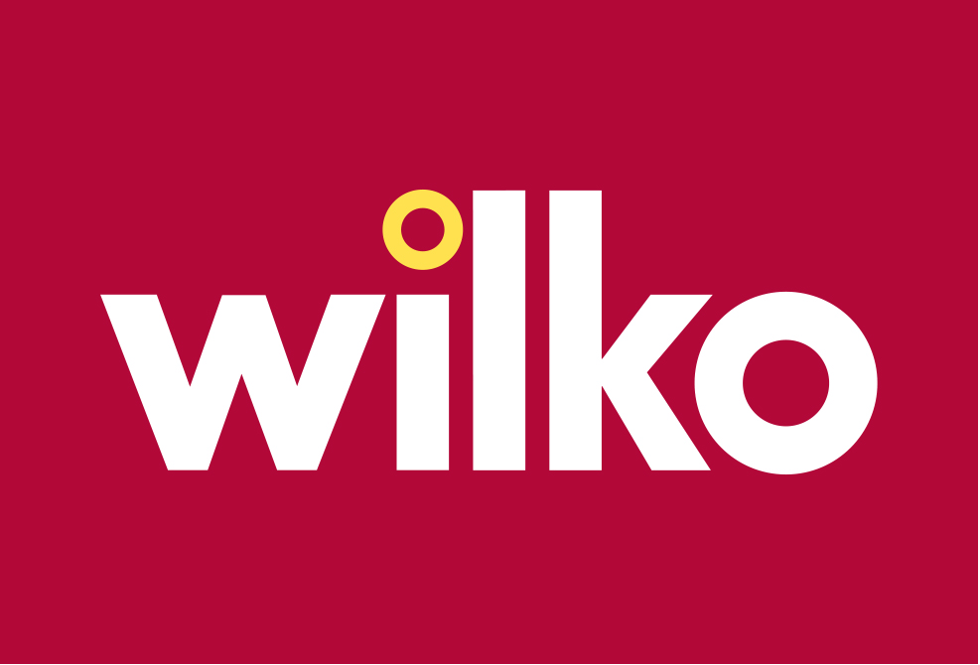
Wilko retail sees lockdown demand with TV advertising
Source: BARB / Google Trends, 2020
Notes:
For some types of advertisers, For some types of advertisers, the lockdown environment, plus TV advertising, has driven search demand.
Retailer Wilko is a good example of a brand which has benefitted from TV advertising during the lockdown period.

Slide 18
Expert guidance for advertisers
SECTION THREE
Virgin Media ‘Stay Home, Stay Safe, Stay Connected’

Slide 19
Peter Field’s guidance for this recession
Do not withdraw brand advertising, unless short-term survival depends on it
Resist the pressure to switch spend from brand solely to activation
If the resources can be found, aim to maintain your share of voice, ideally at least at the level of your market share
Consider the opportunity to invest in lower-cost long-term growth by increasing share of voice during the recession
Do not abandon your existing brand campaign unless it is clearly unsympathetic to the mood of customers
Do not be frightened to use emotional brand advertising during recession – but ensure it is appropriate to the mood of customers
Look for tactical opportunities to create goodwill through acts of humanity and generosity
Source: ‘Advertising in Recession – Long, Short or Dark? A Guide to Advertising Best Practice in Recession’, Peter Field, April 2020.
Notes:
‘Advertising in Recession — Long, Short, or Dark? A Guide to Advertising Best Practice in Recession’
Peter Field, April 2020
https://business.linkedin.com/marketing-solutions/blog/linkedin-news/2020/advertising-in-recession-long-short-or-dark

Slide 20
Advertisers with higher SOV in last recession benefitted most
Source: Peter Field / IPA
Notes:
Analysis of the IPA databank covering cases during the 2008-2009 recession shows that advertisers with highest share of voice benefitted from greatest effectiveness.
https://cdn2.hubspot.net/hubfs/2235762/Coronavirus/Week%208/System1_PeterField_Week8_Webinar-compressed.pdf?utm_campaign=Coronavirus&utm_source=hs_email&utm_medium=email&utm_content=87921430&_hsenc=p2ANqtz-8jMDlrqsDABPAzT7U-lGdVIiXEWYPLv4hGVZD-EylzRgTLj0C_Lja4bfGyttcjebE0vYMgg12aBgQbuq0nPwhKYK_dDQ&_hsmi=87921430

Slide 21
The optimum response to the recession is to maintain, and ideally increase, your advertising investment… There are few things more proven in the world of marketing than the power of advertising in a recession
“
“
Mark Ritson
Marketing Week, April 2020
Notes:
‘The best marketers will be upping, not cutting, their budgets’
Mark Ritson, Marketing Week, April 2020
https://www.marketingweek.com/mark-ritson-marketing-spend-recession-coronavirus/

Slide 22
Creative guidance from System1’s Orlando Wood
There has been no reduction in advertising’s ability to connect with people
Certain advertising characteristics are connecting slightly better today, e.g. ads using established brand characters or campaign scenarios
Certain advertising characteristics are connecting slightly less well at this point in the crisis, e.g. ‘hard sell’ ads directly focusing on price
Companies should embrace generosity of spirit, humour, humility and spontaneity in their communications and working practices
Source: ‘What Should Ads Look Like in the Time of Recession?’, Orlando Wood, April 2020
Notes:
‘What Should Ads Look Like in the Time of Recession?’
Orland Wood, April 2020
https://business.linkedin.com/marketing-solutions/blog/content-marketing-thought-leaders/2020/what-should-ads-look-like-in-the-time-of-recession-

Slide 23
Why TV advertising during a time of uncertainty?
SECTION FOUR
Cadbury ‘This Doesn’t Need to End’

Slide 24
Why TV advertising during a time of uncertainty?
Superior effectiveness
Driver of short-term sales
Low short-term risk
Highly trusted
Notes:
TV advertising has been proven to have superior effectiveness, be a high contributor of short-term sales, be a low risk advertising medium and is a highly trusted form of advertising.

Slide 25
TV delivers 71% of advertising-generated profit
Bubble size represents % of total profit
Total profit = all return (short + long-term)
generated over 3 years
Print: 18%
TV: 71%
Online Video: 4%
TOTAL PROFIT ROI EFFICIENCY
Radio: 3%
OOH: 3%
BREAK EVEN
Online Display: 1%
% OF BUDGET
Source: ‘Profit Ability: the business case for advertising’, Nov 2017
Ebiquity ROI campaign database (Feb’14-May’17) & Gain Theory. Campaign obs: 1,954
NB: Online Video includes Broadcaster VOD, YouTube, Facebook video & online programmatic video
Notes:
Findings from ‘Profit Ability: the business case for advertising’ commissioned by Thinkbox with Ebiquity and Gain Theory shows that only by looking at the combined short and long-term effects of advertising can you see the entirety of what each medium provides in profitable return. To do this we combine the results of the short and long-term section of the Profit Ability study to report total efficiency and profit volume returned by media channel.
TV delivers 71% of total advertising-generated profit over 3 years despite TV currently commanding 54% of average advertising budget.
For more information on this study please see:
https://www.thinkbox.tv/research/thinkbox-research/profit-ability-the-business-case-for-advertising/

Slide 26
TV creates 62% of short-term profit at the highest efficiency (all categories)
Bubble size represents % of short-term return
TV: 62%
Radio: 5%
Print: 22%
SHORT-TERM PROFIT ROI EFFICIENCY
Online Video: 5%
BREAK EVEN
Online Display: 2%
OOH: 3%
% OF BUDGET
NB: Online Video includes Broadcaster VOD, YouTube, Facebook video & online programmatic video
Source: ‘Profit Ability: the business case for advertising’, November 2017
Ebiquity ROI campaign database (Feb’14-May’17). Campaign obs: 1954
Notes:
TV drives the largest short-term profit at the highest efficiency, as shown by findings from ‘Profit Ability: the business case for advertising’ commissioned by Thinkbox with Ebiquity and Gain Theory.
This chart demonstrates how each channel performs in terms of its short-term efficiency (ROI) versus % budget. However, it’s crucial to consider not only the ROI efficiency of a channel, but also the relative profit generated by each media (represented by the size of the ‘bubble’).
Whilst TV accounts for just over half of all media spend in the Ebiquity database, the returns from TV represent nearly two thirds of all the measured short-term profit generated from media investment. The impact of TV investment surpasses what the weight of investment implies it should deliver.
For more information on this study please see:
https://www.thinkbox.tv/research/thinkbox-research/profit-ability-the-business-case-for-advertising/

Slide 27
TV’s short-term effect drives high level of sales
Source: ‘Demand Generation’, Nov 2019, MediaCom/Wavemaker/Gain Theory
Notes:
‘Demand Generation’, a Thinkbox study conducted by WPP agencies Mediacom, Wavemaker and Gain Theory, investigated how advertising channels contribute to short-term sales.
Results showed that TV was responsible for nearly a quarter of all sales which are generated within two weeks of a campaign going live – second only to generic paid search.
For more information on this study please see:
https://www.thinkbox.tv/research/thinkbox-research/demand-generation/

Slide 28
TV is the safest investment in the short-term
£2.50
£2.00
£1.50
£0.50
£0.00
Inter-quartile range
SHORT-TERM PROFIT ROI
BREAK EVEN
Source: : ‘Profit Ability: the business case for advertising’, Nov 2017
Ebiquity ROI campaign database (Feb’14-May’17) Campaign obs: 1954
NB: Online Video includes Broadcaster VOD, YouTube, Facebook video & online programmatic video
Notes:
Findings from ‘Profit Ability: the business case for advertising’ uncovered the risk associated with advertising in different forms of advertising in the short term.
Ebiquity assessed the investment risk by the typical range of ROIs delivered in the short term for each media. To do this they removed the outlying ROIs and focussed on the middle 50%. This is called the inter-quartile range and demonstrates the typical short-term ROI a brand could expect. The shorter the bar, the higher the certainty. The higher the bar the better the short-term efficiency.
The discovered that TV is the safest place to invest your advertising budget.
For TV, the inter-quartile range is consistently higher than it is for other media, meaning that TV is a safer investment than other media channels and more likely to deliver a profitable short-term ROI. It also delivers the highest maximum profit ROI in the short-term.
For more information on this study please see:
https://www.thinkbox.tv/research/thinkbox-research/profit-ability-the-business-case-for-advertising/

Slide 29
TV advertising is the most trusted
TV
Newspapers
Websites
Radio
Magazines
YouTube
Social Media
Search
Outdoor
Source: TV/Ad Nation, 2016, Ipsos Connect/Thinkbox, adults 15+ Question: ‘In which, if any, of the following places are you most likely to find advertising that…’
Notes:
Thinkbox’s ‘TV Nation’ work showed that TV ads were by far the most trusted form of advertising.
For more information on this study, see the full write up on the Thinkbox website:
https://www.thinkbox.tv/Research/Thinkbox-research/TV-Nation-Ad-Nation

Slide 30
Find out more on Thinkbox.tv
Helping you get the best out of TV
Notes:
Find out more from Thinkbox
Whether you are in need of information or inspiration, we’ll keep you up to date:
Visit www.thinkbox.tv
Register for our newsletter
Or simply talk to us

