Slide 1
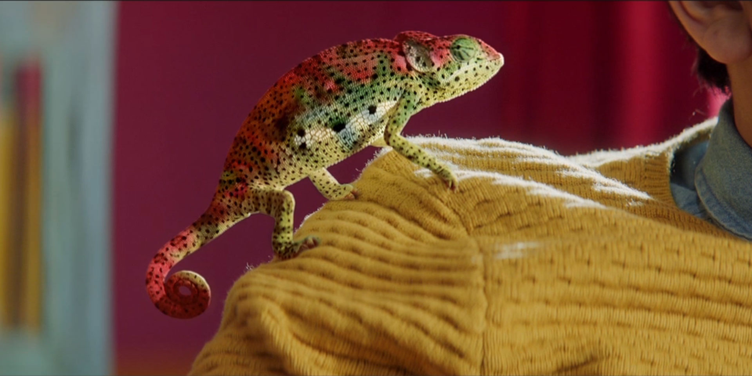
Nailing DIY with Wickes
Challenge
Wickes wanted to change perceptions and drive consideration, particularly with 16-34s, and increase sales at key DIY periods
Solution
Carat identified sponsorship of ‘Homes on 4’ as the perfect vehicle which included:
Over 2,600 hours of content sponsored across Channel 4, More 4 and 4 Seven, plus all VOD programming on All 4, with the Wickes logo on promotional trails
Co-creation of an original content series, My Epic Room Makeover, consisting of four 8-minute long episodes, with additional activation via a Channel 4 competition
Coupled with tactical ad campaigns such as ‘buy-it-now-do-it-later’
Results
71% of viewers of C4 Homes would consider Wickes for home improvement purchases
Easter fortnight was £1m more profitable compared to the prior year
Notes:
The Challenge:
As a challenger brand, Wickes was traditionally perceived as a destination for tradesmen. They understood that, if they were to grow the business, they needed to remain an important retail destination for their heartland, the Trade; as well as growing their relevancy to the DIY consumer as well, striking the right balance of media to reach both audiences.
Wickes wanted to change perceptions, drive consideration and increase sales at key periods
Solution:
With the need to raise awareness and change perceptions, Carat identified TV sponsorship as a perfect vehicle. And Homes on 4 was the perfect match.
In ‘Homes on 4’, not only did Wickes find accessible and inspiring subject matter that was very obviously relevant, but more than that, the shows are about real people taking on projects of their own whilst being guided, advised and sometimes merely observed by the expert hosts.
Across the first year of the partnership in 2017, a range of elements were included:
Over 2,600 hours of content sponsored across Channel 4, More 4 and 4 Seven, plus all VOD programming on All 4, with the Wickes logo on promotional trails
Co-creation of an original content series, My Epic Room Makeover, consisting of four 8-minute long episodes, with additional activation via a Channel 4 competition
Employees engagement through ticket giveaways to Channel 4 shows and events
Activation of the ‘Homes on 4’ licence through customer communications across e-CRM, direct mail, catalogues and in-store radio.
Wickes also needed to stimulate short-term spikes in awareness during the key sales periods of Easter and bank holiday weekends:
To drive cut-through and reach, Wickes took over an entire ad break on Good Friday in Channel 4’s top Easter weekend show, Gogglebox. Featuring Channel 4 talent, Dom Joly, twelve bespoke spots were created and, in the takeover, each Wickes ad contextually linked to the ad before. For example, after a Lidl wine ad, Dom reminded people they should be wining and dining a dashing date instead of doing DIY.
To maintain impact throughout the weekend, similar takeovers (although non-contextual) appeared across the Channel 4 portfolio and this was supported by interactive VOD ads that featured location-based store proximity information to drive engagement.
Results:
The sponsorship idents alone have reached 83% of the adult population
Of those exposed to the sponsorship:
61% of viewers had an improved opinion of Wickes
71% of viewers of C4 Homes would consider Wickes for home improvement purchases
89% of viewers were inspired to start a new project and more likely to consider using Wickes
63% of the younger DIY audience have an improved perception of Wickes due to the partnership
75% of viewers were aware of Wickes painting and decorating products, compared with 66% of non-viewers
50% uplift in engagement for interactive VOD formats
My Epic Room Makeover was seen 4.6m times:
26% of 16-34 year olds were inspired to start a project after watching
79% said that it improved their opinion of Wickes
Easter fortnight was £1m more profitable compared to the prior year
Online sales smashed through the £1m barrier for the first time on Good Friday, and then immediately broke that record with £2.3m on Easter Monday
For the full case study and to view the ad campaigns visit: https://www.thinkbox.tv/Case-studies/Wickes

