Slide 1


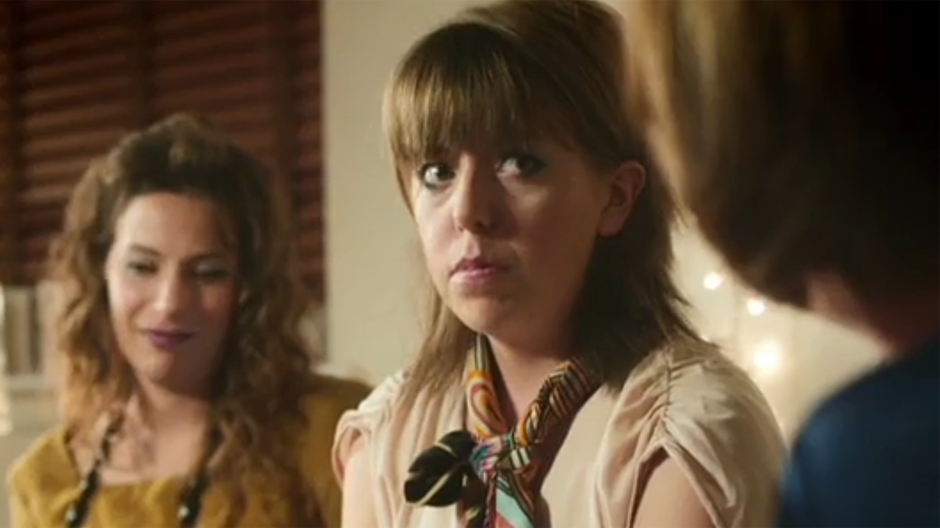
Boots delivers more than just invitations to feel good
Challenge
Boots wanted to increase frequency of visit amongst their core consumer base over the Christmas period
Solution
Mother and OMD opted for five different creatives to support multiple layers of business – gifting, winter health, fragrances etc.
Planning strategy shifted to ensuring that consumers saw as many versions of the ads as possible to appeal to different shopping missions
Results
Christmas gift sales increased by 8%
Notes:
Challenge
Boots launched their brand promise “to champion every woman’s right to feel good” back in November 2007. Since then they have engaged their core audience of 25-55 women via the “Here come the girls” creative campaign. The traditional creative strategy focused on Boots demonstrating their ability to understand real women and creating TV advertising based on true insights into how women feel about health and beauty.
However, in 2010 the market had shifted and supermarkets were encroaching into the health and beauty categories so Boots needed to make a change. Boots primary business objective was to increase frequency of visit amongst their core customer base. An understanding of what motivates women to shop in Boots was required to achieve this.
‘Mission shopping’ best describes the way in which women typically shop health and beauty categories. They generally have different shopping missions depending on the category and the immediacy of their requirements. The path to purchase on a moisturiser for example is a lot longer and involves more research than shopping for an immediate needs based product such as paracetamol. The previous communication strategy focused on four week vertical promotions which often triggered a single mission shop per month. The challenge for Boots was to alter the strategy and encourage women to shop more frequently in the stores. To achieve this Boots had to communicate more of the services and promotions that Boots offer and ensure they were front of mind for multiple missions.
The “Here come the girls” communication strategy needed amending to incorporate the multiple mission aims. However, the three most effective aspects of the creative strategy were retained these being the celebration of sisterhood, the demonstration of a deep understanding of women and the famous music. In addition a cast of comedy actresses were introduced to play different characters in multiple scenarios with a more humorous tone. The aim of this was to create a number of individual executions supporting a multitude of products and services rather than just one solus advert as of the Boots campaigns of the past, thus delivering multiple “invitations to feel good” to the target audience. This reflected not only why but how women shop.
The Solution
The role of TV was clear – to help deliver the new communication strategy to deliver more invitations to feel good to give women more reasons to shop at Boots more frequently. Christmas 2010 was the ideal time to bring the new communications strategy to life. 40% of Boots annual health and beauty budget is spent over the festive period to support multiple layers of business; Christmas gifting, Christmas parties, winter health and Christmas fragrances. It is a period of high visibility for Boots and it gave them a rich variety of messages to communicate.
Instead of focusing on the big 60” spot announcing the start of the Christmas advertising period, Boots in conjunction with their media agency OMD and creative agency Mother launched five multiple length Christmas related executions. This meant that the planning strategy had shifted away from chasing 1+ cover to ensuring that consumers saw as many versions of the adverts as possible over a condensed period to build early Christmas brand favourability in a unique way and appeal to as many different shopping missions as possible.
Through the use of DDS Craft OMD tracked viewing behaviour over the same period in 2009 and used the data to predict the ‘journey’ that viewers would take across different TV channels. The viewing journey was then overlaid with TV executions to ensure the target audience were exposed to more than one execution in close proximity to another during a single evening of viewing. This was a crucial element of the plan as the TV laydown had to fully mirror a typical journey to maximise the impact of multiple executions.
To maximise touchpoints of TV executions and to specifically target light TV viewers video on demand was included on the plan for the first time at Christmas. This was utilised for three of the executions, fragrance, party and mix and match. C4Beauty on 4oD was utilised for the party creative to drive relevance with the cosmetics content.
Results
Christmas gift sales up 8%
ITV.com research showed that, with the addition of video on demand to the plan, awareness of Boots as a fragrance retailer increased by 9%
TV recognition scores up from 71% in 2009 to 75% in 2010 (Source: Synovate)
The success of the new communication strategy has now been implemented across the remainder of the annual plan
Finalist in ‘Best Use of TV in an Integrated Campaign” in the 2010 TV Planning Awards
TV played a pivotal role in the success of the campaign. It was used to build reach early in the Christmas season and the creative executions demonstrated how women shop for health and beauty products and delivered insight based advertising that resonated with consumers. TV was also used as a springboard to deepen conversations in more ‘one to one’ media channels such as press and online where consumers would be looking for gift inspiration. By being active on TV across the festive period, Boots ensured they would be top of mind during the most business critical time of the year and it also helped other media work harder to secure the crucial additional visits to stores.
To read the full case study and access the creative visit: https://www.thinkbox.tv/Case-studies/Boots

