Slide 1
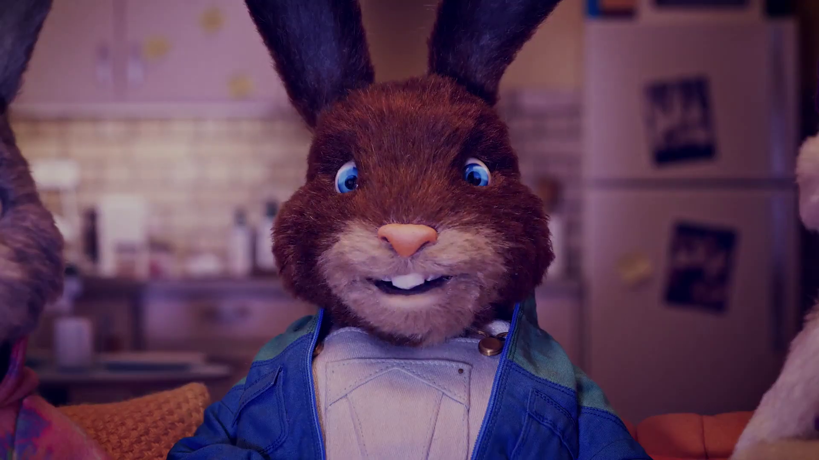
Monthly TV viewing report
February 2024
“Season Finale”, Just Eat

Slide 2
February linear TV facts & figures
Total TV weekly reach %
Total TV viewed per day
Commercial TV viewed per day
Impacts
Individuals
78.4 | 53.4bn | 2h 25m | 1h 37m
81.0 | 51.6bn | 2h 45m | 1h 50m
80.2 | 20.7bn | 2h 13m | 1h 22m
62.1 | 3.6bn | 43m | 29m
80.1 | 23.3bn | 2h 39m | 1h 46m
81.9 | 28.3bn | 2h 51m | 1h 53m
79.4 | 3.9bn | 1h 31m | 1h 2m
Adults
ABC1 adults
16-34
Men
Women
Housepersons with children
Sources: Barb February 2024, industry standard TV viewing in-home on a TV set. Reach 3min+. 30” equivalent impacts.
Notes:
February linear TV figures for weekly reach, impacts, total TV viewing hours and commercial TV viewing hours

Slide 3
Some notable TV moments in February
On 25 February, ITV1 aired the penultimate episode of Trigger Point to an average audience of 7.38m
On 26 February, Channel 4 aired The Jury: Murder Trial to an average audience of 3.17m.
On 22 February, Channel 5’s Too Good To Be True aired to a live audience of 468k, time-shifted audience of 879k, and a pre-broadcast audience of 307k.
On 4 February, Sky Sports aired Arsenal v Liverpool to an average audience of 1.24m on TV set and 88k on device.
Source: Barb, February 2024, individuals. Average audience figures, TV set and devices viewing 1-7 days (includes pre-broadcast figures, if applicable). Coronation figure from Barb publication.

Slide 4
Top 5 ITV1 programmes
Trigger Point (25 February) 7.38 million viewers
After The Flood (14 February) 6.14 million viewers
Ant & Dec’s Saturday Night Takeaway (24 February) 5.86 million viewers
The Masked Singer (17 February) 5.54 million viewers
The 1% Club (24 February) 5.18 million viewers
“Ant & Dec’s Saturday Night Takeaway”, ITV1
Source: Barb, February 2024, individuals. Average audience figures, TV set and devices viewing 1-7 days (includes pre-broadcast figures, if applicable)
Notes:
Top 5 programmes - ITV

Slide 5
Top 5 Channel 4 programmes
Gogglebox (23 February) 3.50 million viewers
The Jury: Murder Trial (26 February) 3.17 million viewers
The Great Pottery Throw Down (11 February) 2.76 million viewers
To Catch a Copper (5 February) 2.17 million viewers
Kirstie and Phil's Love It or List It (7 February) 1.72 million viewers
“Gogglebox”, Channel 4
Source: Barb, February 2024, individuals. Average audience figures, TV set and devices viewing 1-7 days (includes pre-broadcast figures, if applicable)
Notes:
Top 5 programmes – Channel 4

Slide 6
Top 5 Channel 5 programmes
Too Good To Be True (14 February) 2.21 million viewers
Madame Blanc (8 February) 2.01 million viewers
Inside The Force (26 February) 1.47 million viewers
Air Fryers: An Easy Way To Lose Weight? (28 February) 1.47 million viewers
Ben Fogle: New Lives in the Wild (6 February) 1.46 million viewers
“Inside The Force”, Channel 5
Source: Barb, February 2024, individuals. Average audience figures, TV set and devices viewing 1-7 days (includes pre-broadcast figures, if applicable)
Notes:
Top 5 programmes – Channel 5

Slide 7
Top 5 commercial non-PSB* programmes (non-sport)
Love Island All Stars, ITV2 (13 February) 2.39 million viewers
Married at First Sight Australia, E4 (27 February) 1.42 million viewers
Married at First Sight UK: The Reunions, E4 (26 February) 1.10 million viewers
G'wed, ITV2 (26 February) 0.78 million viewers
True Detective, Sky Showcase (12 February) 0.77 million viewers
“Love Island All Stars”, ITV2
Source: Barb, February 2024, individuals. Average audience figures, TV set and devices viewing 1-7 days (includes pre-broadcast figures, if applicable)
Notes:
Top 5 programmes – commercial non-public service broadcasting channels

Slide 8
Top commercial programmes with largest proportion of device viewing
Total audience
2.39m
1.21m
1.10m
1.33m
1.09m
Source: Barb, February 2024, individuals. Average audience figures, TV set and devices viewing up to 7 days post-broadcast. Based on programmes with 1 million+ total TV viewers
Notes:
Top commercial programmes with largest proportion of device viewing

Slide 9
Top commercial programmes with largest proportion of pre-broadcast boxset BVOD viewing
Total audience
6.14m
6.91m
1.31m
1.04m
1.65m
Source: Barb, February 2024, individuals. Average audience figures, TV set and devices viewing up to 7 days post-broadcast. Based on programmes with 1 million+ total TV viewers
Notes:
Top commercial programmes with largest proportion of pre-broadcast boxset BVOD viewing

Slide 10
Key new to linear TV advertisers in February
Dalgety Herbal Teas As part of Channel 4’s Black In Business initiative, Dalgety Herbal Teas launched its first-ever TV advert.
Jollyes Pet supply superstore Jollyes launched its first-ever TV campaign, promising to get tails wagging.
Air up Water bottle brand Air up debuted its first ever UK TV campaign across linear TV and BVOD.
Air Up “Not a water bottle”
Notes:
New to TV advertisers in February.

