Slide 1


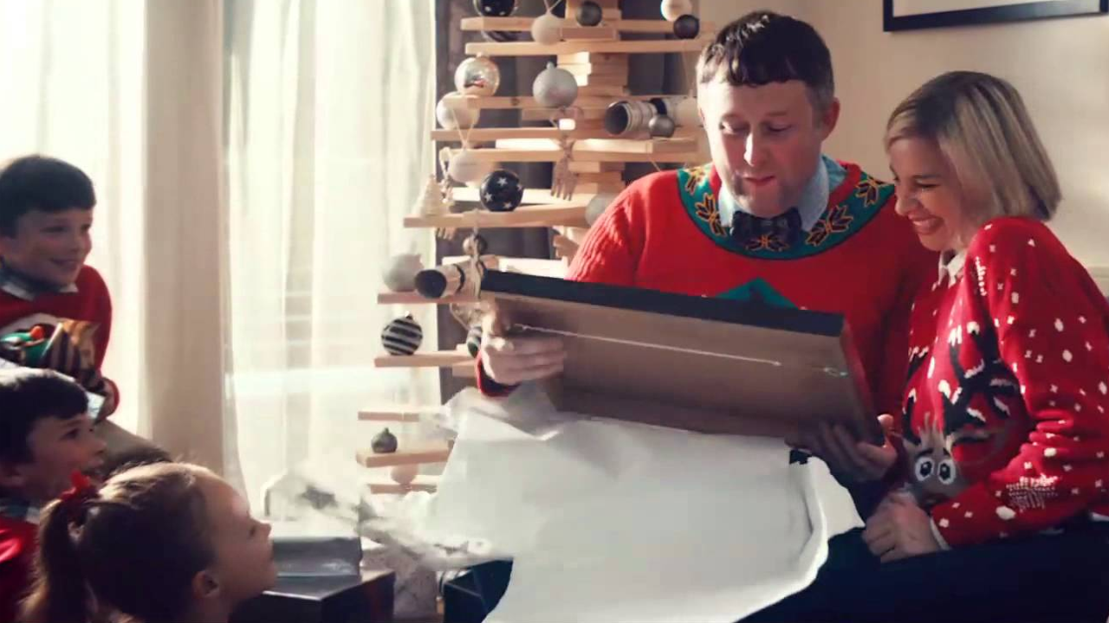
Notonthehighstreet.com used all the elements TV has to offer to drive Christmas success
Challenge
NOTHS wanted to drive awareness of their unique gifts whilst increasing business growth
Solution
They used a multi-format campaign targeting “Early Planners” featuring 60, 30 and 10” ads, pre-rolls on BVOD and an on-air competition in The X Factor to generate maximum impact
As Christmas drew closer, programming was skewed more towards men, estimated to account for 7 out of 10 last minute shoppers
Results
Sales grew by 53% year on year
Black Friday saw the brand’s most successful day ever with sales growing 187% YoY
Notes:
Challenge
Christmas is a special time. One of the most fun things about Christmas is the presents we give and receive. The presents we love best, we hold onto long after the Christmas tree is taken down.
In 2014, there appeared to be growing demand for buying different presents, as 9% of people now buy at least some of their gifts from Christmas craft fairs. Research showed that people thought that the best presents were the ones that someone had put genuine thought into.
Notonthehighstreet.com pride themselves on offering shoppers a more original and inspired selection of presents that are more personal to the recipients. For their Christmas campaign in 2014, they wanted to celebrate how notonthehighstreet.com helps you find the perfect and unique gifts for the ones you love.
Their objective was to communicate this to Christmas shoppers, as well as driving awareness and delivering business growth in the process. However, with expenditure considerably less than their competitors, this was always going to be a challenge.
The TV Solution
They wanted to create buzz and awareness, particularly amongst people who start thinking and planning about Christmas early. TV was the obvious medium to choose because of its ability to reach a large number of people quickly and its power to generate buzz. These early planners became the core target audience for the brand. Their media agency, M2M, recommended that they target this audience using Sky AdSmart, as they were able to target three core mosaic audiences exclusively and deliver a creative message directly to them alone.
M2M then matched postcode data to identify if the brand message and the product featured within it had resonated with the audience. They were able to pinpoint the orders, sales and new customers directly generated by the campaign. This allowed notonthehighstreet.com to speak directly to and create brand awareness with the most relevant and thoughtful audience segments.
Launching early, on a big scale, meant they could deploy their budget where it would work the hardest. Their competitors traditionally launch during the second week of November and so, by launching their Christmas campaign before this, gave them a head start.
Plan
They decided to kick off the campaign with activity in The X Factor on 1st November. To create maximum impact and engagement, they opted to run a competition. They created a 60 second spot which asked viewers to count the number of Christmas trees they spotted during the ad and tweet their answer to #treespotting for a chance to win a voucher for notonthehighstreet.com worth £5,000. In the preceding break, there was a 10 second call to action spot that encouraged viewers to pay attention in the following break for a chance to win big money. In the break following, the winner was revealed live on air with their Twitter handle written amongst the stars for all to see.
The campaign continued with 60 second spots, in order to establish an emotional connection with viewers and drive the greatest impact in recall and awareness. In order to sustain the campaign throughout November, they introduced 30 second versions of the spots, ensuring an all-important presence in the build up to Christmas. They then supported this with 10 second reminder spots featuring the full range of exciting and unique gifts on the site.
M2M analysed BARB data in order to create a bespoke notonthehighstreet.com target audience and then identified the best converting channels and programmes in order to reach them. The programme mix included high profile event spots to reach a broader gifting audience, alongside upmarket female programming such as The X Factor, Homeland, Grand Designs, I’m A Celebrity Get Me Out of Here and Liberty of London.
As Christmas approached, programming was skewed more towards men, as it was anticipated that seven out of ten last minute panic-buying shoppers would be men. In addition, they upweighted the days around Black Friday and Cyber Monday as these are critical spending days in the run up to Christmas.
Alongside the TV campaign, notonthehighstreet.com used a bespoke interactive format across 4oD to reach viewers in their ‘me time’. The format meant that the viewer could link directly through to key sections of the website. They also ran pre-rolls on ITV’s BVoD to generate reach and standout.
The TV campaign was complemented by activity in national press gift guides, relevant weeklies, rich media online, OOH and radio. The TV ad featured rhyming couplets and so the radio campaign acted as an audio reminder of the TV creative.
Results
Expenditure from customers who had not bought from notonthehighstreet.com before doubled year on year
Growth in expenditure from active customers increased from 30% to 37%
Sales of multiple items from current buyers increased by 40%
Consideration for gift purchasing at notonthehighstreet.com increased 104%
Prompted brand awareness rose from 56% to 71%
Unprompted ad awareness increased 14% to 19% - a massive 36% lift compared to a category average for the same period of +16%
Brand image statements for unique, creative, original and inspirational all increased
On Black Friday, notonthehighstreet.com had its most successful day in its history, with sales growing 187% year on year
The X Factor competition spot drove a 77% increase in visits to the site that day. Traffic from mobiles and tablets saw the biggest uplifts of 91% and 83% respectively
#treespotting trended nationwide becoming the second most popular hashtag in the UK
notonthehighstreet.com saw the fastest growth in traffic of any other site, moving 21 places in IMRG’s top 50 retailer ranking for November
They drove 53% year on year sales growth, significantly higher than their competitors. Importantly, the growth has carried on post-Christmas in to 2015
To read the full case study and access the creative visit: https://www.thinkbox.tv/Case-studies/notonthehighstreet-com

