Slide 1
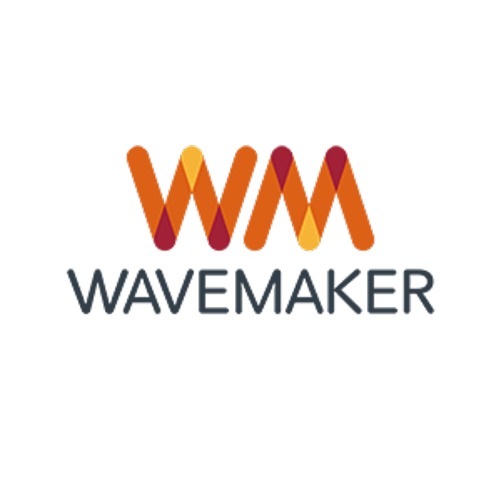

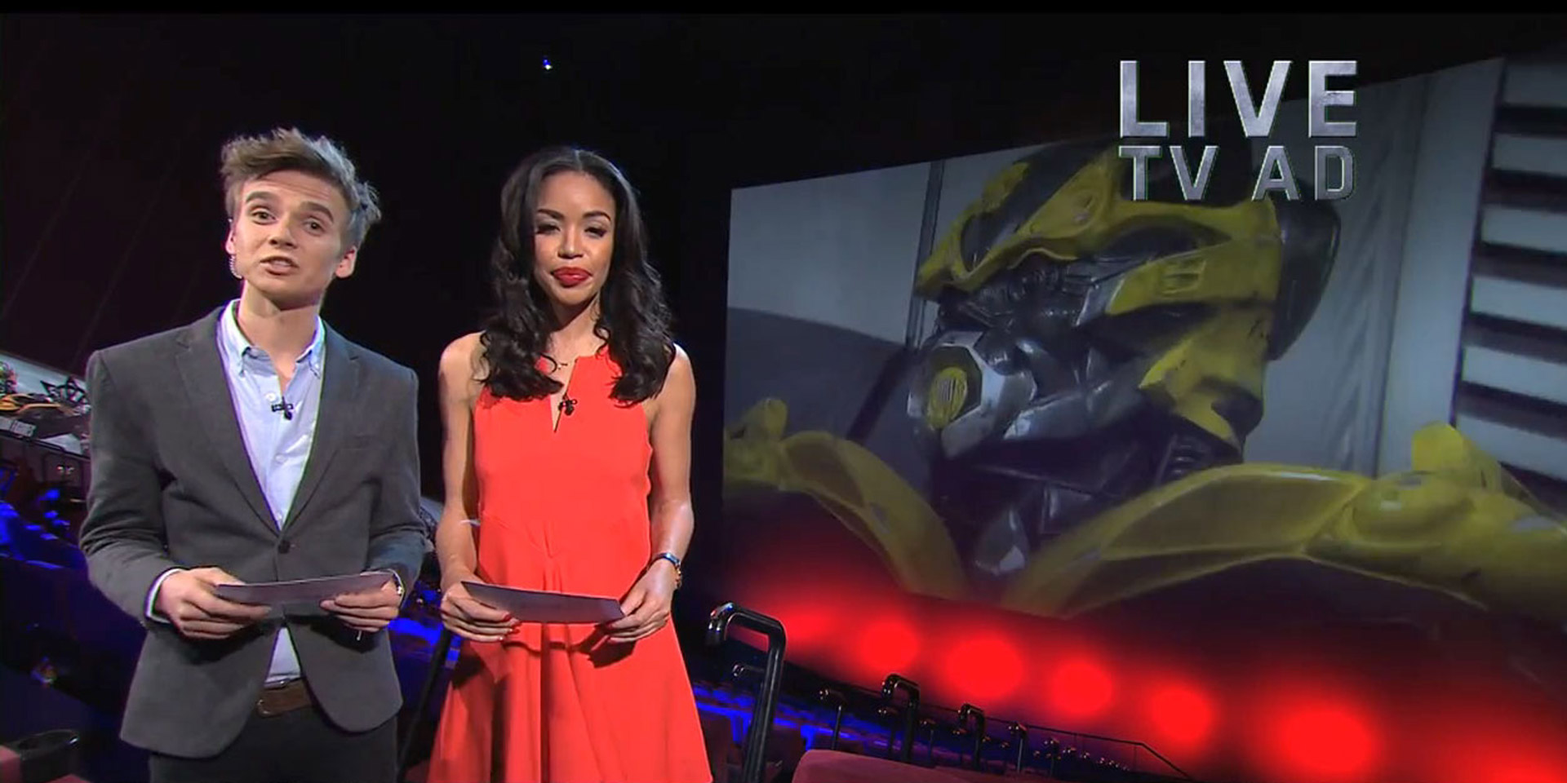
An absolutely Paramount TV execution for Transformers 4
Challenge
Paramount needed to deliver the largest opening for a Transformers movie and increase positive sentiment towards Transformers 4
Solution
They used the power of TV’s scale, in combination with its most highly sociable programming, to drive mass conversion
This was achieved by a 3 part partnership – bespoke co-created Transformer interstitials across C4 and E4, a live screening at the BFI IMAX to an audience of social influencers and an entire C4 night dominated with a series of three live ads
Results
Transformers 4 became a box office hit with the biggest opening of 2014, beating all previous Transformers films in the process
Notes:
Challenge:
With Age of Extinction being the 4th Transformers film and no longer featuring any of the key stars of previous releases (no Megan Fox or Shia Lebouf), it risked a reliable fan base potentially being disengaged and disinterested and being seen as expected and boring, making it very hard to drive buzz and admission for the film.
Further challenges included a budget decrease of 20% compared to the previous film and a release date that not only came up against two of the biggest films of the year but also during the World Cup.
Despite all of this, Paramount tasked itself with increasing positive sentiment towards Transformers 4 and delivering the largest opening for a Transformers movie ever in the UK. They knew they needed to do something a bit special in order to avoid being over-looked as more of the same and not worth talking about.
Paramount needed to inspire millions of people to talk about the film to help make it stand out amongst such fierce competition.
Solution:
Getting people to talk wouldn’t be an easy task. From understanding their audience of 16-34 year olds, Paramount knew that the key driver of talking about a film was actually seeing it and this was even more pronounced if their audience felt others may not have seen it. This gave the film social currency, helping the audience look well-informed and in the know.
Working with their media agency, MEC, Paramount turned their launch communication into a live exclusive screening of the film complete with pre and post film chatter. Being the most talked about media channel and the strongest conversation driver meant that TV was the only medium capable of generating high levels of word of mouth and was crucial to amplifying a single event like this.
To make this as effective as possible, they had to determine around which programmes their audience was most vocal, identifying those key shows which would drive both scale and conversation. MEC’s analysis showed that to engage with their target audience, Channel 4 would be able to provide the majority of the “buzzworthy” programming to spark conversation and by exclusively partnering with Channel 4, this meant that Paramount could dominate the launch period, despite its reduced budget, and tap into highly sociable programming to drive mass conversation.
The partnership was made up of 3 key parts:
Bespoke co-created Transformers interstitials across Channel 4 and E4
A live screening of Transformers 4 at the BFI IMAX to an audience of social influencers
An entire Channel 4 night dominated with a series of three Live Ads, the greatest number ever ran in a single night on TV
Channel 4 and E4 worked with Paramount to co-create interstitials of the channel logos transforming into a Transformer’s face. These 10” interstitials ran on both channels in the lead up to the night of the exclusive screening to help generate buzz about the upcoming event.
The exclusive screening of the event itself included an audience of social influencers and die hard Transformer fans who were most likely to engage in conversations, with reactions and commentary that were broadcast to the wider audience through not just one but three live ads that dominated Channel 4 that night.
The first of the live ads was 30” straight from the red carpet before the start of the film, after an episode of Hollyoaks on Channel 4. The presenters set the scene and sparked excitement for viewers, asking them to tune back in at 10pm to hear immediate reactions to the film and promising an exclusive two minute preview of the hotly-anticipated film, introduced by one of the stars of the film Mark Wahlberg. At 10pm that night, Paramount took over an entire ad break in One Born Every Minute with exclusive content live from the IMAX. The final of the three live ads went out in 8 out of 10 Cats. It shared more previously unseen footage from the film and directed viewers to a special transformersreview website for more reactions to the film.
Results:
9.9m people watched the Channel 4 partnership, on the evening of the live screening.
Conversations about the film generated an earned reach of over 10m
Positive sentiment about the film grew to 80%
Transformers 4 became the biggest opening of 2014, a box office hit, and the biggest-opening Transformers movie ever in the UK (£11.75m) beating competition from all other major releases.
Transformers 4 became the biggest film in the world in 2014
Finalist in Thinkbox TV Planning Awards 2015: Best use of TV innovation
For the full case study and to view the ad campaigns visit: https://www.thinkbox.tv/Case-studies/Paramount

