Slide 1
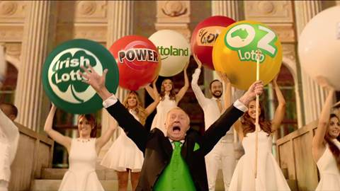
Lottoland launches in the UK
Challenge
Lottoland wanted to launch the brand, generate trust and inspire purchase. Their target was to recruit 100,000 new players from a standing start
Solution
Through a deal with Sky Media, Lottoland used the SkyView panel to target regular lottery players
By recording multiple voice overs, Lottoland were able to serve ads dynamically, detailing the latest Jackpot size
Results
146,000 new customers generated
New customer revenue target exceeded by 48.7%
Gaming revenue target exceeded by 174%
Notes:
Challenge:
The National Lottery has been around since 1994 and so has become a constant presence in people’s lives. However, 8 out of 10 people still buy their lottery tickets on the high street. Lottoland is a proposition well suited for the current climate, as it offers players the opportunity to bet online on the biggest and best lotteries throughout the world for the chance to win a new jackpot every day.
More than 32 million people play the lottery in the UK and so Lottoland wanted to grab the attention of this existing market and extend their behaviour. They knew that response would be dependent on trust and so the challenge was to deliver a campaign that combined immediate credibility with instant returns.
Success would be measured over a four month trial period and based on the number of new players acquired and the revenues generated. Their target was to recruit 100,000 new players from a standing start.
An additional challenge was that UK lottery advertisers spent over £50m on TV in 2015 so they knew they would have to do something special to cut through competitor noise.
Solution:
Their agency, Home, recommended an audio-visual approach, as they felt this was the best way to explain and educate. TV would be the spine of the launch campaign, as they wanted mass-market exposure and also to build trust, a key strength of TV.
Research showed that jackpot size was by far the biggest motivator for playing the lottery and so it was important that this could be communicated in the campaign. As the size of the jackpot varied all the time, they needed a campaign that could offer ‘real-time’ jackpot updates. In a category heavily driven by the unpredictable ‘size of jackpot’ variable, success would ultimately be determined by the speed of reaction. In addition, they wanted to reach viewers when they were most likely to be connected to the internet.
Data informed them that the core audience would be those people already purchasing lottery tickets, ideally more than once a week and from more than one supplier, so they needed to seek these people out. Instinct from Home led them to explore Sky subscribers as a potential audience. This intuition proved correct as Sky subscribers indexed highly for:
Regular lottery players
Purchase of Euromillions tickets
Access to gambling/bingo platforms online and on mobile
This insight led them to negotiate an exclusive partnership with Sky Media. Firstly, they interrogated the SkyView panel, to identify those channels most viewed by people who play lottery more than once a week. They chose lower rating programmes, as these tend to encourage more second screening. In addition, they chose sports programming as that audience are already primed for betting, often with mobile device in hand.
They also negotiated an element of flexibility with their airtime, so they could reduce or upweight the spots at short notice, depending on the size of jackpots that Lottoland was advertising.
The ads, featuring Chris Tarrant, were designed to be highly responsive to the jackpot size. Chris recorded millions of versions so that the correct number could be announced. This meant that the dynamic element of the campaign was an intrinsic part of the ad rather than an obvious bolt-on.
The TV campaign was supported by a radio campaign, paid search, broadcaster VoD and digital posters.
Results:
At the time of writing, the campaign had reached over 70% of adults
TV generated response from 31st August to 31st December 2015 accounted for 146,000 new customers
Revenue target for new customers was exceeded by 48.7%
Net gaming revenue target was exceeded by 174%
Finalist in TV Planning Awards Best Use of TV Innovation category
For the full case study and to view the ad campaigns visit: https://www.thinkbox.tv/Case-studies/Lottoland

