Slide 1
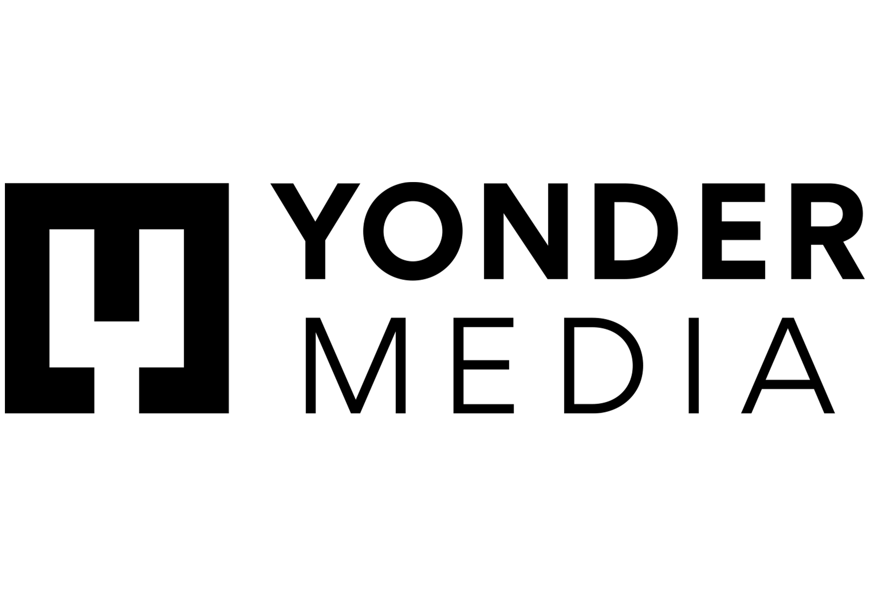
Zizzi – bringing different to the table
Challenge
Zizzi wanted to drive consideration and penetration amongst 16-34s
Solution
They worked with ITV to run a TV and BVOD regional test to reach their target audience
Results
+51% increase in spontaneous awareness among 16-34s vs the same period last year
Their campaign effectiveness study saw a 46% uplift in consideration amongst 16-34s exposed to the ad
Comparing the regions with advertising vs those without, penetration amongst 16-34s increased by 10% YOY, vs 6% for the regions without advertising
Notes:
The Challenge
Zizzi wanted to reignite the familiar memory of their Italian restaurant for their 16-34 cohort who considered Zizzi ‘just another’ chain restaurant, less exciting than others in the category, and not relevant for them anymore. Combined with the constantly evolving messaging surrounding eating out that impacted casual diners’ dinner schedules over the COVID period, Zizzi were faced with a tough job to get this younger demographic back on board.
Zizzi revamped the product in Autumn 2021, ‘bringing different to the table’ with stylish new interiors and a reinvigorated menu including funky new flavour combos and twists on the classics, such as chorizo carbonara, loaded ’nduja chips, and pasta crisps. However, there was stiff competition in the casual dining category so it was important for Zizzi to connect with those who would buy into their new look and feel, as well as their non-traditional approach to Italian food. The objective was to drive consideration by 20% and penetration by 6% year on year amongst their 16-34 target audience.
The TV Solution
Yonder Media’s strategy was fuelled by the insight that under 35s felt that Zizzi was no longer cool or exciting and weren’t even bothering to go in and take a look. They needed a powerful audio-visual medium that would get this group to reconsider their current perceptions and put Zizzi top of mind as a great choice for good times with friends. They chose TV and BVOD to showcase in full HD glory the revamped dishes, the stylish new décor, the cocktails and the party vibe, to show 16-34s that Zizzi is actually a fun place for people like them.
Yonder Media also drew on TV’s ability to drive fame and trust. Most of Zizzi’s bookings in December are group bookings: office outings and friendship groups and there’s usually one person in charge of choosing the venue and they often feel under pressure to choose well. Running a TV ad campaign on a broad reach basis, across linear and VOD in cherry picked genres, would help that party organiser choose Zizzi with confidence, knowing that their peers will have likely seen the ad too.
The Plan
Yonder Media wanted to find programmes that under 35s would watch and know their friends were watching too, like I’m a Celebrity or TOWIE. They were also looking for a smart way to maximise value whilst maintaining a premium environment.
The other consideration was regionality: Zizzi has a good distribution of restaurants in London, the South, and the Midlands, but barely any stores in the North, Scotland, Wales or Northern Ireland. This led Yonder Media to select ITV as their preferred media owner, enabling them to advertise regionally. They were also able to take advantage of ITV’s Backing Business initiative, which offers ‘new to TV’ advertisers additional airtime value for a debut TV campaign.
Yonder Media then created a test and learn plan, consisting of linear TV and BVOD on a regional basis, which would provide them with the perfect experiment to determine the impact of advertising on both consumer sentiment and behaviour. An ‘Elevate’ campaign effectiveness study was also set up with ITV to measure the impact of the campaign.
Results
+51% increase in spontaneous awareness among 16-34s vs the same period last year
Their campaign effectiveness study saw a 46% uplift in consideration amongst 16-34s exposed to the ad, increasing to 41% from 28%
Despite the resurgence of COVID, when Zizzi compared the regions with advertising vs those without, Zizzi’s penetration amongst 16-34s increased by 10% YOY, vs 6% for the regions without advertising

