Slide 1


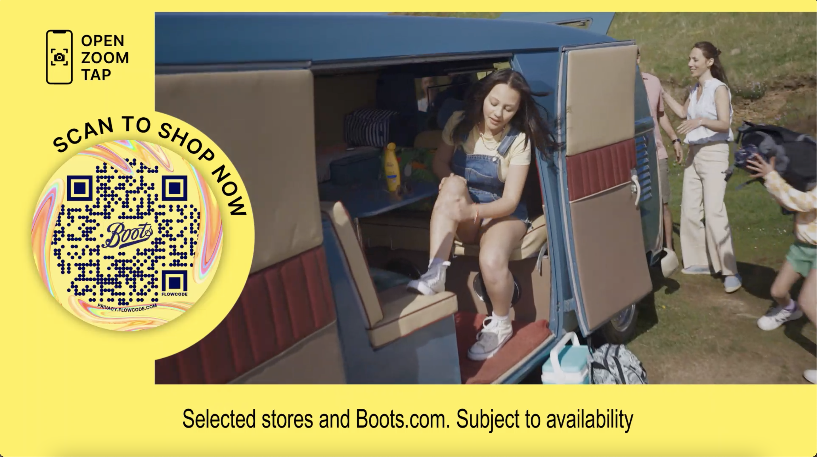
Boots: Leveraging data to fight against growing competition
The Challenge:
The brand was still well known with high scores in awareness, trust and perception but was fighting against growing competition and decline in footfall.
The Solution:
Leverage their first party data from over 15 million Advantage Card holders to offer personalisation on mass.
The Results:
Highest ever Share of Voice score, increased share of market for 7 consecutive quarters, maintained a stable ROI against increased spend for 3 consecutive years, AV accounted for 30% of in store sales growth and increased estimated bag value of 25-44 audience off the back of Love Island activity.
Notes:
The Challenge
Boots has been a high street staple for over 170 years with generation after generation using the store to pick-up last-minute holiday essentials or make use of the chemist in stores. 2019/20 had been a difficult period for Boots. Competition had increased with Supermarkets offering a wider beauty selection, online players like Cult Beauty entering the market and online retail juggernauts move into the beauty space. While Boots was still well-known and loved with brand metrics showing that awareness levels, trust and perception all in a healthy position, but the brand wasn’t giving customers a reason to return to stores either in person or online.
The objectives of the campaign were clear as a result, they needed to reverse the decline in penetration and increase market share.
The TV Solution
Boots had been long standing supporters of TV but in recent years with media budgets declining, TV had started to be used as more of a short-term response channel as a way of supporting offers or hitting short term business objectives. There were only 2 brand building campaigns a year, summer and Christmas, the remainder of the activity was focused on short bursts with short time lengths that would promote time-limited offers.
This activity wasn’t growing the brand and wasn’t leaning into what Boots’ main strength is, their offering. With a range that helped you through all the times in your life both good and bad. This would highlight Boots as the go to in both the best and worst moments of our lives.
Boots also have a secret weapon, they have over 15 million Boots advantage card holders. First party data that could be leveraged across broadcast channels to improve the long-term effectiveness and switch the narrative of TV from short term to long term investment that would deliver business results.
The Plan
The use of data in Boots TV activity kicked off at Christmas 2020. To understand the way in which current Boots customers consume TV, media agency, EssenceMediacom overlayed Advantage Card data with Barb data with agency tool, Minsights. This allowed EssenceMediacom to create 4 audience segments around shopping habits at Christmas. The four groups were called Core Carol, Online Engagement Sophie, Causal Sarah Jane and Deal Engaged Michele. The decision was made to focus on Core Carol for the brand linear TV Christmas activity as this group represented the biggest revenue opportunity and their media habits fitted with channel consumption around Christmas. This focused attention to a channel mix that best represented the Core Carol group’s media habits. This leveraging of Advantage Card data allowed Boots to increase the efficiency of their targeting by 13% and ensured that 83% of the Core Carol audience was exposed to the Christmas campaign. The remaining three audience groups were recreated using YouGov data, this allowed EssenceMediacom to target them across BVOD environments with a 48% increase in efficiency vs a broader audience buy. This showed Boots that they could offer mass personalisation to their key audiences at a macro level with broader audience receiving the most relevant messaging for their shopping and media habits.
This activity in 2020, showed that Boots could leverage data and create personal relevance to their customers. But this approach would only allow Boots to offer hyper targeting which would drive demand, but they need a broad audience approach that would deliver scale to drive the demand. To create this demand, Boots became the first EssenceMediacom brand to leverage its data across all three sales houses simultaneously. This allowed Boots to create 4 audiences within data bunkers based on the best source of growth of the brand. These covered Pharmacy, Beauty, Brand and Lapsed customers. This data match gave them a pool of viewers known to Boots across Sky, ITV Hub and All4, allowing them to target them with more relevant copy based on their purchasing habits. These audiences were scaled up with lookalike modelling to increase the pool of consumers and drive-up sales in stores.
Mass personalisation of their campaigns had been a success for Boots but in 2021, they noticed they were losing ground to competitors for younger audiences with under 25s 2 times less likely to shop at Boots compared to over 55s. To combat this, Boots sort out the biggest property on TV. They aligned with Love Island, as beauty partner with passive and active product placement in show. EssenceMediacom then increased spends into Love Island across linear and BVOD to drive home the association for younger audiences buying 9 spots in 2021 and 58 in 2022.
Boots learnt their use of data and targeting of existing customers would only take them so far. They needed to find a way that fuse TVs ability to tap into the nation’s mood with their wealth of first party data. This would allow EssenceMediacom to align the brand further with themes and moments that matched with Boots’ motto ‘With you for Life’. To do this, EssenceMediacom used HPTOs and 24-hour surges on BVOD to own moments and became a collection lounge partner with All4 during Christmas 2021. To take this further in 2022, Boots became one of the first brands to use ITV new Automated Contextual Targeting (ACT), which uses an AI to scan through every show on ITVX allowing targeting of certain moods, moments, or objects. Boots leveraged this to target moments of joy across ITV to align with their Christmas message of ‘Joy for All’, this created the association of finding the joy in finding the right gift for the right person all around the right contextual moments to create a contextual link between Boots and the viewer.
Results
The step change in TV activity had a profound effect on Boots business. Firstly, they were able to wrestle back share of voice from new players in the category, taking them to their highest ever score and moving them up to 3rd in the category. The campaign reversed the four years decline that Boots had experienced and increased their share of market for 7 consecutive quarters.
Econometrics run during the campaign proved that the ROI for the activity had increased for three years in a row. Against three back-to-back years of increasing spend Boots were able to maintain a stable ROI for 2022 despite being much higher up the return curve. In terms of in store sales overall media double its contribution over the 2020-2022 period with AV accounting for 30% of this in store sales growth.
The commitment to using first party data was also showed huge success. Brand tracking through first party data campaigns showed an increase in spontaneous ad recall for the in-market audiences with an increase in purchase consideration for 45–54-year-olds. The focus on Love Island also proved to be extremely successful, there was an increase in the estimated bag value with the highest value coming from 25-44 adults, the core viewers of Love Island across Linear and BVOD.

