Slide 1
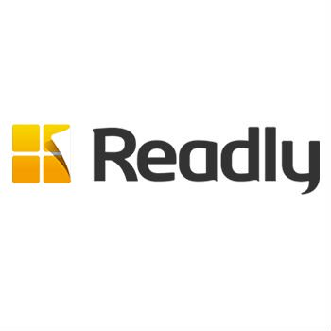
Readly leverages TV to reach digital magazine subscribers
Challenge
Readly wanted to grow their business, drive subscribers and usage and drive brand awareness
Solution
Achieved their goal of getting onto TV through an airtime-for-equity deal with Channel 4
TV campaign ran Jul-Dec, weighted towards weekends at breakfast time or mid-morning, with an ad that was shown 6,500 times in programming identified to drive the strongest engagement
Results
Tripled its subscriber base during the campaign, accounting for +210% year on year growth
Stimulated usage among existing customers with 40% of subscribers using the app daily
Notes:
Challenge:
Readly UK is a digital magazine newsstand that provides readers with unlimited, multi-device access to the digital editions of more than 700 magazines. Digital magazines are growing in popularity, particularly on mobile where consumers can have easy, immediate access.
Previously, Readly had spent the bulk of its marketing spend on online advertising and there was a feeling that TV would be too expensive. Not to mention that, in the publishing world, TV is considered an elitist medium. But Readly wanted to grow the business and they knew that TV had the ability to do this by reaching large numbers of people. Also, because many TV viewers multi-screen whilst watching TV, this provided the perfect environment for an online brand.
The challenge was how to get on TV with a small budget.
Solution:
Readly achieved their goal of getting on to TV through an airtime-for-equity deal with Channel 4. The airtime was funded by Channel 4’s Commercial Growth Fund – an initiative that offers high growth potential companies, who are not currently advertising on TV, the opportunity to build their business through advertising on Channel 4.
So from July to December 2016, Readly’s 30 second ads were shown 6,500 times. The airtime’s rate card cost was estimated at more than £1m.
Ranj Begley, Readly’s UK Managing Director said “The partnership with Channel 4 opened up the world of TV to us. For the first time, we had a mainstream presence and the opportunity to scale up our audience much more rapidly than we had originally forecast.”
Throughout the campaign, Readly worked closely with its agency Squadron Venture Media and also TVSquared’s ADvantage platform to measure and optimise spots. By accessing same-day analytics on TV performance, Readly could measure the immediate impact of TV and assess the precise ROI of each spot at every step of the acquisition process – from initial contact to free trial and on to paid subscription.
Working with TVSquared, Readly uncovered powerful, data-driven insights on campaign performance by day, daypart, genre, programme and ad creative. They were able to identify that the best days were weekends, the best times of day were breakfast and mid-morning and also which programmes drove the strongest engagement.
Results:
In the second half of 2016, when the TV campaign ran, readers opened more than 4m magazines – up 84% compared to the second half of 2015
Readly tripled its subscriber base during the TV campaign, accounting for +210% year on year growth
The subscribers that came that came through the Channel 4 activity proved to be highly engaged, using the service more quickly and intensely compared to subscribers from other sources
The TV campaign stimulated usage among existing customers, with 40% of subscribers using the app daily, averaging 22 minutes per reading session
Due to the success of the UK campaign, Readly Germany and also Readly Sweden have started their own TV initiatives. Readly UK is going to continue with the Channel 4 partnership and also launch into Ireland
For the full case study and to view the ad campaigns visit: https://www.thinkbox.tv/Case-studies/Readly-leverages-TV-to-reach-digital-magazine-subscribers

