Slide 1


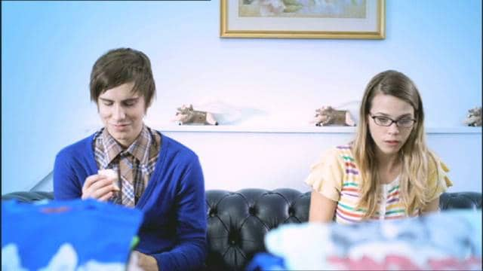
O2 talked to teens via Hollyoaks
Challenge
O2 needed to engage teenagers with their pre-pay Load & Go card to meet their ambitious target of 10,000 recruits within the first month
Solution
Partnered with Hollyoaks via a contextual ad campaign - 20 adverts were developed that complimented the Hollyoaks’ storylines and unfolded across a 4 week period, exclusively in centre breaks of Hollyoaks
Added a microsite for behind the scenes content, daily polls and competitions
Results
2 million teenagers watched the campaign on TV
The sales target was smashed by 300%
Notes:
Challenge:
In August 2009, O2 entered the financial category and needed to engage teenagers with their pre-pay Load & Go card. They knew it would be difficult to get teens interested in finance, so O2 needed to approach their target audience differently in order to meet the ambitious target of 10,000 recruits within the first month.
At the same time, O2 were also launching another pre-pay card aimed at adults using a spot campaign. So the additional challenge was how to talk only to teenagers to avoid confusion with the adult card. The TV activity needed to be discrete and highly targeted at teens.
The final challenge was to combine scale with engagement for maximum impact.
Solution:
O2 identified Hollyoaks as the perfect partner for their plan. With over 5.5 million viewers (80% of which are 13-17) and 2 million online users, it was the only show in the top 20 that indexes at over 150 on TGI for teens. It would allow O2 to deliver scale via a top TV programme and also deeper engagement via the web community of 400,000 monthly unique users.
O2 wanted to create the type of association that only sponsorship can provide, whilst also delivering a subtle sales message and a clear call to action that sponsorship does not allow. Contextual advertising provided the opportunity to do both. Through a close partnership with Channel 4 and Clearcast, they created a series of 20 individual adverts tailored to complement the ongoing Hollyoaks storylines. These ads were broadcast exclusively during Hollyoaks’ centre breaks.
The adverts featured two teenagers, Matt and Sam, who work together in a shop called Load & Go. Matt is a Hollyoaks superfan and the narrative focused on his relationship with his co-worker Sam. Their story unfolded across the four week period they were on TV, with characters and events from Hollyoaks tied into the advertising along with subtle Load & Go product integrations.
In order to support the contextual TV narrative, viewers were driven online to a microsite in the Hollyoaks section on Channel4.com. Here, fans were given unprecedented access to behind the scenes content that linked explicitly or implicitly to positive spending opportunities.
The online activity was supplemented with daily polls and competitions, with each episode accompanied by details of the blossoming relationship between Matt and Sam.
O2 identified 10 Hollyoaks “superfans”, who were invited to the set and were given instructions to engage with the thousands of followers Hollyoaks has across social networks, blogs and twitter. They generated thousands of conversations about O2 Load & Go Hollyoaks activity on every blog, forum, and social network page.
Results:
2 million teenagers watched the campaign on TV and 260,000 engaged further online
10% of positive buzz for the whole O2 Money launch was attributed to this campaign (Nielsen Buzz Metrics) Hollyoaks was the only element of the ad campaign to drive positive buzz
54% of those who saw the campaign said they were already or would consider applying for the card – an increase of 69%
Campaign recall was a staggering 80%
The sales target was smashed by 300%
The campaign won the Thinkbox Planning Awards Grand Prix in 2010 and also the Best Use of TV Innovation Award
For the full case study and to view the ad campaigns visit: https://www.thinkbox.tv/Case-studies/O2-Load-and-Go

