Slide 1
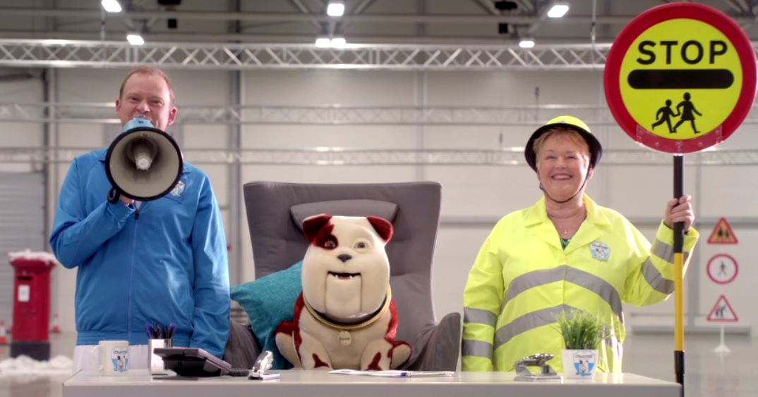
The Churchill Lollipopper campaign
Challenge
Churchill wanted to drive spontaneous consideration and positive buzz, to demonstrate active customer engagement and to drive customer growth
Increase agreement with the statement ‘Churchill understands what matters to me’
Solution
Churchill set up a £250,000 fund and launched a campaign to help schools recruit 50 new Lollipoppers, rallying people to nominate a school in need - with its ability to build scale quickly, to establish fame and drive social conversations TV was the only choice
Made Robert Webb the face of the campaign adding humour and had an exclusive deal with Ch4 and to achieve maximum reach in a short period of time they selected the most highly viewed programmes such as Gogglebox and First Dates
They amplified the campaign across other media
Results
19% uplift in YouGov Buzz tracking and 24% uplift in score for the 35+ audience
Positive social media grew from 5% to 37% and agreement that “Churchill understands what matters to me’ increased by 12%
Sales were up 2% and gross CPAs improved by 7% vs. forecast
Drove 111,000 visits to the nomination website with 53,000 nominations for 6,500 schools
Notes:
Challenge
Churchill offer a range of insurance products that can be bought either direct via phone or web or via aggregators. In 2016, their main priority was to drive spontaneous consideration and positive buzz for Churchill including increasing agreement with the brand statement “understand what matters to me”.
Four key KPIs were identified to focus on:
Demonstrate active consumer engagement
Increase agreement with the statement ‘understands what matters to me’
Build positive buzz
Drive customer growth
Solution
Mediacom conducted in depth analysis to discover what matters most to Churchill’s target audience. The research showed that the one unifying area that they all really cared about was their families and that having/raising children was the biggest priority in their life.
In 2015, of the 4.1 million children who walked to school, 29 children were killed walking on the roads and 1,350 were seriously injured. At the same time, the number of Lollipoppers has plummeted due to law changes and budget cuts. So the idea was born to help schools to fund more Lollipoppers to keep children safe when walking to and from school.
Churchill set up a £250,000 fund to help schools recruit 50 new Lollipoppers and needed a campaign that would raise awareness by showing the great work Lollipoppers do, as well as rallying people to nominate a school for a Churchill Lollipopper. Mediacom knew that television was the perfect platform with which to launch the campaign, with its ability to build scale quickly, to establish fame and drive social conversations.
Humour was key as an emotional trigger for the core audience and if done correctly, so they produced a humourous TV ad starring Robert Webb of Peep Show fame who became the face of the campaign. They wanted the TV activity to punch above its weight, so they negotiated an exclusive deal with Channel 4. Channel 4 felt like the right partner due to its heritage of cultural ground-breaking programme formats, in particular comedy.
BARB analysis as well as qualitative research helped them to enhance targeting, optimise coverage and drive standout. The primary target audience was parents of school age children but there was also a secondary target audience of grandparents – as potential prospects and also as intergenerational influencers. They launched on 12th April to coincide with children returning to school following the Easter holidays. The launch spot went out in ‘One Born Every Minute’ which converted brilliantly for parents, provided scale and also the perfect environment. They wanted to achieve maximum reach in a short period of time and so they selected the most highly viewed programmes at the time such as Gogglebox, First Dates, The Island with Bear Grylls and The Supervet.
To ensure maximum stand out and engagement, they used 91% centre breaks, 59% first in breaks and 69% late peak – all significantly ahead of natural delivery. In addition, they made adjustments to the normal Churchill spot laydown. For example, daytime was upweighted and post peak (after11pm) removed in order to reach parents and grandparents more efficiently.
Alongside the TV, in order to reach out into regional and local communities, they partnered with Bauer and their Big City Network of radio stations to mobilise listeners and get them involved with the campaign. They also used social media and websites such as Mumsnet and Gransnet to spread the word and start conversations. They worked with PTA UK to access their membership of 14,000 schools around the UK. They set up an advice bank on their website and sent information to schools so that they could nominate themselves for funding.
On 29th November, a National Lollipopper Day was established to recognise and celebrate all Lollipoppers throughout the country
Results
19% uplift in YouGov Buzz tracking and 24% uplift in score for the 35+ audience
Positive sentiment on social media grew from 5% to 37% across the campaign period, and agreement that “Churchill understands what matters to me’ increased by 12%
Sales were up 2% and gross CPAs improved by 7% versus forecast
Drove 111,000 visits to the nomination website producing 53,000 nominations for 6,500 schools
For the full case study and to view the ad campaigns visit: https://www.thinkbox.tv/Case-studies/The-Churchill-Lollipopper-campaign

