Slide 1



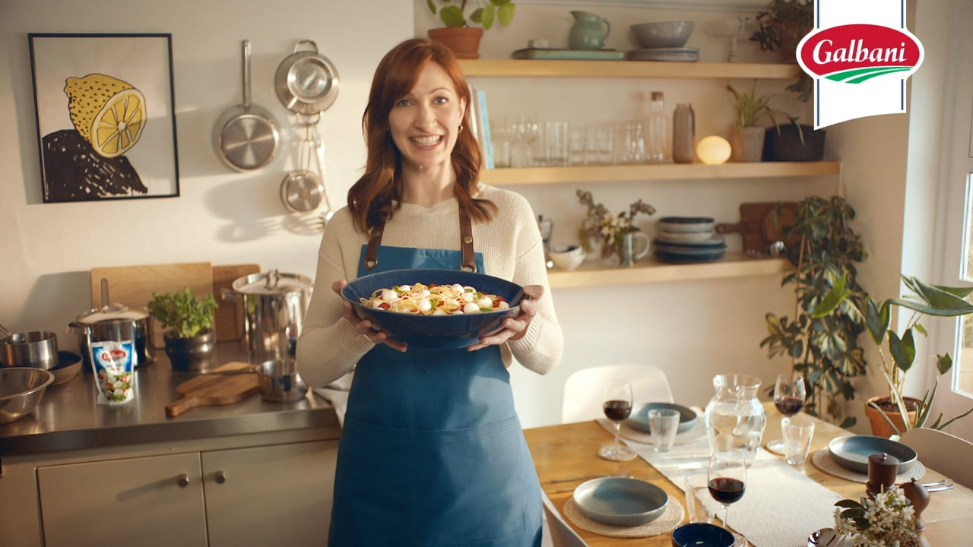
It’s Got to be Galbani
Challenge
Galbani were losing out to own label cheese
The challenge was to increase brand awareness, improve consideration and drive memorability
Solution
Zenith recommended sponsorship of Come Dine With Me on Channel 4, providing a good level of frequency as well as a natural affinity with the brand
Initials created funny, quirky, memorable idents
Results
Spontaneous awareness rose by 122%
Spontaneous consideration rose by 100%
Average base volume sales increased by 9.3%
Notes:
The Challenge
Galbani, Italy’s number one mozzarella, was losing out to own label cheese - partly because British people thought that there wasn’t much difference between one mozzarella and another and partly because the brand lacked memorability. Research revealed that Galbani existed as a badged product, rather than a brand.
The challenge for Galbani’s agencies – Initials (creative) and Zenith (media) - was to increase brand awareness and get mozzarella-loving shoppers to see Galbani as an essential part of any high-quality Italian dish. Specifically, the objectives were to:
Generate awareness of Galbani amongst home cooks
Drive memorability of the Galbani name
Increase consideration of Galbani versus its competitors
The challenge was made harder by having only a modest budget of around £240,000, so they would have to work hard to achieve these objectives.
The TV Solution
Zenith decided that a TV sponsorship would offer the most productive route. It had the capacity to generate mass awareness efficiently, would provide a good level of frequency and had the emotive power to change people’s opinions.
The vehicle chosen was ‘Come Dine With Me’. Not only is the programme enjoyed by cooks throughout the country, but there was a natural synergy between the programme and the brand. The programme epitomised home-cooking, good taste and entertaining at home, which would prime viewers and drive memorability as well as positive associations for the brand.
An added benefit was that the Come Dine With Me audience correlated strongly with the core Galbani buyer, namely ABC1, predominantly female and mostly over 45.
The idea for the idents came from a scene from the programme where a hapless contestant mispronounces the word ‘magnificent’. Initials created a series of engaging parody idents that playfully poked fun at people’s poor retention of the Galbani brand name. The spoof of the show was completed with the voice-over mimicking the show’s off-screen narrator. These funny and entertaining idents appealed to the show’s core audience whilst putting the Galbani name front and centre.
The Plan
The sponsorship ran from the middle of May until the end of September on Channel 4.
The partnership was supported by a radio campaign.
Results
Spontaneous awareness of Galbani rose by 122%
Spontaneous consideration rose by 100% and prompted consideration by 76%
Amongst viewers who recalled seeing the sponsorship, 39% said they had taken an action after seeing it and 29% went on to purchase
Base volume sales of Galbani hero SKU (Galbani Mozzarella 125g pack) spiked during the campaign period – up 8.1% versus previous six-week period and up 4.5% year on year
Overall, Galbani Mozzarella average base volume sales increased by 9.3% during the campaign period
Viewers associated the idents with the Galbani name, its Italian heritage, taste and quality
For the first time, Galbani ranked first in top of mind awareness among Italian cheese
Total campaign ROI was 3.9
The brand owners, Lactalis, were so happy with the results that they repeated the sponsorship in 2020

