Slide 1
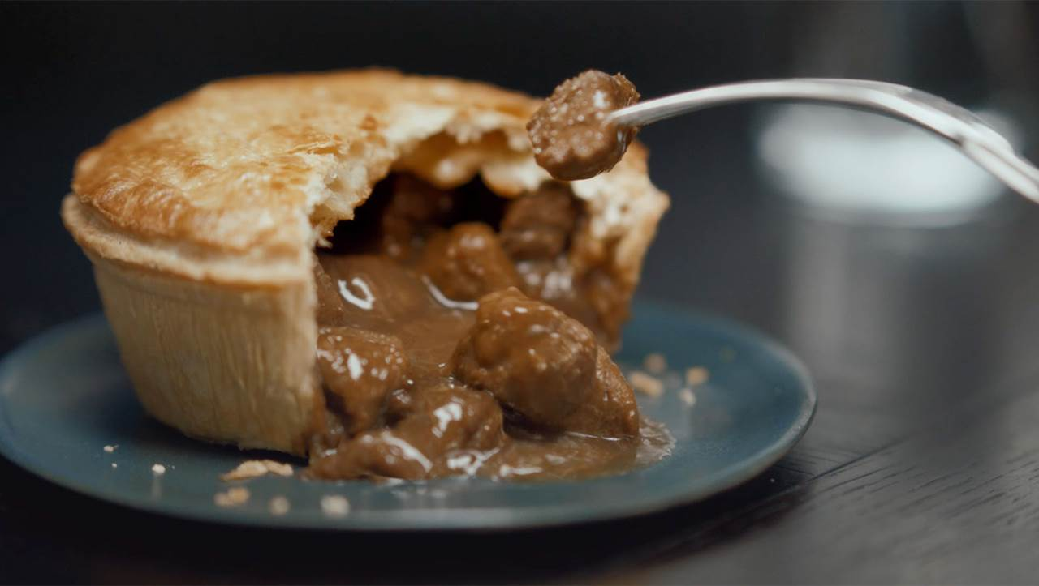
Pukka Pies packs a punch with clever use of TV
Challenge
Pukka Pies wanted to drive awareness of their new product and reposition themselves as a great quality, great tasting pie, perfect for a convenient evening meal
Solution
PHD developed a strategy focusing on main shoppers with children and by using Touchpoints analysis, they tapped into consumers’ moods across the week, leading to upweighting on Wednesdays and Fridays
Results
+£1.5m value sales growth
£806k incremental sales driven by TV
Notes:
The Challenge
Pukka Pies has been a family owned business in the ‘Food Service’ industry for over 50 years. However, a strategic review of the business in 2016 reviewed some issues that needed addressing.
In 2017, their aim was to relaunch the nation’s favourite pie brand by:
Driving awareness of Pukka’s new product and new campaign
Repositioning Pukka Pies as a great quality, great tasting pie, perfect for a convenient evening meal
Exploding sales into the Grocery sector
Driving penetration -1m new shoppers (by 2020)
The Solution
For its first foray into grocery retail, Pukka created a unique product line to meet the specific needs of this environment. The result was Pukka’s ‘Best Ever’ range and alongside a new logo and packaging, Pukka had new assets for the relaunch.
Pukka Pies worked with their media agency, PHD, to develop their strategy. They decided on a target audience of families, more specifically, main shoppers with children, as they believed this audience posed the biggest opportunity. They decided to target these families by positioning Pukka as the main meal on a school night.
PHD knew they needed a solution that would deliver huge impact and land Pukka as the number one pie. To relaunch the new brand proposition and do it at scale meant TV would be the lead medium. TV would provide the mass reach needed for the brand relaunch and would also generate the impact required as well as brand fame. TV would have the power to make Pukka famous for the right reasons and challenge current perceptions of the brand. Finally, they knew that TV would drive sales and deliver a return on investment in excess of other media.
Results
Pukka’s foray into grocery retail has been a phenomenal success:
82% of target audience saw the TV ad
Shoppers 2.5x more likely to purchase Pukka Pies vs. nearest brand competitor
+23% non-promotional sales growth (vs previous 6 weeks)
+£1.5m value sales growth
£806k incremental sales driven by TV
To read the full case study and access the creative visit: https://www.thinkbox.tv/Case-studies/Pukka-Pies

